Slide 1
Chapter 51
Animal Behavior

Slide 2
Overview: Shall We Dance?
Animal behavior is based on physiological systems and processes.
A behavior is the nervous system’s response to a stimulus and is carried out by the muscular or the hormonal system.
Behavior helps an animal
Obtain food
Find a partner for sexual reproduction
Maintain homeostasis.

Slide 3
Animal Behavior is subject to Natural Selection.
An animal’s behavior is its response to external and internal stimuli.
Ethology is the scientific study of animal behavior, particularly in natural environments.
According to early ethologist Niko Tinbergen, four questions should be asked about behavior:
What stimulus elicits the behavior, and what physiological mechanisms mediate the response?
How does the animal’s experience during growth and development influence the response mechanisms?

Slide 4
How does the behavior aid survival and reproduction? Survival value
What is the behavior’s evolutionary history?
These questions highlight the complementary nature of proximate and ultimate perspectives.
Behavioral ecology is the study of the ecological and evolutionary basis for animal behavior.
It integrates proximate and ultimate explanations for animal behavior.

Slide 5
Proximate causation, or “how” explanations, focus on
Environmental stimuli that trigger a behavior
Genetic, physiological, and anatomical mechanisms underlying a behavior.
Ultimate causation, or “why” explanations, focus on
Evolutionary significance of a behavior.

Slide 6
Fixed Action Patterns FAP
A fixed action pattern is a sequence of unlearned, innate behaviors that is unchangeable.
Once initiated, it is usually carried to completion.
A fixed action pattern is triggered by an external cue known as a sign stimulus.

Slide 7
In male stickleback fish, the stimulus for attack behavior is the red underside of an intruder.
When presented with unrealistic models, as long as some red is present, the attack behavior occurs.

Slide 8
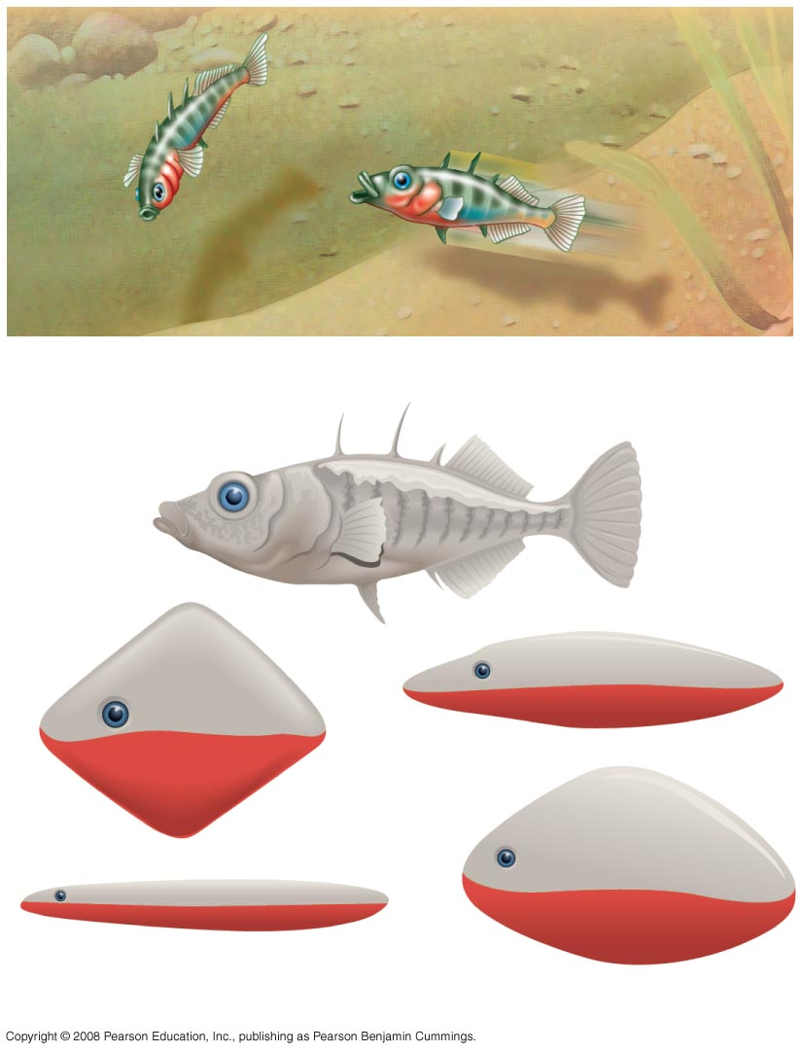
Sign stimuli in a classic FAP fixed action pattern
(a)
(b)
Notes:
Figure 51.3

Slide 9
Oriented / Directional Movement = Taxis …
Environmental cues can trigger movement in a particular direction.
A taxis is a more or less automatic, oriented movement toward or away from a stimulus.
Many stream fish exhibit a positive taxis and automatically swim in an upstream direction.
This taxis prevents them from being swept away and keeps them facing the direction from which food will come.

Slide 10
Kinesis: non-directional change …
A kinesis is a simple change in activity or turning rate in response to a stimulus.
For example, sow bugs become more active in dry areas and less active in humid areas.
Though sow bug behavior varies with humidity, sow bugs do not move toward or away from specific moisture levels.

Slide 11
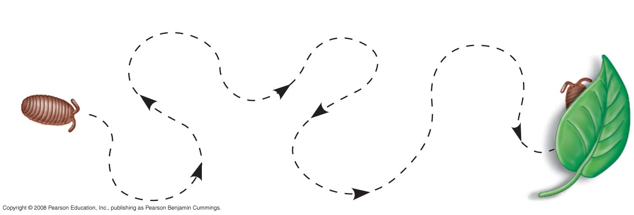
Kinesis - Sow bugs become more active in dry areas and less active in humid areas
Moist site
under leaf
Dry open
area
Sow
bug
Notes:
Figure 51.4 A kinesis

Slide 12
Migration
Migration is a regular, long-distance change in location.
Animals can orient themselves using
The position of the sun and their circadian clock, an internal 24-hour clock that is an integral part of their nervous system
The position of the North Star
The Earth’s magnetic field.

Slide 13
Behavioral Rhythms
Some animal behavior is affected by the animal’s circadian rhythm, a daily cycle of rest and activity.
Behaviors such as migration and reproduction are linked to changing seasons, or a circannual rhythm.
Some behaviors are linked to lunar cycles
For example, courtship in fiddler crabs occurs during the new and full moon.

Slide 14
Animal Signals and Communication
In behavioral ecology, a signal is a behavior that causes a change in another animal’s behavior.
Communication is the transmission and reception of signals.
Animals communicate using visual, chemical, tactile, and auditory signals.
The type of signal is closely related to lifestyle and environment.

Slide 15
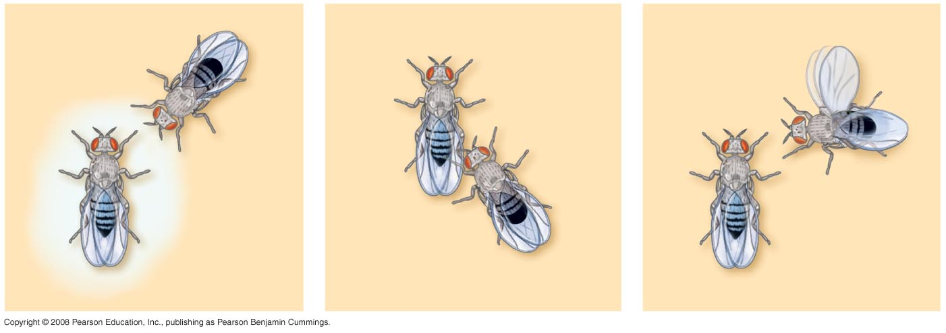
Courtship behavior of the fruit fly
(a) Orienting
(b) Tapping
(c) “Singing”
Notes:
Figure 51.7

Slide 16
Honeybees show complex communication with symbolic language.
A bee returning from the field performs a dance to communicate information about the position of a food source.

Slide 17
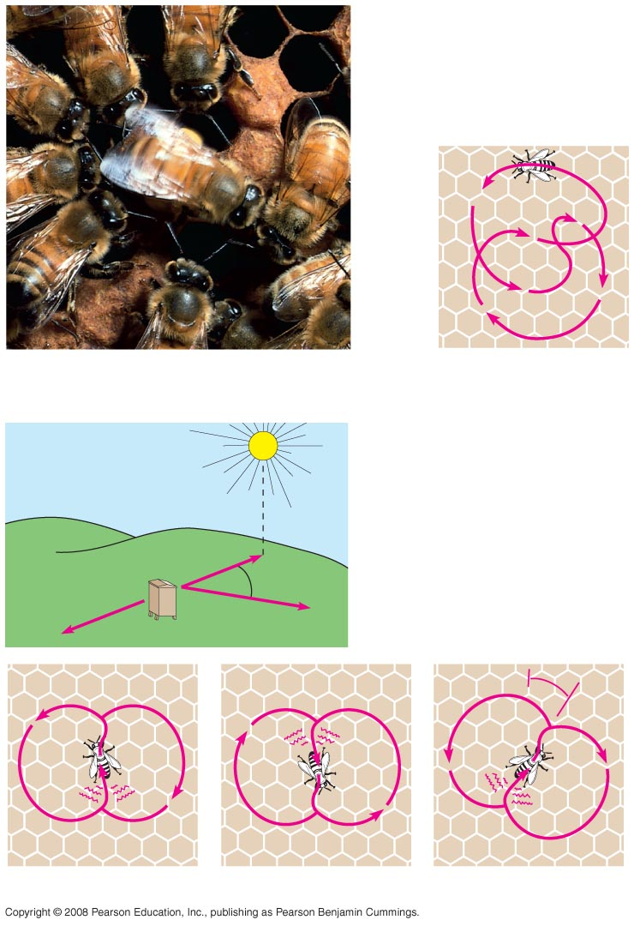
Honeybee dance language
(a) Worker bees
(b)
Round dance
(food near)
(c)
Waggle dance
(food distant)
A
30°
C
B
Beehive
30°
Location
A
Location
B
Location
C
Notes:
Figure 51.8 Honeybee dance language

Slide 18
Pheromones
Many animals that communicate through odors emit chemical substances called pheromones.
Pheromones are effective at very low concentrations.
When a minnow or catfish is injured, an alarm substance in the fish’s skin disperses in the water, inducing a fright response among fish in the area.

Slide 19
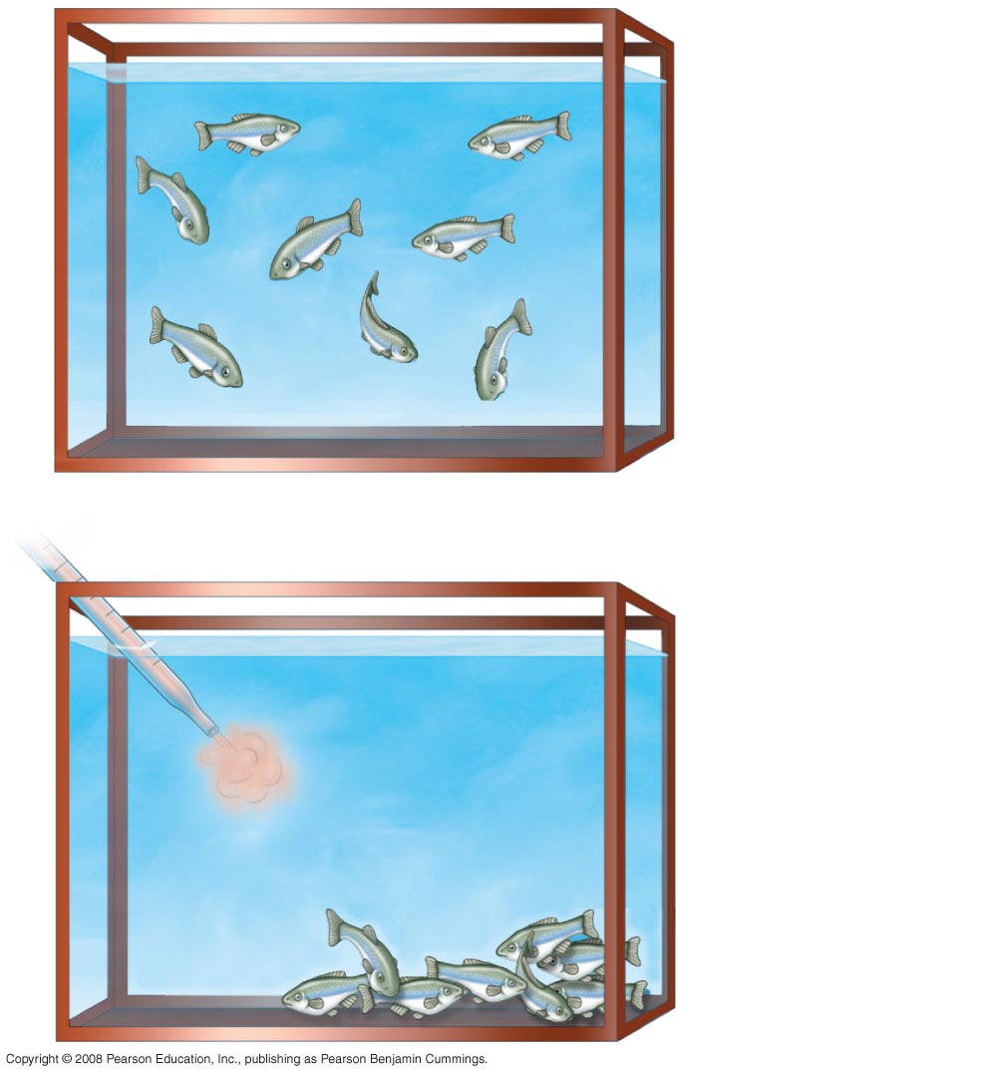
(a)
Minnows
before
alarm
Minnows responding to the presence
of an
alarm substance
(b)
Minnows
After pheromone
alarm signal
Notes:
Figure

Slide 20
Learning establishes specific links between experience and behavior
Innate behavior is developmentally fixed and under strong genetic influence / inborn.
Learning is the modification of behavior based on specific experiences.

Slide 21
Habituation
Habituation is a simple form of learning that involves loss of responsiveness to stimuli that convey little or no information. Stop attending to a stimulus that is irrelevant.
For example, birds will stop responding to alarm calls from their species if these are not followed by an actual attack.

Slide 22
Imprinting
Imprinting is a behavior that includes a specific critical period learning and innate components and is generally irreversible.
It is distinguished from other learning by a sensitive period.
A sensitive period is a limited developmental phase that is the only time when certain behaviors can be learned.

Slide 23
An example of imprinting is young geese following their mother.
Konrad Lorenz showed that when baby geese spent the first few hours of their life with him, they imprinted on him as their parent.
Conservation biologists have taken advantage of imprinting in programs to save the whooping crane from extinction. Young whooping cranes can imprint on humans in “crane suits” who then lead crane migrations using small aircraft.

Slide 24
Spatial Learning
Spatial learning is a more complex modification of behavior based on experience with the spatial structure of the environment.
Niko Tinbergen showed how digger wasps use landmarks to find nest entrances.
A cognitive map is an internal representation of spatial relationships between objects in an animal’s surroundings often using particular landmarks.

Slide 25
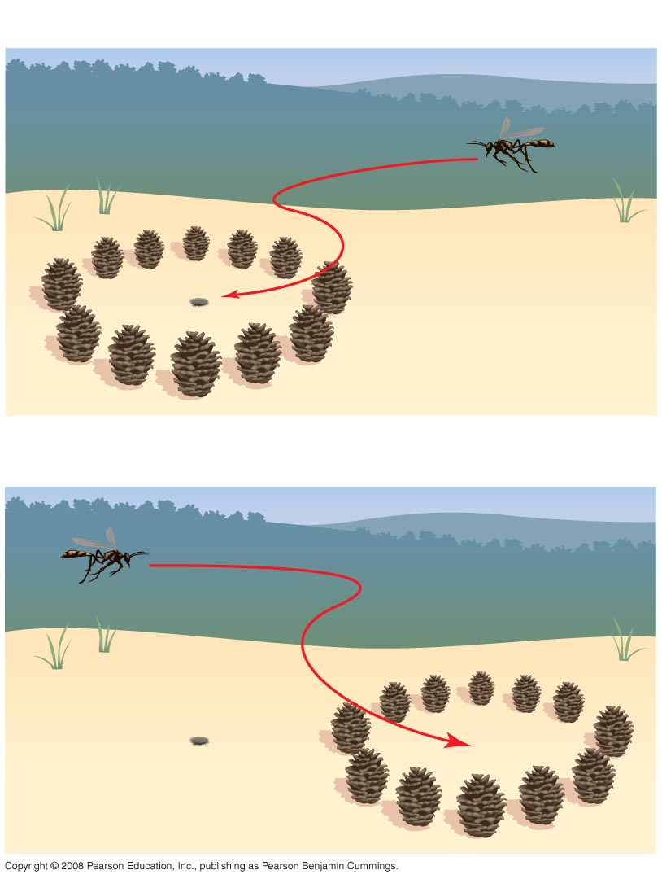
Does a digger wasp use landmarks to find her nest?
EXPERIMENT
Nest
Pinecone
RESULTS
Nest
No nest
Notes:
Figure 51.11

Slide 26
Associative Learning
In associative learning, animals associate one feature of their environment with another. Example: a mouse will avoid eating caterpillars with specific colors after a bad experience with a distasteful monarch butterfly caterpillar.
Classical conditioning is a type of associative learning in which an arbitrary stimulus is associated with a reward or punishment. Example: a dog that repeatedly hears a bell before being fed will salivate in anticipation at the bell’s sound.

Slide 27
Operant conditioning is a type of associative learning in which an animal learns to associate one of its behaviors with a reward or punishment.
It is also called trial-and-error learning.
Example: a rat that is fed after pushing a lever will learn to push the lever in order to receive food.
Example: a predator may learn to avoid a specific type of prey associated with a painful experience.

Slide 28
Cognition and Problem Solving
Cognition is a process of knowing that may include awareness, reasoning, recollection, and judgment.
For example, honeybees can distinguish “same” from “different.”

Slide 29
Problem solving is the process of devising a strategy to overcome an obstacle.
Example: chimpanzees can stack boxes in order to reach suspended food.
Some animals learn to solve problems by observing other individuals.
Example: young chimpanzees learn to crack palm nuts with stones by copying older chimpanzees

Slide 30
Development of Learned Behaviors
Development of some behaviors occurs in distinct stages.
For example a white-crowned sparrow memorizes the song of its species during an early sensitive period.
The bird then learns to sing the song during a second learning phase.

Slide 31
Both genetic makeup and environment contribute to the development of behaviors
Animal behavior is governed by complex interactions between genetic and environmental factors.
Cross-fostering studies help behavioral ecologists to identify the contribution of environment to an animal’s behavior. A cross-fostering study places the young from one species in the care of adults from another species.

Slide 32
Regulatory Genes and Behavior
A master regulatory gene can control many behaviors.
Example: a single gene controls many behaviors of the male fruit fly courtship ritual.
Multiple independent genes can contribute to a single behavior.
Example: in green lacewings, the courtship song is unique to each species; multiple independent genes govern different components of the courtship song.

