Slide 1
Genetically Based Behavioral Variation in Natural Populations
When behavioral variation within a species corresponds to environmental variation, it may be evidence of past evolution.
Case Study: Variation in Migratory Patterns
Most blackcaps (birds) that breed in Germany winter in Africa, but some winter in Britain.
The two migratory populations are genetically distinct.

Slide 2
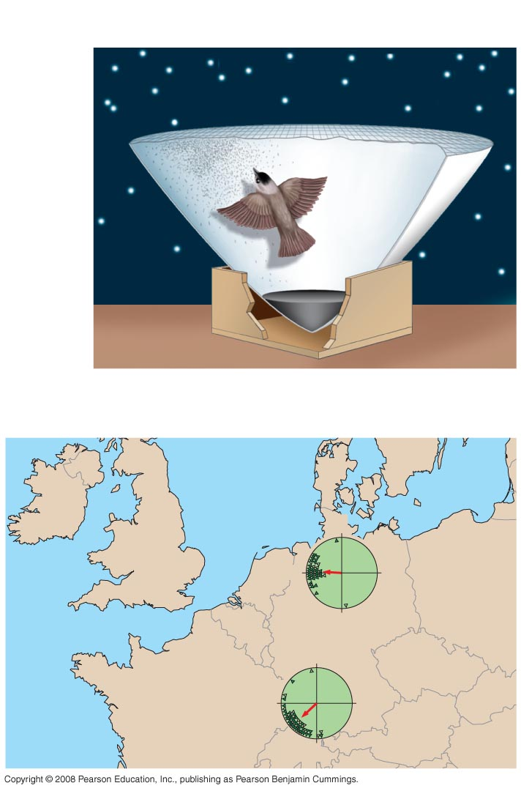
Are differences in migratory orientation within a species genetically determined?
EXPERIMENT
Scratch
marks
RESULTS
N
BRITAIN
Adults from
Britain and
offspring
of British
adults
W
E
S
GERMANY
N
Young
from SW
Germany
W
E
S
Notes:
Figure

Slide 3
Case Study: Variation in Prey Selection
The natural diet of western garter snakes varies by population.
Coastal populations feed mostly on banana slugs, while inland populations rarely eat banana slugs.
Studies have shown that the differences in diet are genetic.
The two populations differ in their ability to detect and respond to specific odor molecules produced by the banana slugs.

Slide 4
Natural Selection for individual Survival and Reproductive Success can explain most behaviors
Genetic components of behavior evolve through natural selection.
Behavior can affect fitness by influencing foraging and mate choice.
Natural selection refines behaviors that enhance the efficiency of feeding.
Foraging = food-obtaining behavior. Foraging includes recognizing, searching for, capturing, and eating food items.

Slide 5
Optimal Foraging Model
Optimal foraging model views foraging behavior as a compromise between benefits of nutrition and costs of obtaining food.
The costs of obtaining food include energy expenditure and the risk of being eaten while foraging.
Natural selection should favor foraging behavior that minimizes the costs and maximizes the benefits.

Slide 6
Balancing Risk and Reward
Risk of predation affects foraging behavior.
For example, mule deer are more likely to feed in open forested areas where they are less likely to be killed by mountain lions.

Slide 7
Mating Behavior and Mate Choice
Mating behavior includes seeking or attracting mates, choosing among potential mates, and competing for mates.
Mating behavior results from a type of natural selection called sexual selection.
The mating relationship between males and females varies greatly from species to species.
In many species, mating is promiscuous, with no strong pair-bonds or lasting relationships.

Slide 8
In monogamous relationships, one male mates with one female.
Males and females with monogamous mating systems have similar external morphologies.

Slide 9
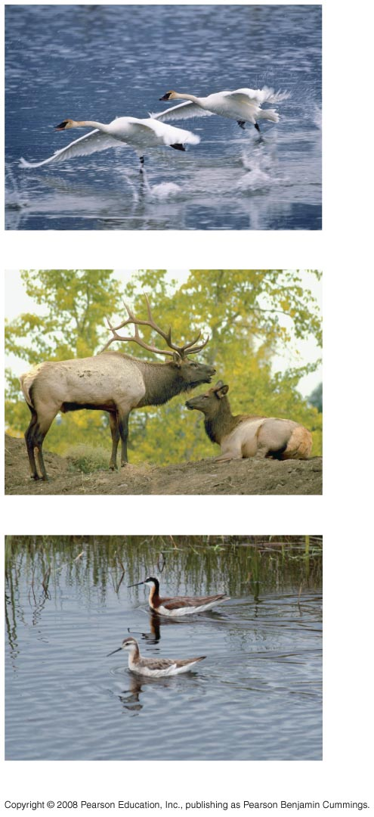
Relationship between mating system
and
male and female
forms.
(a) Monogamous species
(b) Polygynous species
(c) Polyandrous species
Notes:
Figure 51.20

Slide 10
In polygamous relationships, an individual of one sex mates with several individuals of the other sex.
Species with polygamous mating systems are usually sexually dimorphic: males and females have different external morphologies.
Polygamous relationships can be either polygynous or polyandrous. In polygyny - one male mates with many females. The males are usually more showy and larger than the females.

Slide 11
In polyandry = one female mates with many males.
The females are often more showy than the males.
Polyandry is a rare mating system.

Slide 12
Needs of the young are an important factor constraining evolution of mating systems.
Consider bird species where chicks need a continuous supply of food.
A male maximizes his reproductive success by staying with his mate, and caring for his chicks (monogamy).

Slide 13
Consider bird species where chicks are soon able to feed and care for themselves
A male maximizes his reproductive success by seeking additional mates (polygyny).
Females can be certain that eggs laid or young born contain her genes; however, paternal certainty depends on mating behavior.
Certainty of paternity influences parental care and mating behavior.

Slide 14
Paternal certainty is relatively low in species with internal fertilization because mating and birth are separated over time.
Certainty of paternity is much higher when egg laying and mating occur together, as in external fertilization.
In species with external fertilization, parental care is at least as likely to be by males as by females.

Slide 15
Sexual Selection and Mate Choice
In intersexual selection, members of one sex choose mates on the basis of certain traits.
Intrasexual selection involves competition between members of the same sex for mates.

Slide 16
Mate Choice by Females
Female choice is a type of intersexual competition.
Females can drive sexual selection by choosing males with specific behaviors or features of anatomy.
For example, female stalk-eyed flies choose males with relatively long eyestalks.
Ornaments, such as long eyestalks, often correlate with health and vitality.

Slide 17
Another example of mate choice by females occurs in zebra finches.
Female chicks who imprint on ornamented fathers are more likely to select ornamented mates.
Experiments suggest that mate choice by female zebra finches has played a key role in the evolution of ornamentation in male zebra finches.

Slide 18
Male Competition for Mates
Male competition for mates is a source of intrasexual selection that can reduce variation among males.
Such competition may involve agonistic behavior, an often ritualized contest that determines which competitor gains access to a resource.

Slide 19
Applying Game Theory
In some species, sexual selection has driven the evolution of alternative mating behavior and morphology in males.
The fitness of a particular phenotype (behavior or morphology) depends on the phenotypes of other individuals in the population.
Game theory evaluates alternative strategies where the outcome depends on each individual’s strategy and the strategy of other individuals.

Slide 20
For example, each side-blotched lizard has a blue, orange, or yellow throat, and each color is associated with a specific strategy for obtaining mates. There is a genetic basis to throat color and mating strategy.
Like rock-paper-scissors, each strategy will outcompete one strategy, but be outcompeted by the other strategy. The success of each strategy depends on the frequency of all of the strategies; this drives frequency-dependent selection.

Slide 21
Inclusive fitness can account for the evolution of altruistic social behavior
Natural selection favors behavior that maximizes an individual’s survival and reproduction.
These behaviors are often selfish.
On occasion, some animals behave in ways that reduce their individual fitness but increase the fitness of others.
This kind of behavior is called altruism, or selflessness.

Slide 22
Altruism
Example of altruism / selfless behavior for the good of the group:
Under threat from a predator, an individual Belding’s ground squirrel will make an alarm call to warn others, even though calling increases the chances that the caller is killed.

Slide 23
Inclusive Fitness
Altruism can be explained by inclusive fitness.
Inclusive fitness is the total effect an individual has on proliferating its genes by producing offspring and helping close relatives produce offspring.

Slide 24
Hamilton’s Rule and Kin Selection
William Hamilton proposed a quantitative measure for predicting when natural selection would favor altruistic acts among related individuals.
Three key variables in an altruistic act:
Benefit to the recipient (B)
Cost to the altruist (C)
Coefficient of relatedness (the fraction of genes that, on average, are shared; r)

Slide 25
Natural selection favors altruism when:
rB > C
This inequality is called Hamilton’s rule.
Kin selection is the natural selection that favors this kind of altruistic behavior by enhancing reproductive success of relatives.

Slide 26
Reciprocal Altruism
Altruistic behavior toward unrelated individuals can be adaptive if the aided individual returns the favor in the future. This type of altruism is called reciprocal altruism.
Reciprocal altruism is limited to species with stable social groups where individuals meet repeatedly, and cheaters (don’t reciprocate) are punished. Reciprocal altruism has been used to explain altruism between unrelated individuals in humans.

Slide 27
Social Learning
Social learning is learning through the observation of others and forms the roots of culture.
Culture is a system of information transfer through observation or teaching that influences behavior of individuals in a population.
Culture can alter behavior and influence the fitness of individuals.

Slide 28
Case Study: Mate-Choice Copying
In mate-choice copying, individuals in a population copy the mate choice of others.
This type of behavior has been extensively studied in the guppy Poecilia reticulata.
Females who mate with males that are attractive to other females are more likely to have sons that are attractive to other females.

Slide 29
Case Study: Social Learning of Alarm Calls
Vervet monkeys produce distinct alarm calls for different predators.
Infant monkeys give undiscriminating calls but learn to fine-tune them by the time they are adults.

Slide 30
Evolution and Human Culture
No other species comes close to matching the social learning and cultural transmission that occurs among humans.
Human culture is related to evolutionary theory in the distinct discipline of sociobiology. Human behavior, like that of other species, results from interactions between genes and environment.
However, our social and cultural institutions may provide the only feature in which there is no continuum between humans and other animals.

Slide 31
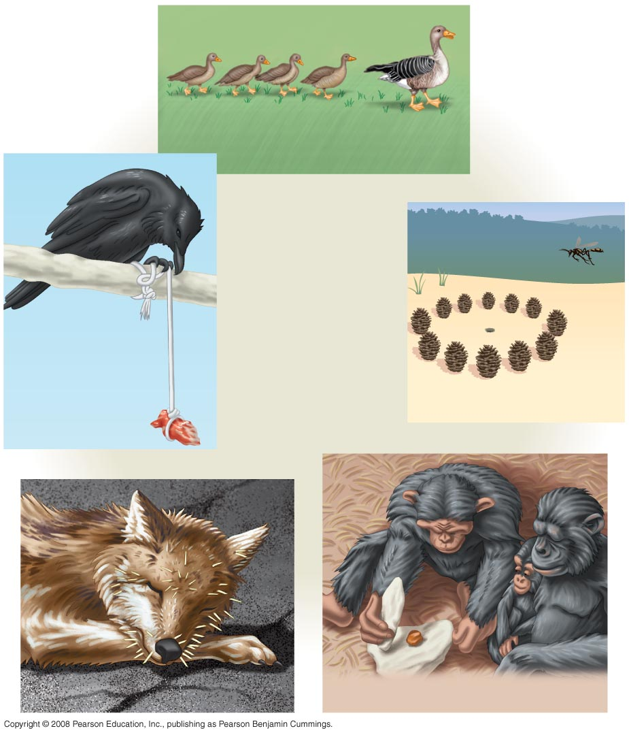
Learning
Imprinting
Learning
and
problem solving
Spatial learning
Cognition
Associative learning
Social learning

Slide 32
You should now be able to:
State Tinbergen’s four questions and identify each as a proximate or ultimate causation.
Distinguish between the following pairs of terms: kinesis and taxis, circadian and circannual behavioral rhythms, classical and operant conditioning.
Suggest a proximate and an ultimate cause for imprinting in newly hatched geese.
Explain how associative learning may help a predator avoid toxic prey.

Slide 33
Describe how cross-fostering experiments help identify the relative importance of environmental and genetic factors in determining specific behaviors.
Describe optimal foraging theory.
Define and distinguish among promiscuous, monogamous, and polygamous mating systems.
Distinguish between intersexual and intrasexual selection.

Slide 34
Explain how game theory may be used to evaluate alternative behavioral strategies.
Define altruistic behavior.
Distinguish between kin selection and reciprocal altruism.
Define social learning and culture.

