Slide 1
The Logistic Model and Life Histories
Life history traits favored by natural selection may vary with population density and environmental conditions.
K-selection = density-dependent selection, selects for life history traits that are sensitive to population density.
r-selection = or density-independent selection, selects for life history traits that maximize reproduction.

Slide 2
Many factors that regulate population growth are density dependent
There are two general questions about regulation of population growth:
What environmental factors stop a population from growing indefinitely?
Why do some populations show radical fluctuations in size over time, while others remain stable?

Slide 3
Population Change and Population Density
In density-independent populations, birth rate and death rate do not change with population density.
In density-dependent populations, birth rates fall and death rates rise with population density.

Slide 4
Density-Dependent Population Regulation
Density-dependent birth and death rates are an example of negative feedback that regulates population growth.
They are affected by many factors, such as competition for resources, territoriality, disease, predation, toxic wastes, and intrinsic factors.
In crowded populations, increasing population density intensifies competition for resources and results in a lower birth rate.

Slide 5
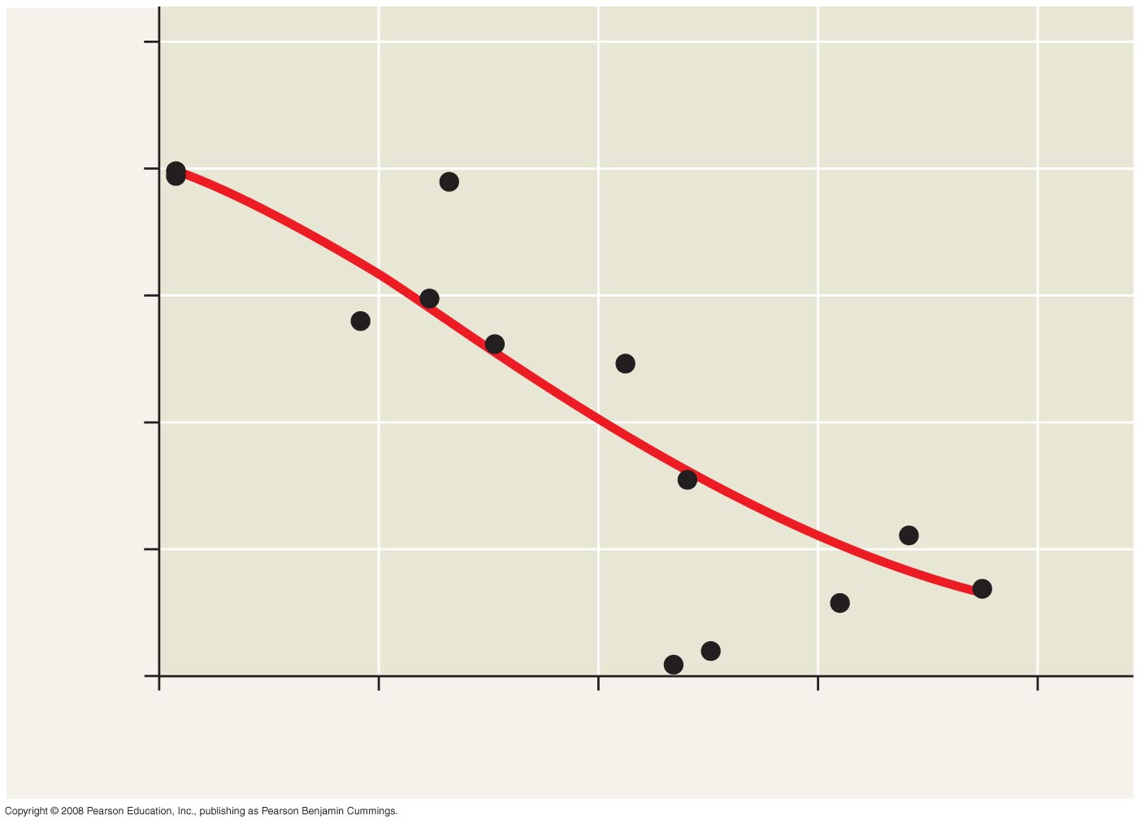
Decreased reproduction at high population densities
100
80
60
Percentage of juveniles producing lambs
40
20
0
200
300
400
500
600
Population size
Notes:
Figure 53.16

Slide 6
Territoriality
In many vertebrates and some invertebrates, competition for territory may limit density.
Cheetahs are highly territorial, using chemical communication to warn other cheetahs of their boundaries.

Slide 7
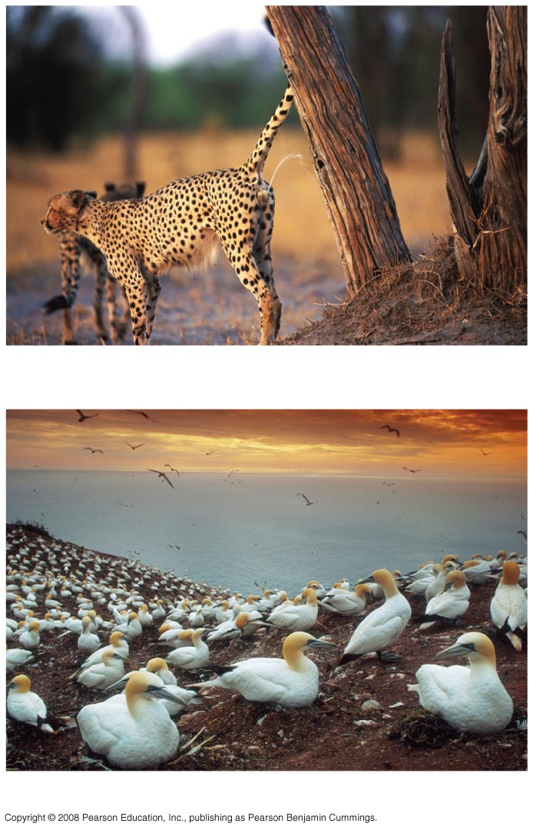
Territoriality
(a) Cheetah marking its territory
(b) Gannets
Notes:
Figure 53.17

Slide 8
Disease, Predation, & Toxic Wastes
Population density can influence the health and survival of organisms. In dense populations, pathogens can spread more rapidly.
As a prey population builds up, predators may feed preferentially on that species.
Accumulation of toxic wastes can contribute to density-dependent regulation of population size.
For some populations, intrinsic (physiological) factors appear to regulate population size.

Slide 9
Population Dynamics
The study of population dynamics focuses on the complex interactions between biotic and abiotic factors that cause variation in population size.
Long-term population studies have challenged the hypothesis that populations of large mammals are relatively stable over time.
Weather can affect population size over time.

Slide 10
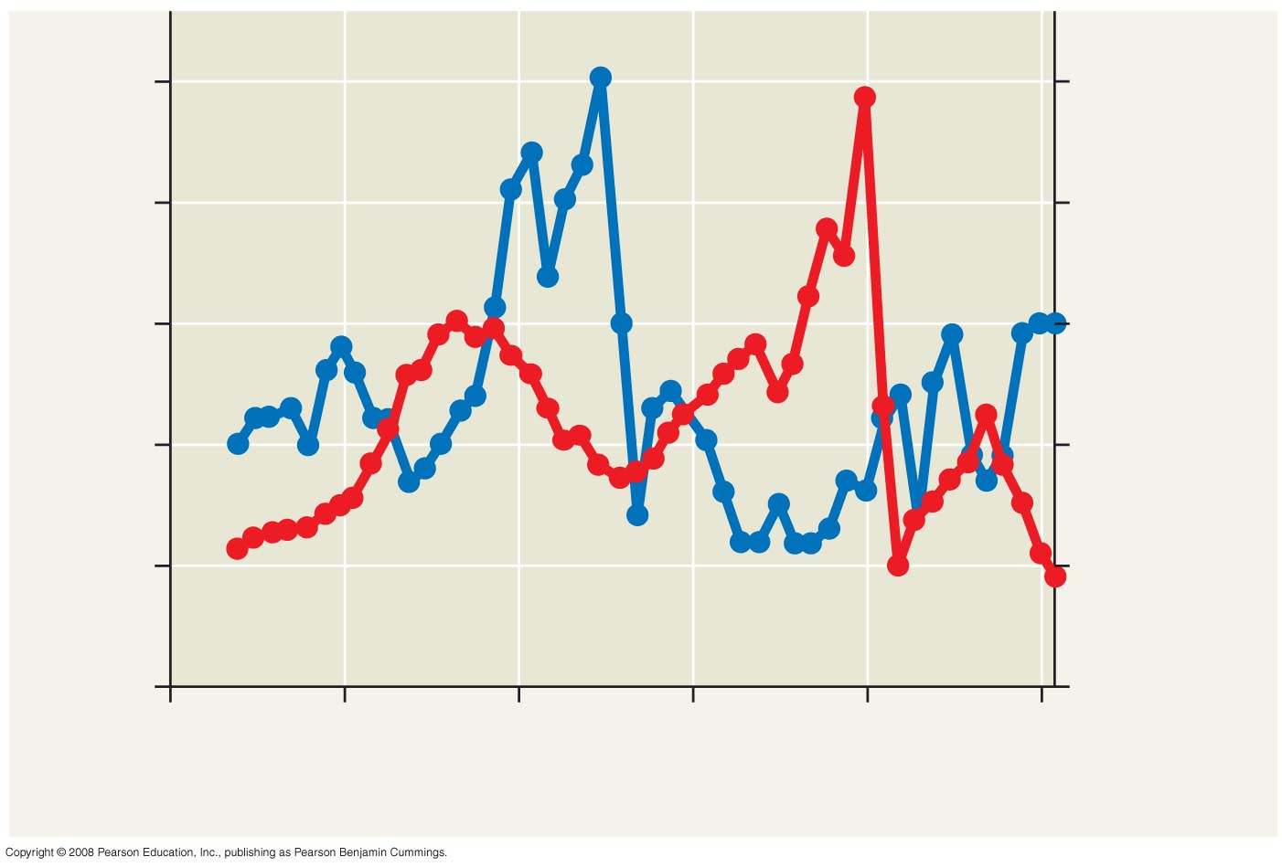
Changes in predation pressure can drive population fluctuations
50
2,500
Wolves
Moose
40
2,000
30
1,500
Number of wolves
Number of moose
20
1,000
10
500
0
0
1955
1965
1975
1985
1995
2005
Year
Notes:
Figure 53.19 Fluctuations in moose and wolf populations on Isle Royale, 1959–2006

Slide 11
Population Cycles: Scientific Inquiry
Some populations undergo regular boom-and-bust cycles.
Lynx populations follow the 10 year boom-and-bust cycle of hare populations.
Three hypotheses have been proposed to explain the hare’s 10-year interval.

Slide 12
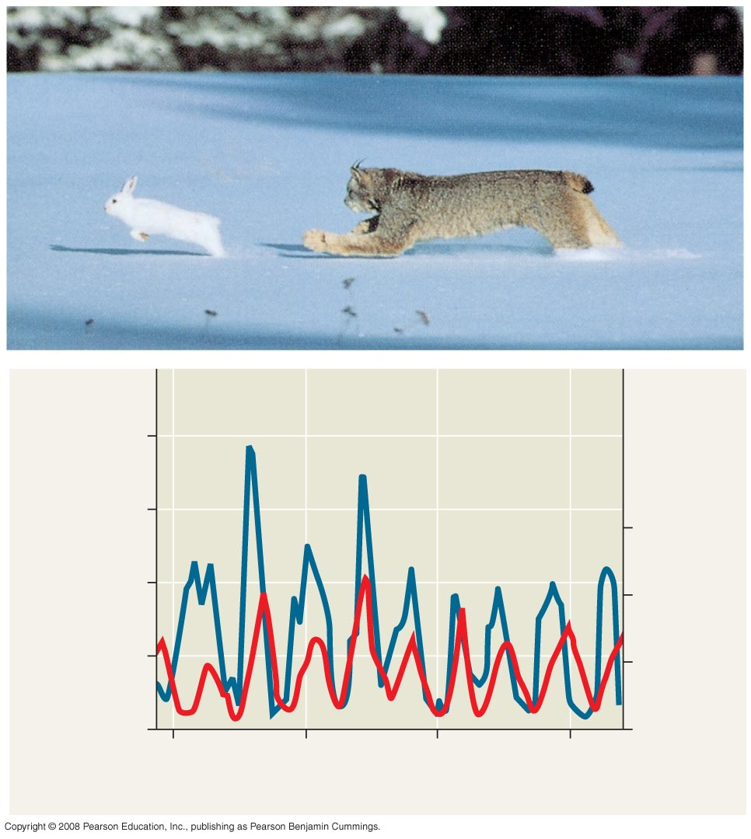
160
Snowshoe hare
120
9
Number of hares
(thousands)
Lynx
Number of lynx
(thousands)
80
6
40
3
0
0
1850
1875
1900
1925
Year
Notes:
Figure 53.20 Population cycles in the snowshoe hare and lynx

Slide 13
Hypothesis 1: The hare’s population cycle follows a cycle of winter food supply.
If this hypothesis is correct, then the cycles should stop if the food supply is increased.
Additional food was provided experimentally to a hare population, and the whole population increased in size but continued to cycle.
No hares appeared to have died of starvation.

Slide 14
Hypothesis 2: The hare’s population cycle is driven by pressure from other predators.
In a study conducted by field ecologists, 90% of the hares were killed by predators.
These data support this second hypothesis.

Slide 15
Hypothesis 3: The hare’s population cycle is linked to sunspot cycles.
Sunspot activity affects light quality, which in turn affects the quality of the hares’ food.
There is good correlation between sunspot activity and hare population size.
The results of all these experiments suggest that both predation and sunspot activity regulate hare numbers and that food availability plays a less important role.

Slide 16
Immigration, Emigration, and Metapopulations
Metapopulations are groups of populations linked by immigration and emigration.
High levels of immigration combined with higher survival can result in greater stability in populations.

Slide 17
The human population is no longer growing exponentially but is still increasing rapidly
No population can grow indefinitely, and humans are no exception.
The human population increased relatively slowly until about 1650 and then began to grow exponentially.
Though the global population is still growing, the rate of growth began to slow during the 1960s.
Most of the current global population growth is concentrated in developing countries.

Slide 18
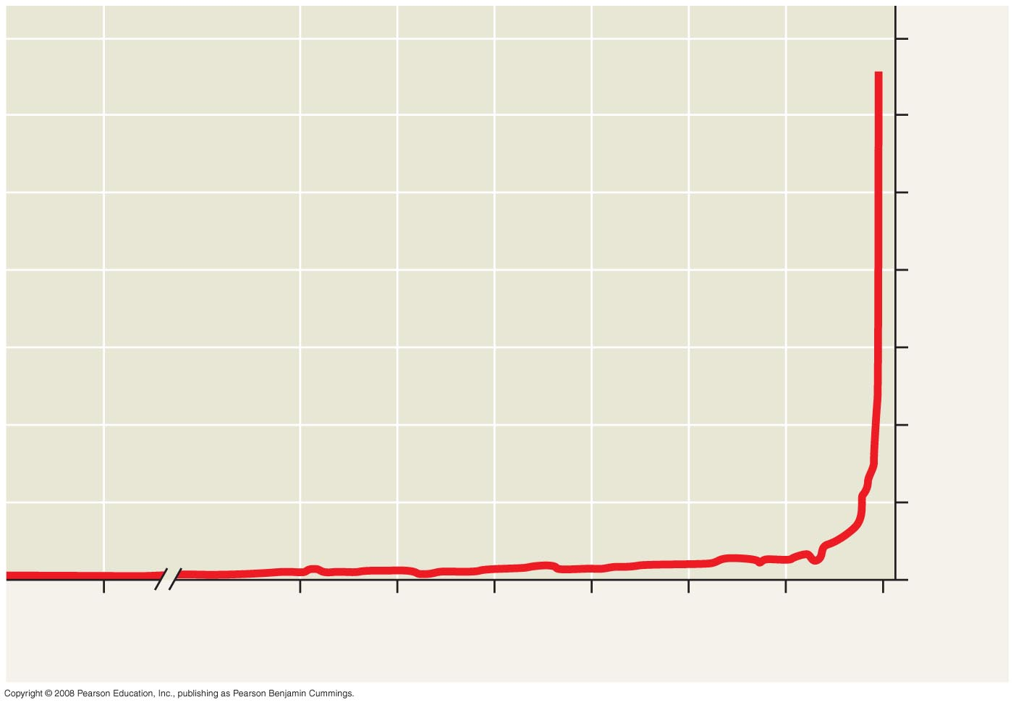
Human population growth
7
6
5
4
Human population (billions)
3
2
The Plague
1
0
8000
B.C.E.
4000
B.C.E.
3000
B.C.E.
2000
B.C.E.
1000
B.C.E.
0
1000
C.E.
2000
C.E.
Notes:
Figure 53.22 Human population growth (data as of 2006)

Slide 19
Regional Patterns of Population Change
To maintain population stability, a regional human population can exist in one of two configurations:
Zero population growth = High birth rate – High death rate
Zero population growth = Low birth rate – Low death rate
The demographic transition is the move from the first state toward the second state.

Slide 20
Age Structure
One important demographic factor in present and future growth trends is a country’s age structure.
Age structure is the relative number of individuals at each age.
Age structure diagrams can predict a population’s growth trends.
They can illuminate social conditions and help us plan for the future.

Slide 21
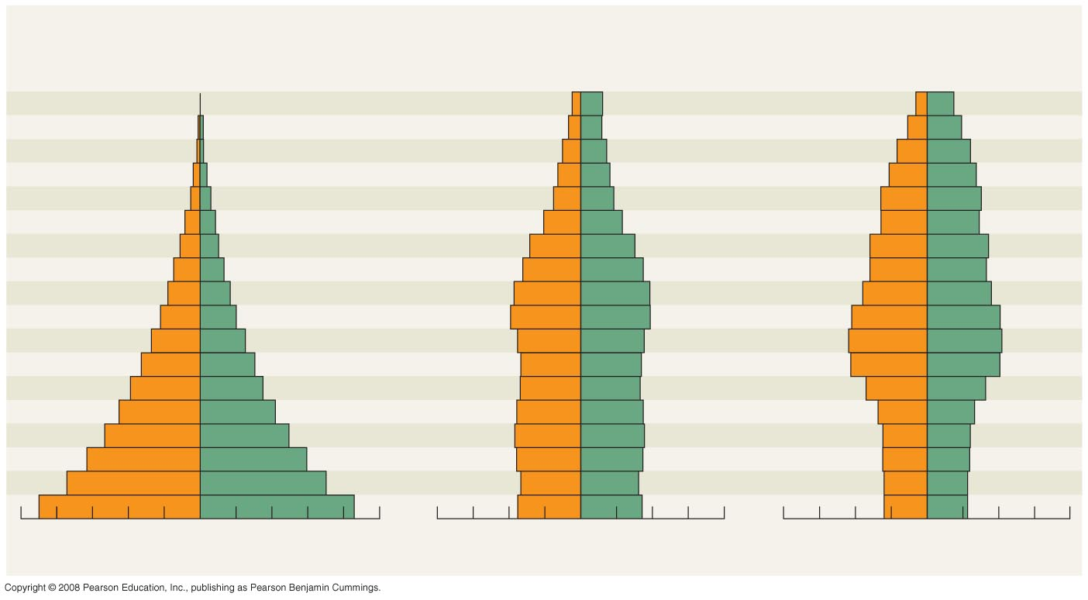
Age-structure pyramids for the human population of three countries
Rapid growth
Slow growth
No growth
Afghanistan
United States
Italy
Male
Female
Age
Male
Female
Age
Male
Female
85+
85+
80–84
80–84
75–79
75–79
70–74
70–74
65–69
65–69
60–64
60–64
55–59
55–59
50–54
50–54
45–49
45–49
40–44
40–44
35–39
35–39
30–34
30–34
25–29
25–29
20–24
20–24
15–19
15–19
10–14
10–14
5–9
5–9
0–4
0–4
10
8
6
4
2
0
2
4
6
8
10
8
6
4
2
0
2
4
6
8
8
6
4
2
0
2
4
6
8
Percent of population
Percent of population
Percent of population
Notes:
Figure 53.25 Age-structure pyramids for the human population of three countries (data as of 2005)

Slide 22
Estimates of Earth’s Carrying Capacity
How many humans can the biosphere support?
The carrying capacity of Earth for humans is uncertain.
The average estimate is 10–15 billion.

Slide 23
Limits on Human Population Size
The ecological footprint concept summarizes the aggregate land and water area needed to sustain the people of a nation.
It is one measure of how close we are to the carrying capacity of Earth.
Countries vary greatly in footprint size and available ecological capacity.
Our carrying capacity could potentially be limited by food, space, nonrenewable resources, or buildup of wastes.

Slide 24
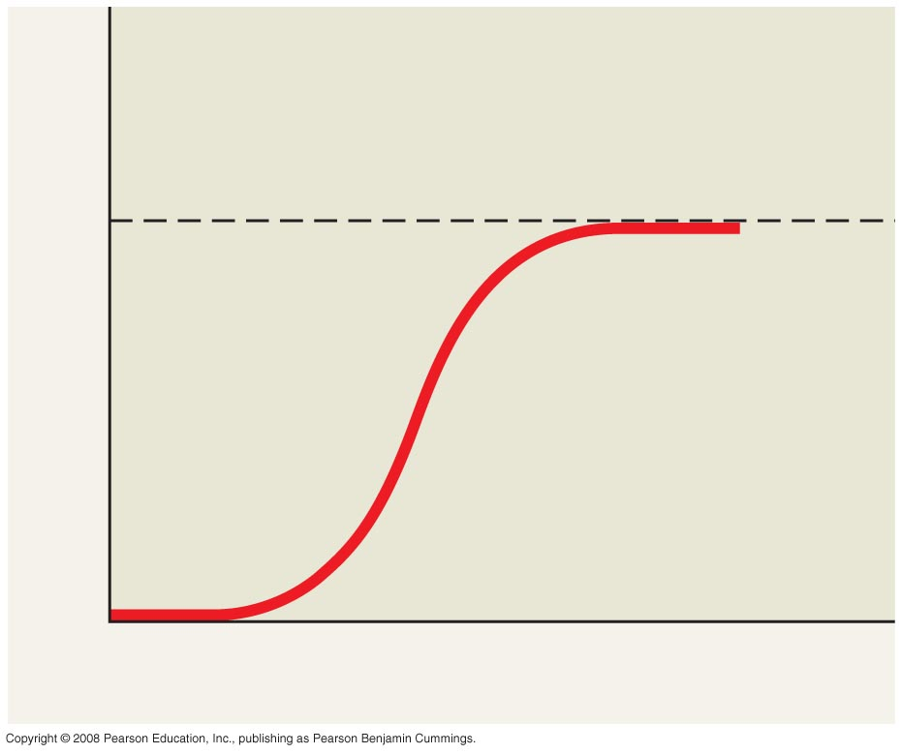
Review: Population Growth Curve
K = carrying capacity
Population size (N)
dN
K – N
=
r_{max} N
dt
K
Number of generations

Slide 25
You should now be able to:
Define and distinguish between the following sets of terms: density and dispersion; clumped dispersion, uniform dispersion, and random dispersion; life table and reproductive table; Type I, Type II, and Type III survivorship curves; semelparity and iteroparity; r-selected populations and K-selected populations.
Explain how ecologists may estimate the density of a species.

Slide 26
Explain how limited resources and trade-offs may affect life histories.
Compare the exponential and logistic models of population growth.
Explain how density-dependent and density-independent factors may affect population growth.
Explain how biotic and abiotic factors may work together to control a population’s growth.

