Slide 1
Chapter 1
Introduction: Themes in the Study of Life

Slide 2
Overview: Inquiring About the World of Life
Evolution is the process of change that has transformed life on Earth
Biology is the scientific study of life
Biologists ask questions such as:
How a single cell develops into an organism
How the human mind works
How living things interact in communities
Copyright © 2008 Pearson Education, Inc., publishing as Pearson Benjamin Cummings

Slide 3
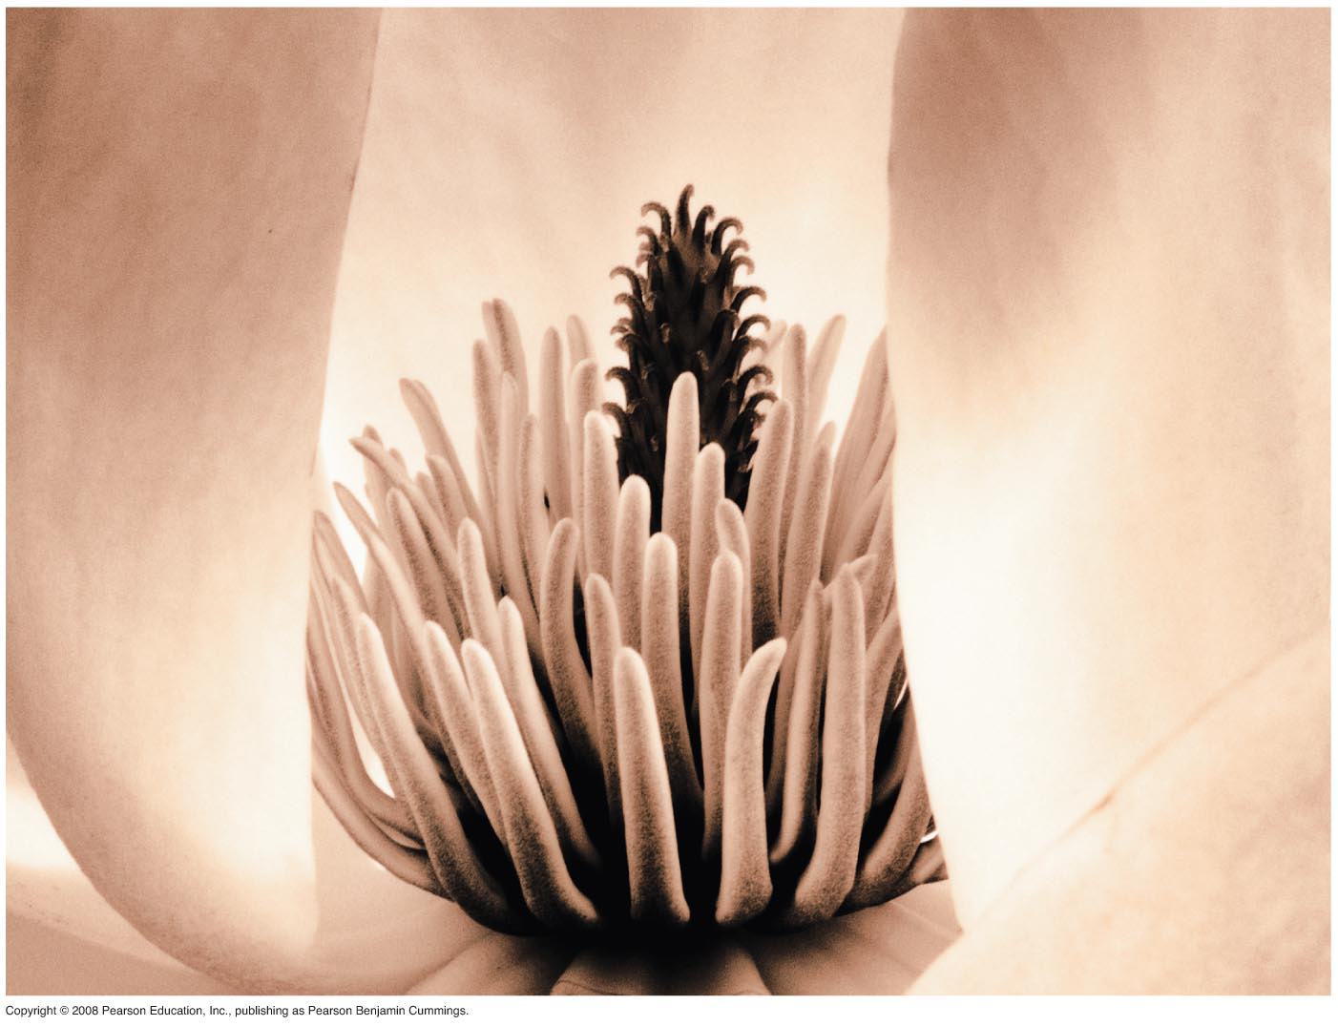
Fig. 1-1
Notes:
Figure 1.1 What properties of life are demonstrated in this flower?

Slide 4
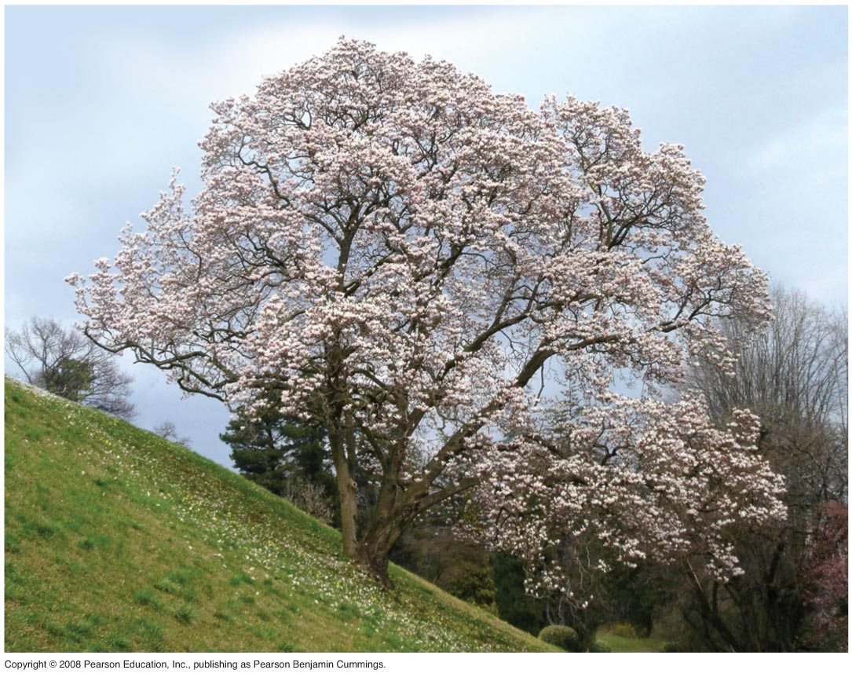
Fig. 1-2
Notes:
Figure 1.2 A magnolia tree in early spring

Slide 5
Life defies a simple, one-sentence definition
Life is recognized by what living things do
Video: Seahorse Camouflage
Copyright © 2008 Pearson Education, Inc., publishing as Pearson Benjamin Cummings
Notes:
Click to add notes

Slide 6
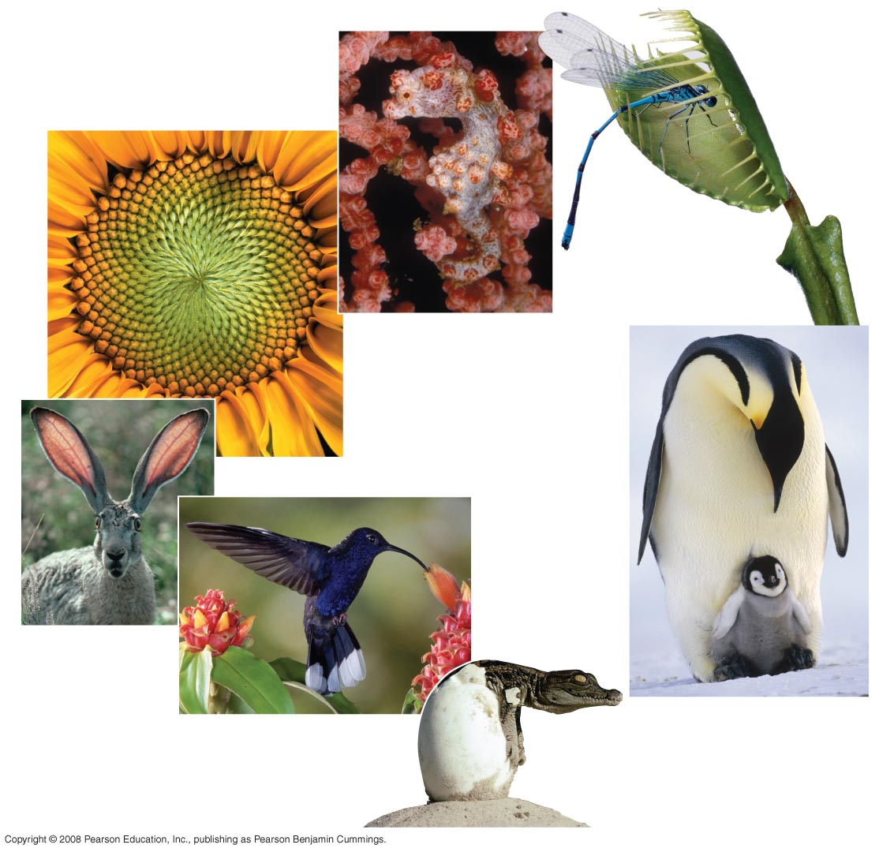
Fig. 1-3
Order
Response
to the
environment
Evolutionary adaptation
Regulation
Reproduction
Energy
processing
Growth and
development
Notes:
Figure 1.3 Some properties of life

Slide 7
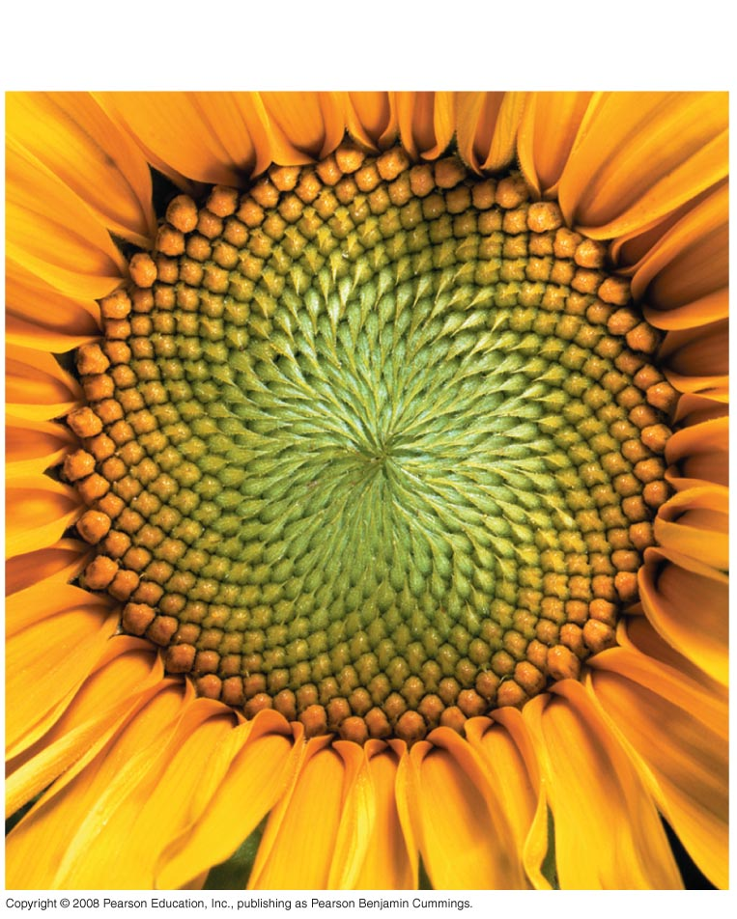
Fig. 1-3a
Order
Notes:
Figure 1.3 Some properties of life

Slide 8
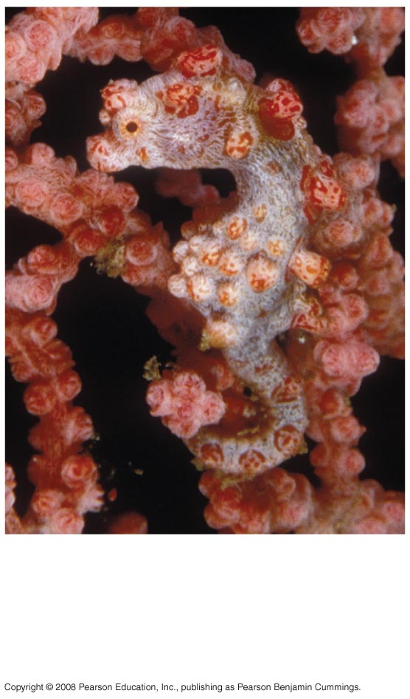
Fig. 1-3b
Evolutionary
adaptation
Notes:
Figure 1.3 Some properties of life

Slide 9
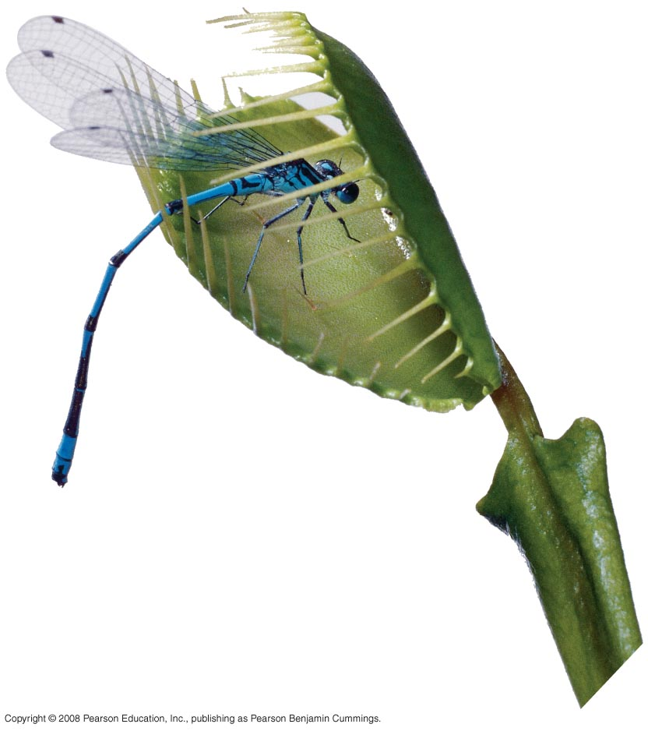
Fig. 1-3c
Response
to the
environment
Notes:
Figure 1.3 Some properties of life

Slide 10
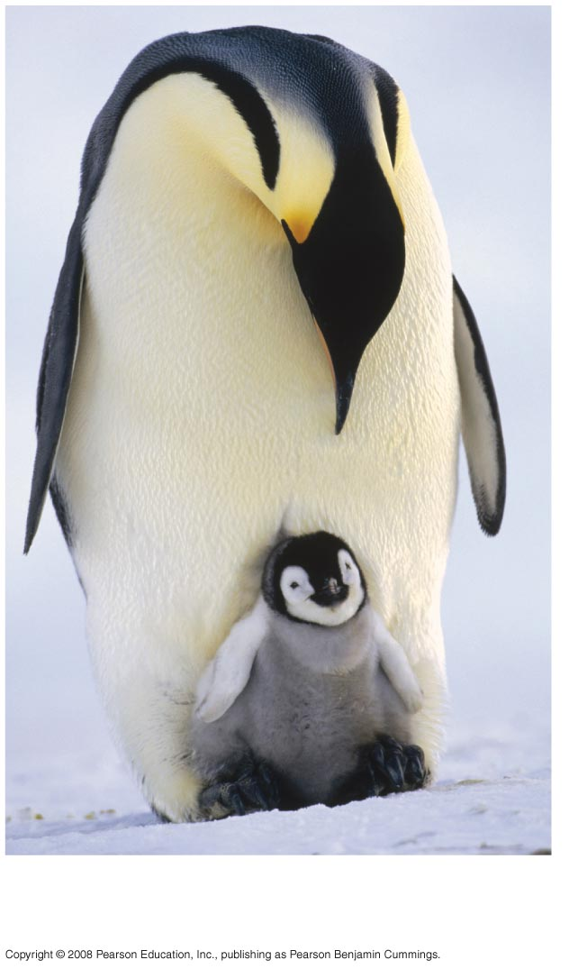
Fig. 1-3d
Reproduction
Notes:
Figure 1.3 Some properties of life

Slide 11
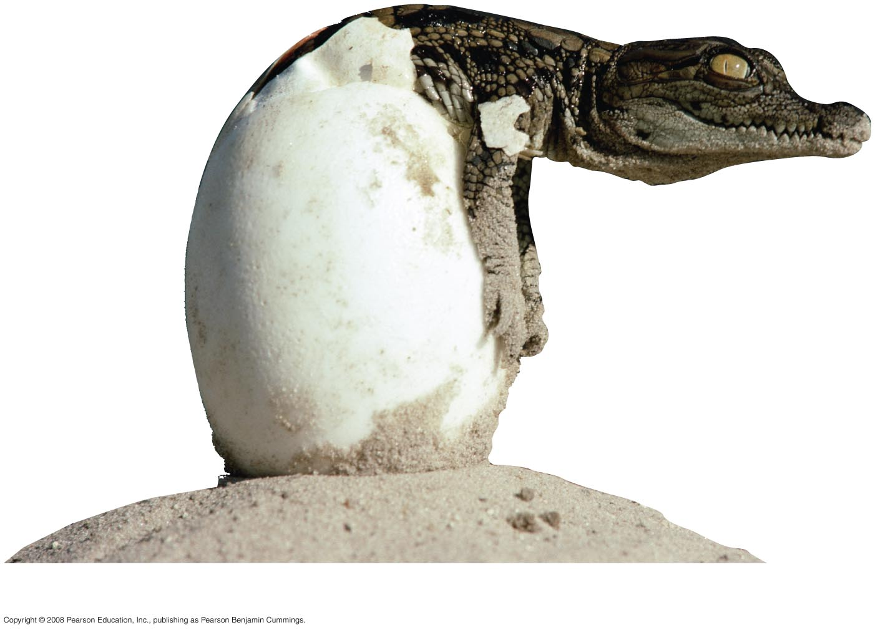
Fig. 1-3e
Growth and development
Notes:
Figure 1.3 Some properties of life

Slide 12
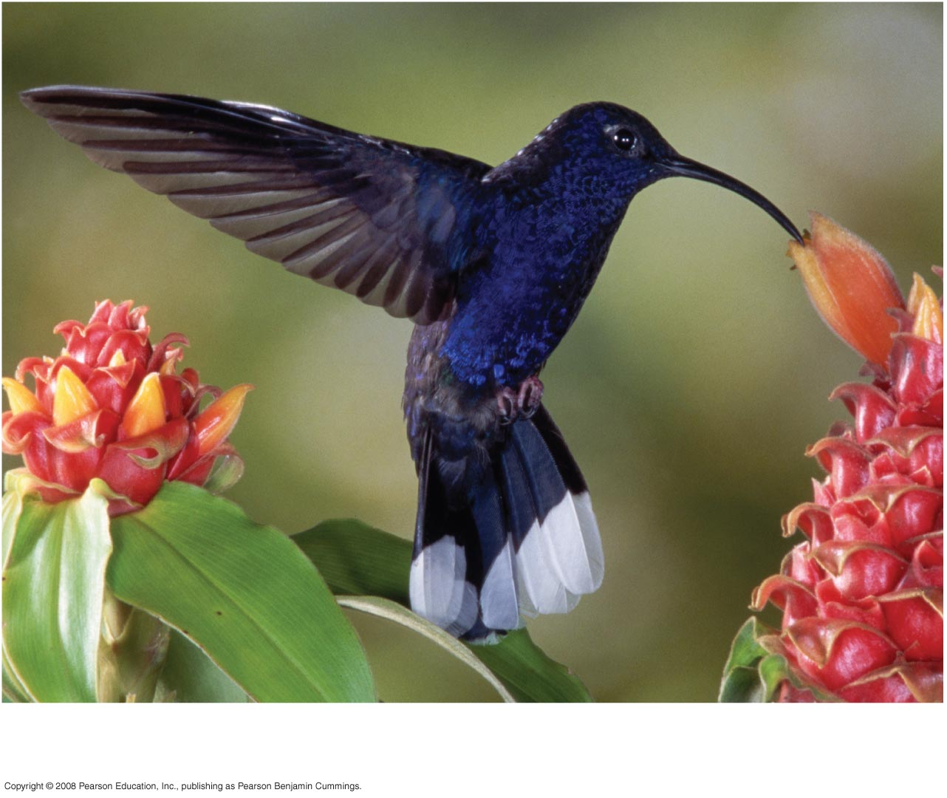
Fig. 1-3f
Energy processing
Notes:
Figure 1.3 Some properties of life

Slide 13
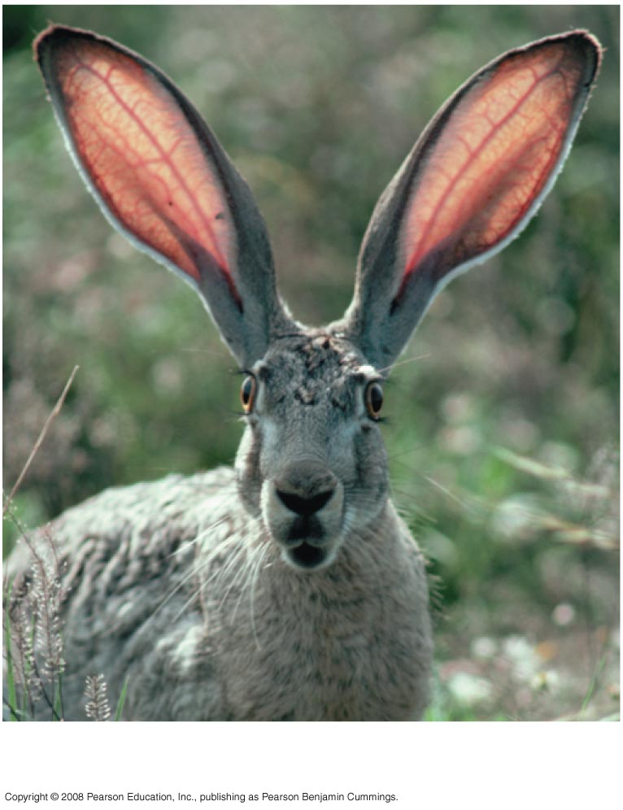
Fig. 1-3g
Regulation
Notes:
Figure 1.3 Some properties of life

Slide 14
Concept 1.1: Themes connect the concepts of biology
Biology consists of more than memorizing factual details
Themes help to organize biological information
Copyright © 2008 Pearson Education, Inc., publishing as Pearson Benjamin Cummings

Slide 15
Evolution, the Overarching Theme of Biology
Evolution makes sense of everything we know about living organisms
Organisms living on Earth are modified descendents of common ancestors
Copyright © 2008 Pearson Education, Inc., publishing as Pearson Benjamin Cummings

Slide 16
Theme: New properties emerge at each level in the biological hierarchy
Life can be studied at different levels from molecules to the entire living planet
The study of life can be divided into different levels of biological organization
Copyright © 2008 Pearson Education, Inc., publishing as Pearson Benjamin Cummings

Slide 17
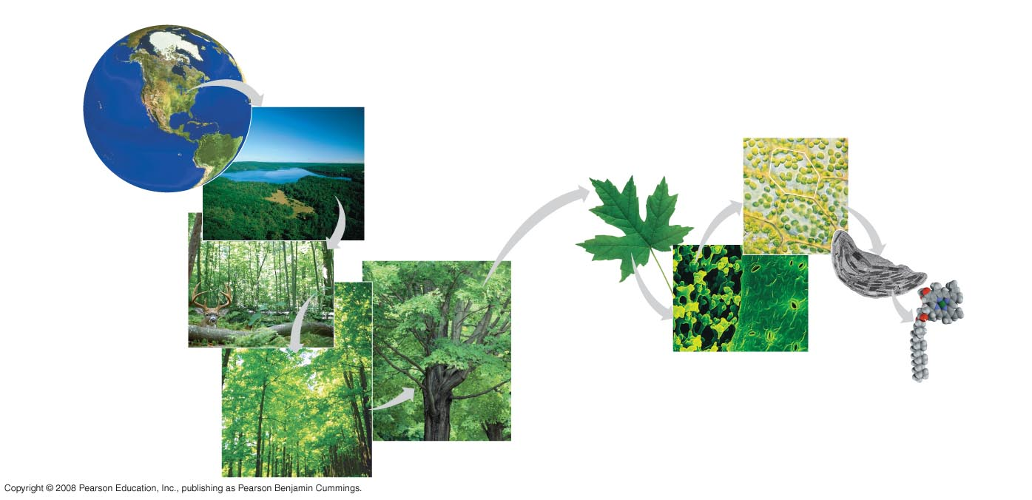
Fig. 1-4
The biosphere
Cells
Organs and organ systems
10 µm
Cell
Ecosystems
Organelles
Communities
1 µm
Atoms
Tissues
50 µm
Populations
Molecules
Organisms
Notes:
Figure 1.4 Levels of biological organization

Slide 18
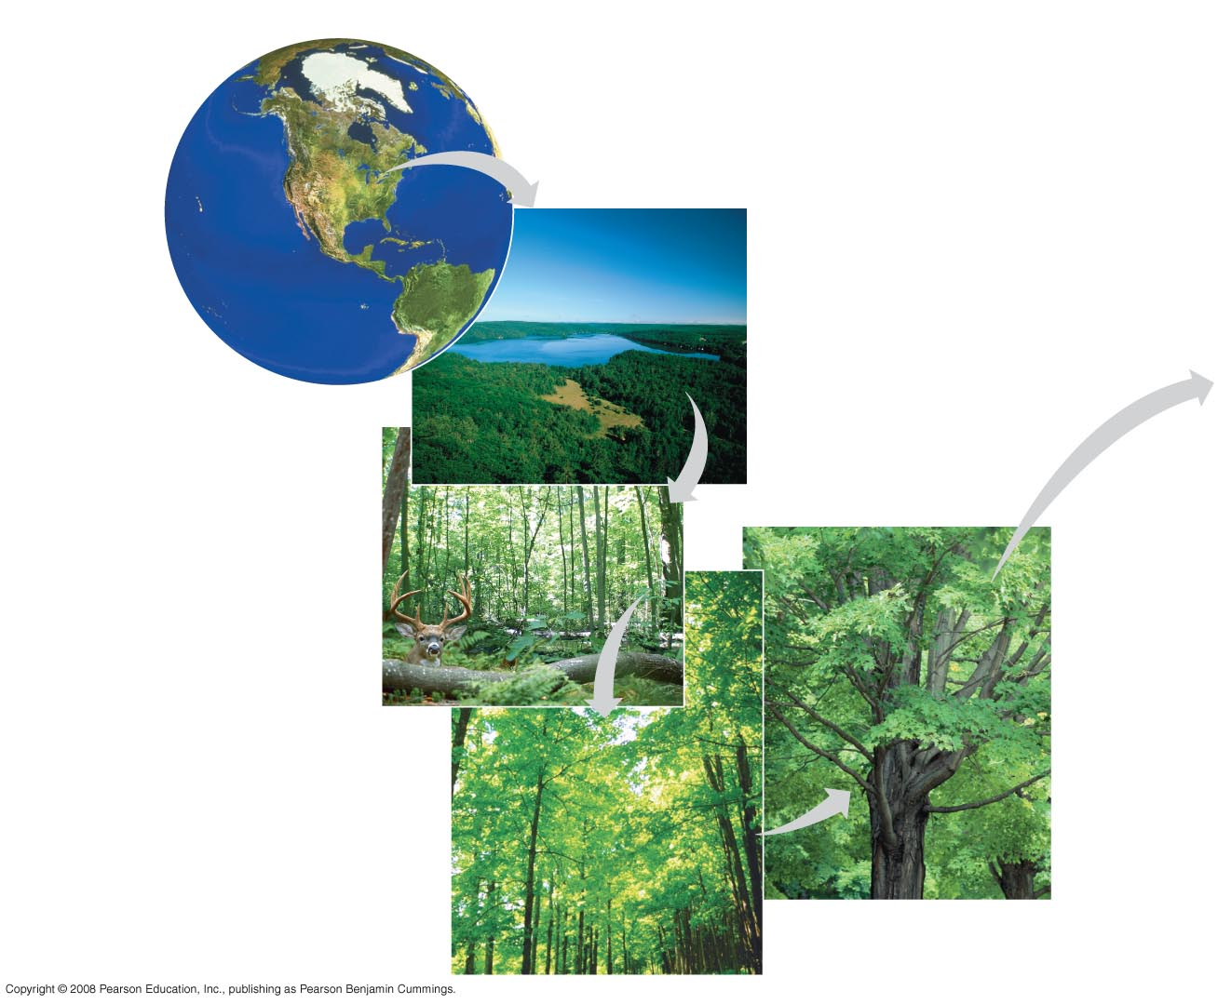
Fig. 1-4a
The biosphere
Ecosystems
Communities
Populations
Organisms
Notes:
Figure 1.4 Levels of biological organization

Slide 19
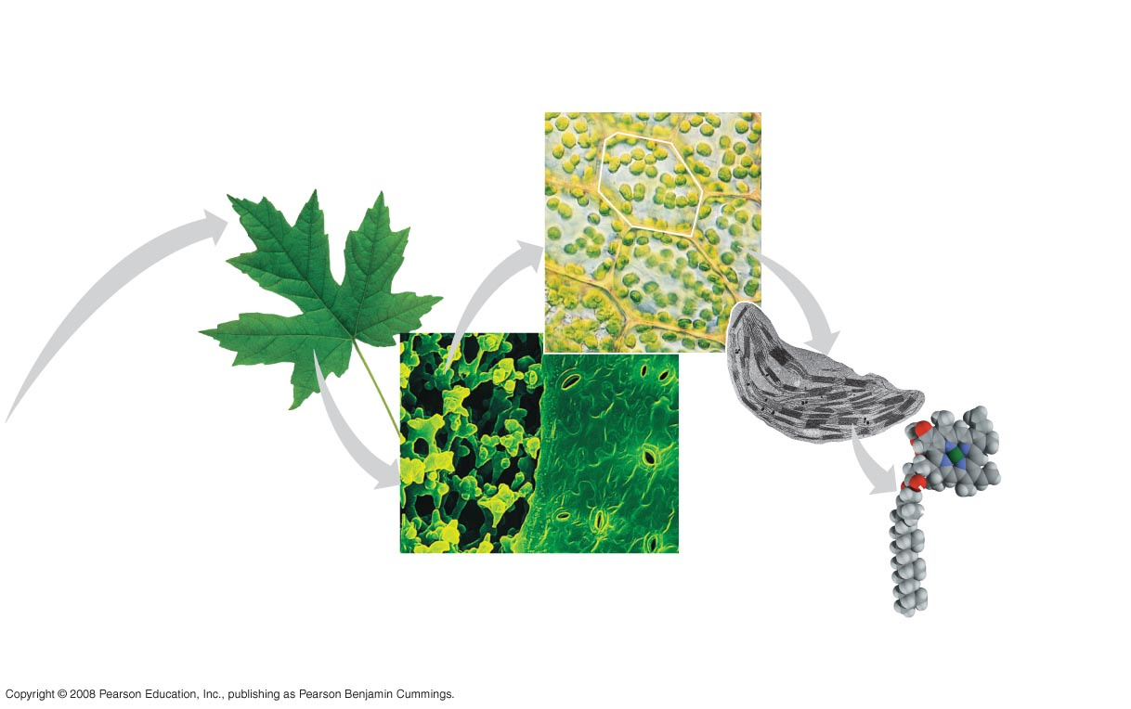
Fig. 1-4b
Cells
Organs and organ systems
10 µm
Cell
Organelles
1 µm
Atoms
Tissues
50 µm
Molecules
Notes:
Figure 1.4 Levels of biological organization

Slide 20
Fig. 1-4c
The biosphere
Notes:
Figure 1.4 Levels of biological organization

Slide 21
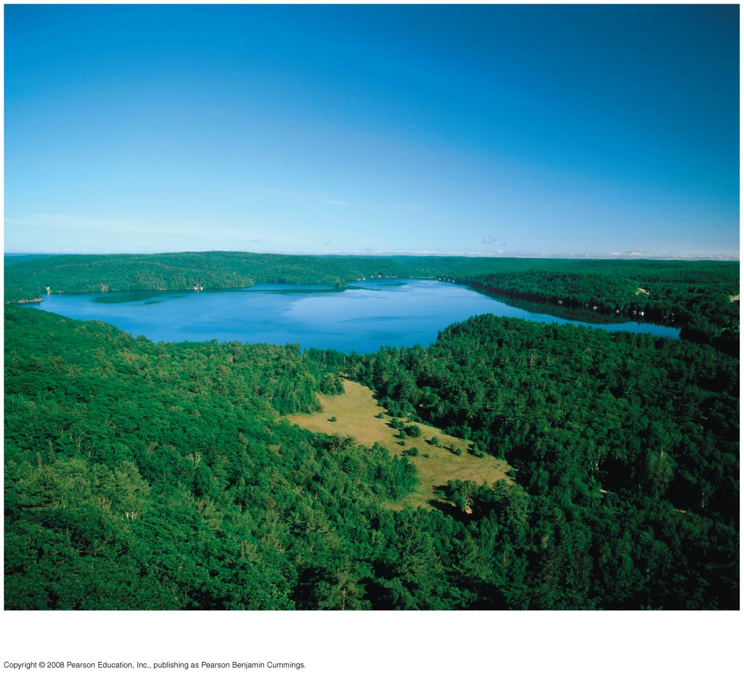
Fig. 1-4d
Ecosystems
Notes:
Figure 1.4 Levels of biological organization

Slide 22
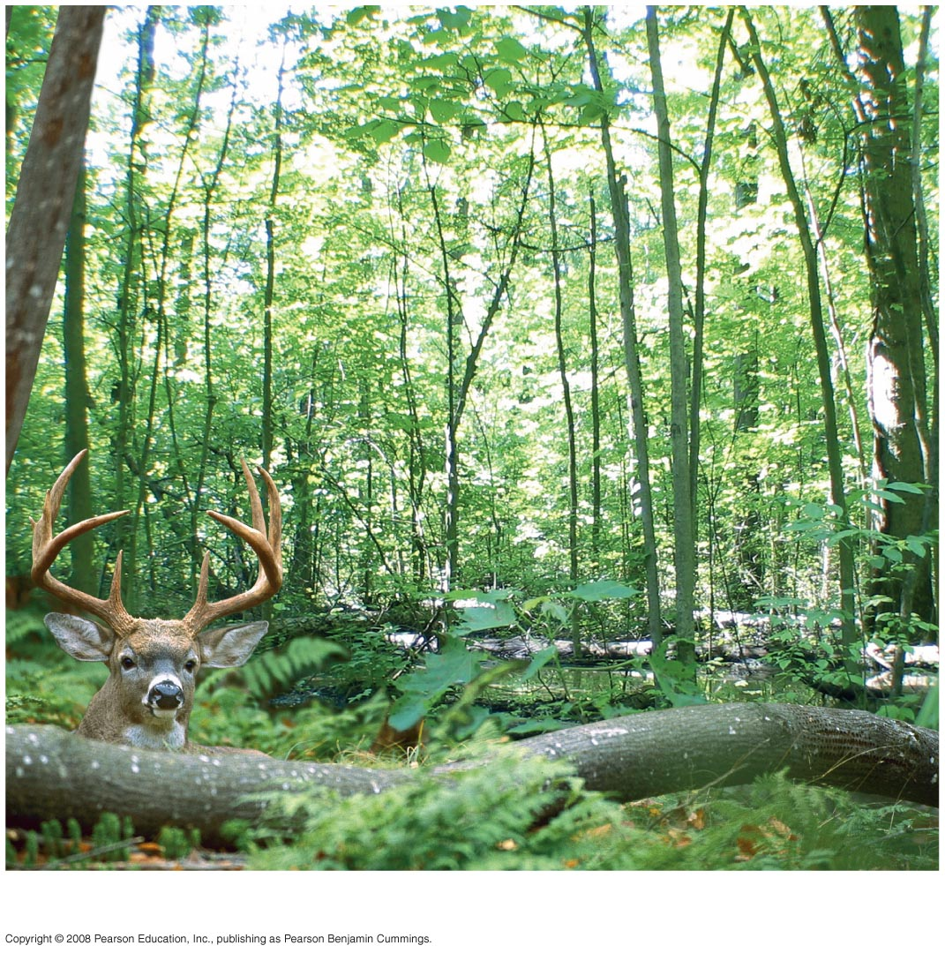
Fig. 1-4e
Communities
Notes:
Figure 1.4 Levels of biological organization

Slide 23
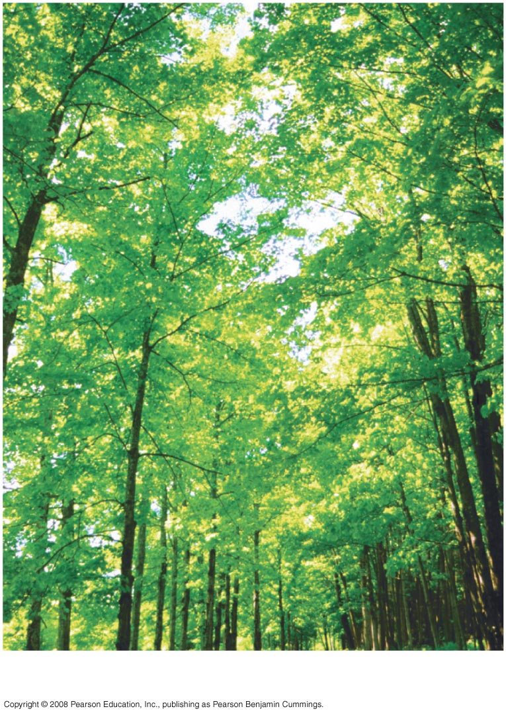
Fig. 1-4f
Populations
Notes:
Figure 1.4 Levels of biological organization

Slide 24
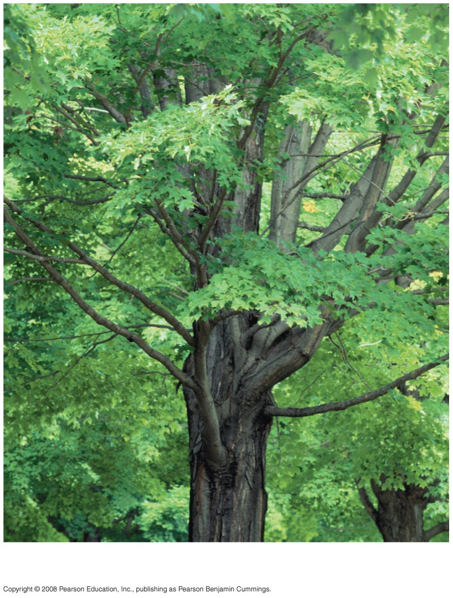
Fig. 1-4g
Organisms
Notes:
Figure 1.4 Levels of biological organization

Slide 25
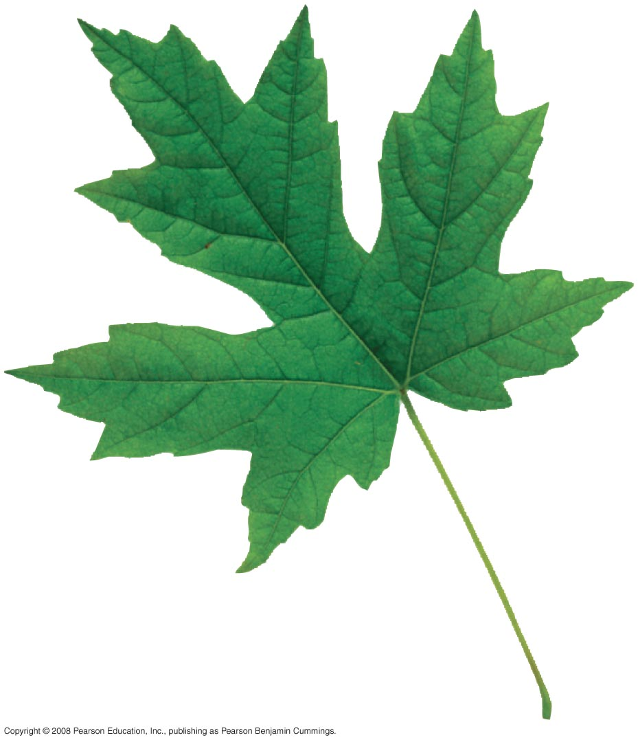
Fig. 1-4h
Organs and
organ systems
Notes:
Figure 1.4 Levels of biological organization

Slide 26
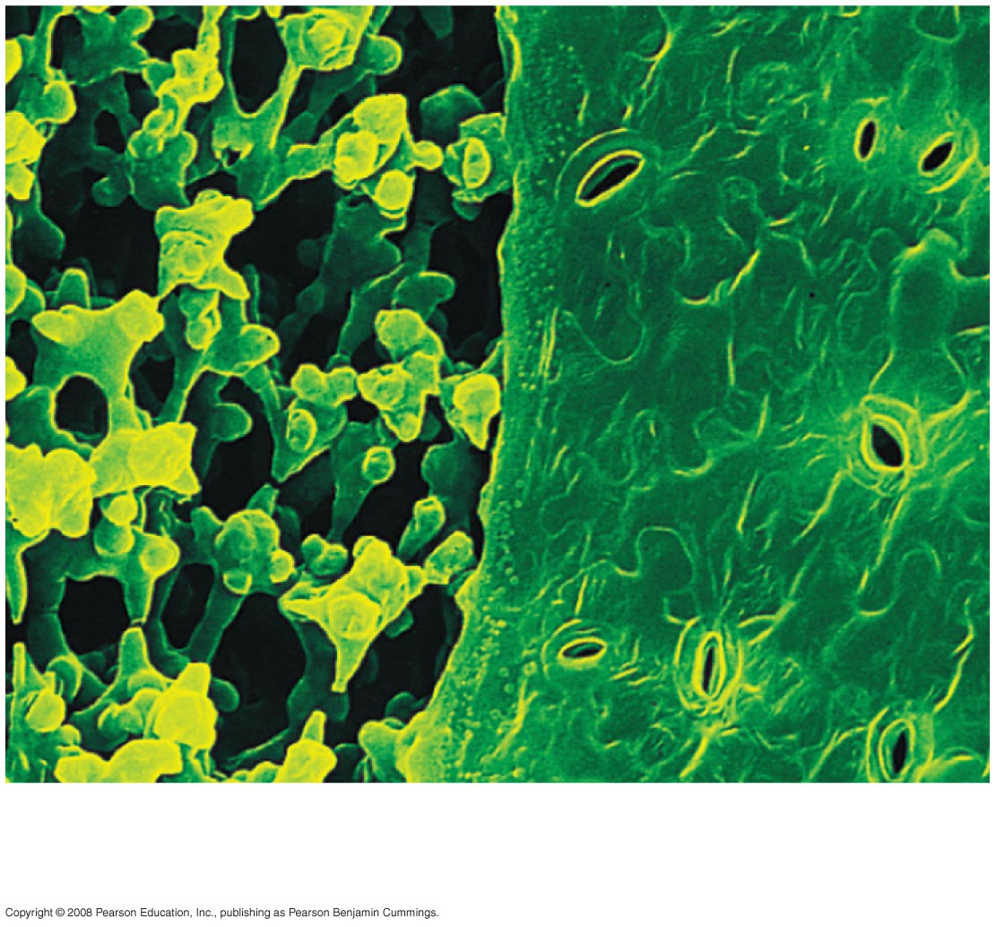
Fig. 1-4i
Tissues
50 µm
Notes:
Figure 1.4 Levels of biological organization

Slide 27
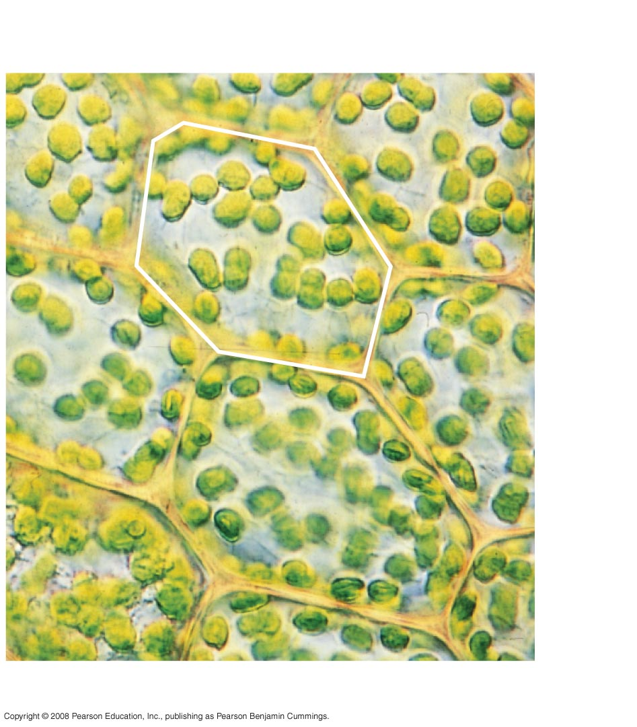
Fig. 1-4j
10 µm
Cell
Cells
Notes:
Figure 1.4 Levels of biological organization

Slide 28
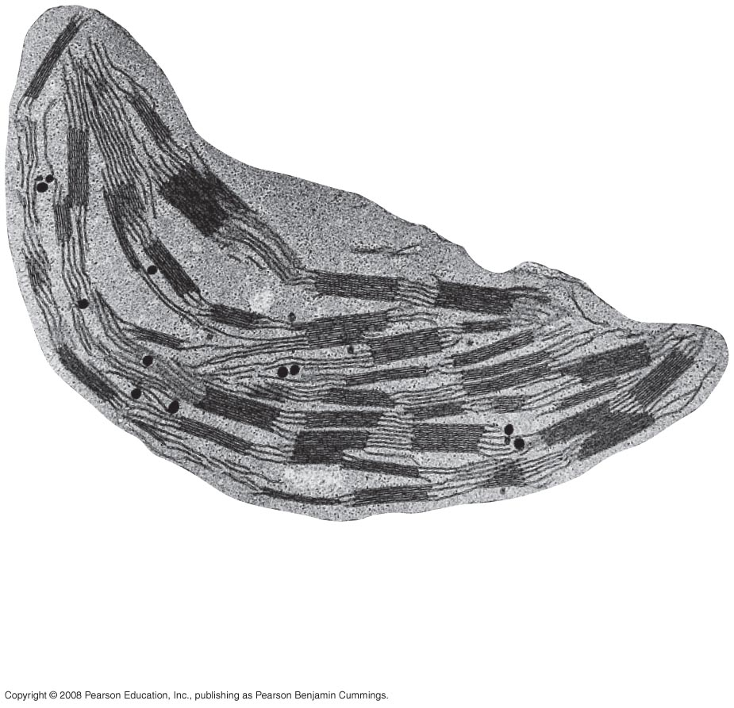
Fig. 1-4k
1 µm
Organelles
Notes:
Figure 1.4 Levels of biological organization

Slide 29
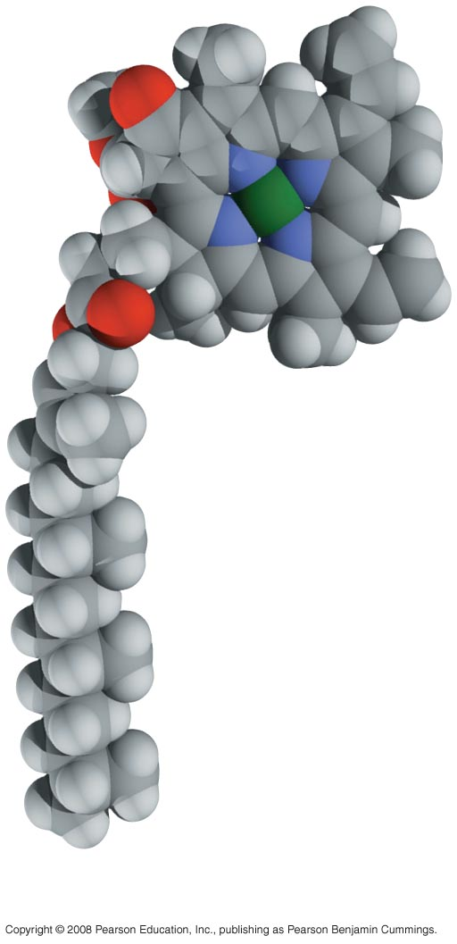
Fig. 1-4l
Atoms
Molecules
Notes:
Figure 1.4 Levels of biological organization

Slide 30
Emergent Properties
Emergent properties result from the arrangement and interaction of parts within a system
Emergent properties characterize nonbiological entities as well
For example, a functioning bicycle emerges only when all of the necessary parts connect in the correct way
Copyright © 2008 Pearson Education, Inc., publishing as Pearson Benjamin Cummings

Slide 31
The Power and Limitations of Reductionism
Reductionism is the reduction of complex systems to simpler components that are more manageable to study
For example, the molecular structure of DNA
An understanding of biology balances reductionism with the study of emergent properties
For example, new understanding comes from studying the interactions of DNA with other molecules
Copyright © 2008 Pearson Education, Inc., publishing as Pearson Benjamin Cummings

Slide 32
Systems Biology
A system is a combination of components that function together
Systems biology constructs models for the dynamic behavior of whole biological systems
The systems approach poses questions such as:
How does a drug for blood pressure affect other organs?
How does increasing CO₂ alter the biosphere?
Copyright © 2008 Pearson Education, Inc., publishing as Pearson Benjamin Cummings

Slide 33
Theme: Organisms interact with their environments, exchanging matter and energy
Every organism interacts with its environment, including nonliving factors and other organisms
Both organisms and their environments are affected by the interactions between them
For example, a tree takes up water and minerals from the soil and carbon dioxide from the air; the tree releases oxygen to the air and roots help form soil
Copyright © 2008 Pearson Education, Inc., publishing as Pearson Benjamin Cummings

Slide 34
Ecosystem Dynamics
The dynamics of an ecosystem include two major processes:
Cycling of nutrients, in which materials acquired by plants eventually return to the soil
The flow of energy from sunlight to producers to consumers
Copyright © 2008 Pearson Education, Inc., publishing as Pearson Benjamin Cummings

Slide 35
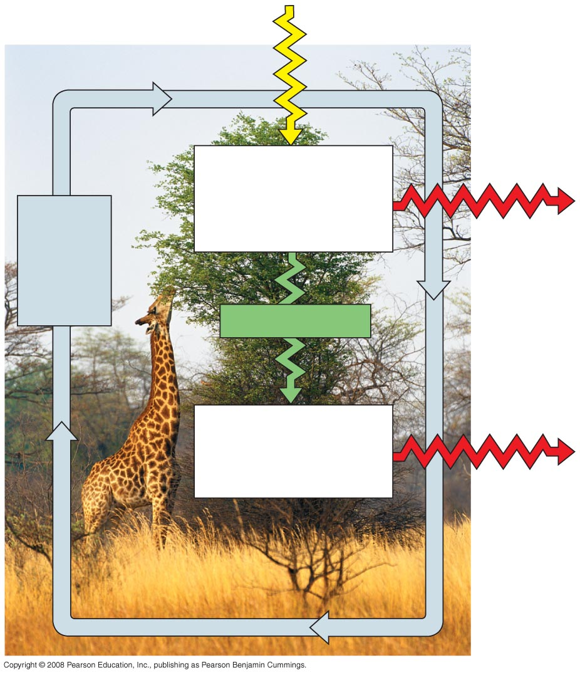
Fig. 1-5
Sunlight
Ecosystem
Producers
(plants and other photosynthetic
organisms)
Cycling
of
chemical
nutrients
Heat
Chemical energy
Consumers
(such as animals)
Heat
Notes:
Figure 1.5 Nutrient cycling and energy flow in an ecosystem

Slide 36
Energy Conversion
Work requires a source of energy
Energy can be stored in different forms, for example, light, chemical, kinetic, or thermal
The energy exchange between an organism and its environment often involves energy transformations
Energy flows through an ecosystem, usually entering as light and exiting as heat
Copyright © 2008 Pearson Education, Inc., publishing as Pearson Benjamin Cummings

Slide 37
Theme: Structure and function are correlated at all levels of biological organization
Structure and function of living organisms are closely related
For example, a leaf is thin and flat, maximizing the capture of light by chloroplasts
Copyright © 2008 Pearson Education, Inc., publishing as Pearson Benjamin Cummings

Slide 38
Fig. 1-6
(a) Wings
(b) Bones
Infoldings of
membrane
Mitochondrion
100 µm
0.5 µm
(c) Neurons
(d) Mitochondria
Notes:
Figure 1.6 Form fits function in a gull’s wing

Slide 39
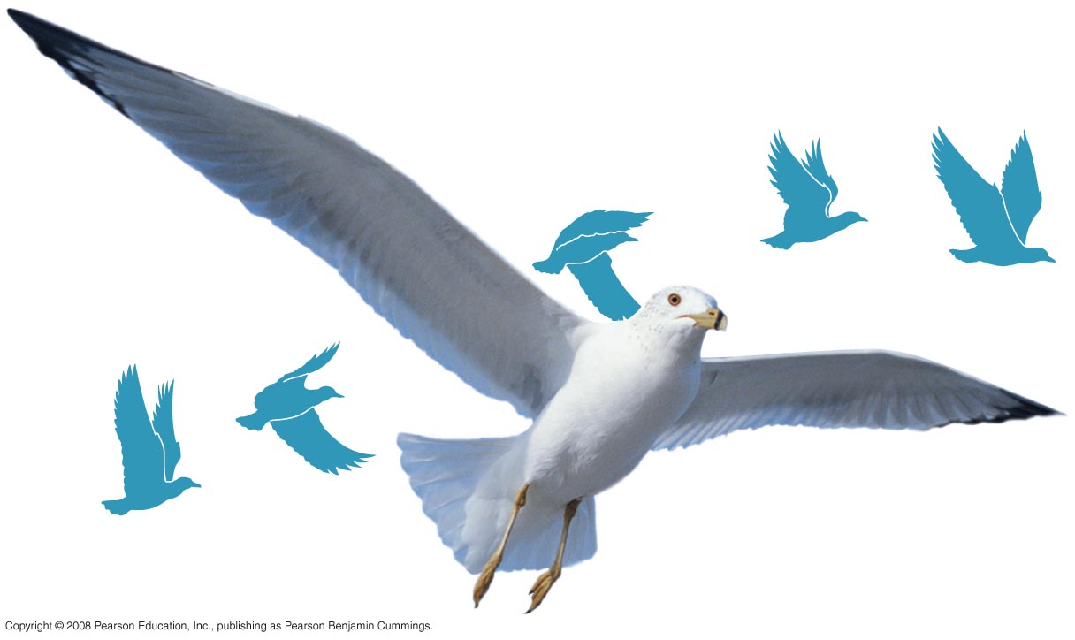
Fig. 1-6a
(a) Wings
Notes:
Figure 1.6 Form fits function in a gull’s wing

Slide 40
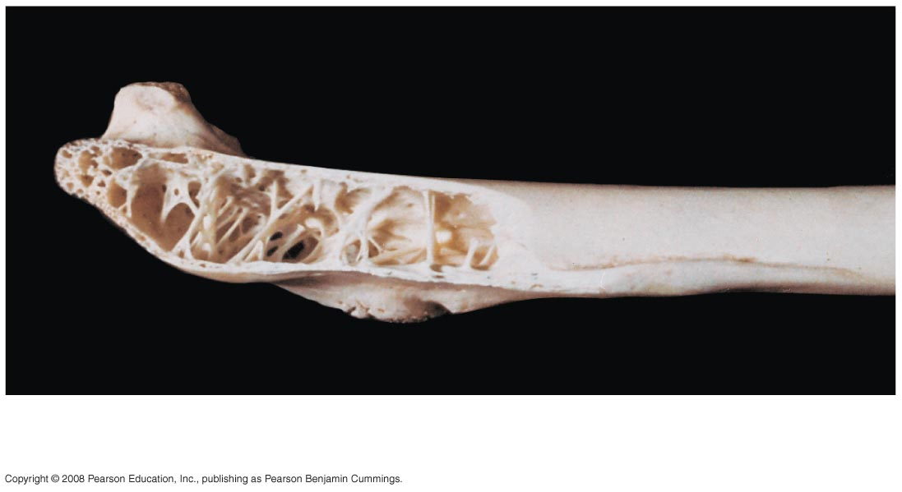
Fig. 1-6b
(b) Bones
Notes:
Figure 1.6 Form fits function in a gull’s wing

Slide 41
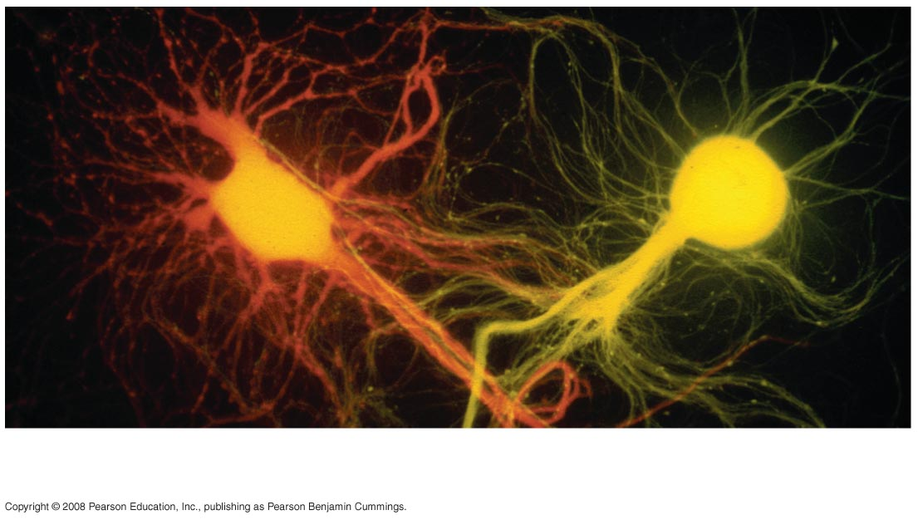
Fig. 1-6c
100 µm
(c) Neurons
Notes:
Figure 1.6 Form fits function in a gull’s wing

Slide 42
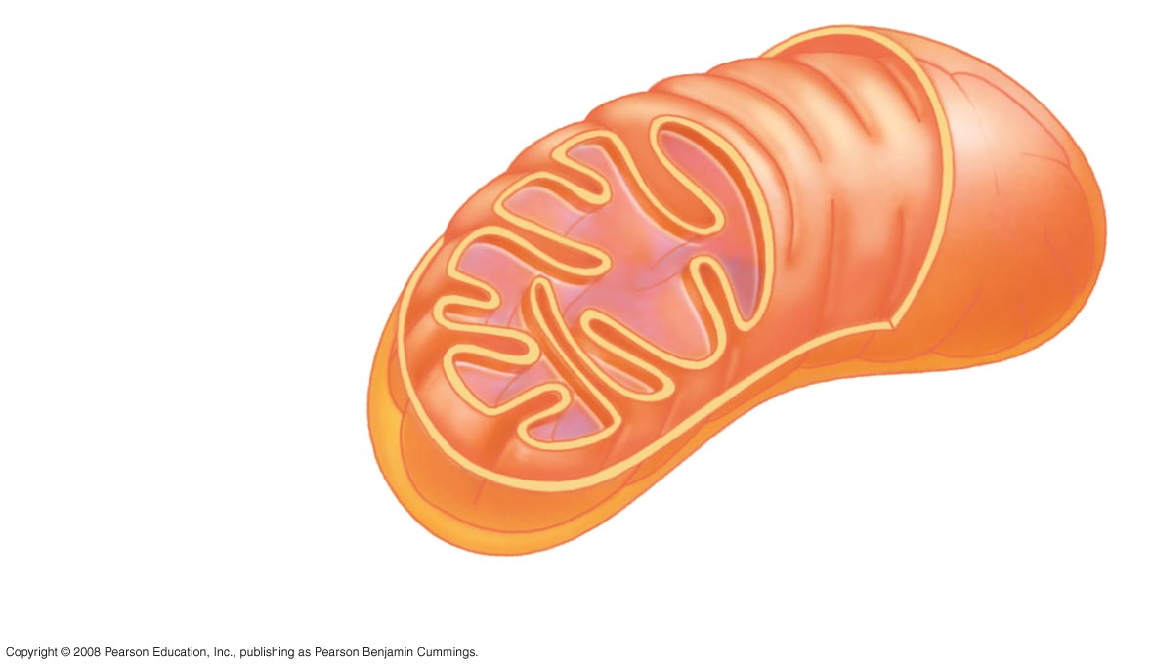
Fig. 1-6d
Infoldings of
membrane
Mitochondrion
0.5 µm
(d) Mitochondria
Notes:
Figure 1.6 Form fits function in a gull’s wing

Slide 43
Theme: Cells are an organism’s basic units of structure and function
The cell is the lowest level of organization that can perform all activities required for life
All cells:
Are enclosed by a membrane
Use DNA as their genetic information
The ability of cells to divide is the basis of all reproduction, growth, and repair of multicellular organisms
Copyright © 2008 Pearson Education, Inc., publishing as Pearson Benjamin Cummings

Slide 44
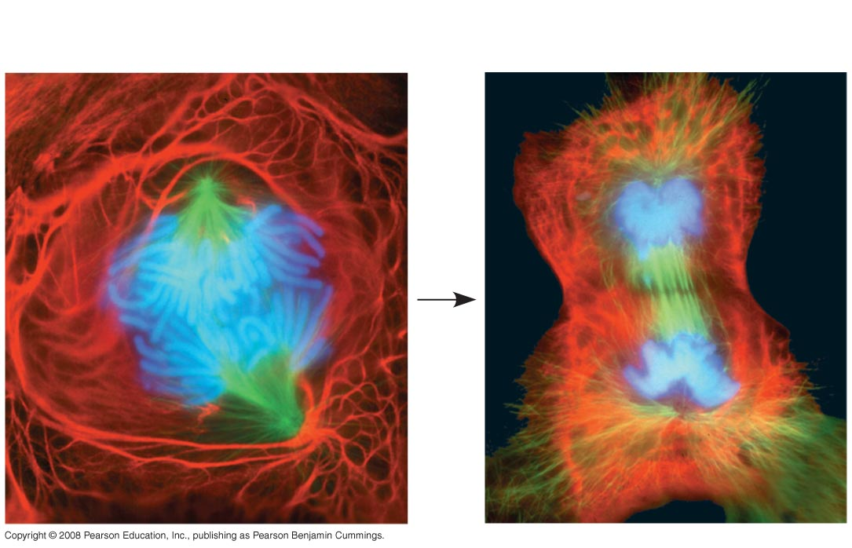
Fig. 1-7
25 µm
Notes:
Figure 1.7 A lung cell from a newt divides into two smaller cells that will grow and divide again

Slide 45
A eukaryotic cell has membrane-enclosed organelles, the largest of which is usually the nucleus
By comparison, a prokaryotic cell is simpler and usually smaller, and does not contain a nucleus or other membrane-enclosed organelles
Bacteria and Archaea are prokaryotic; plants, animals, fungi, and all other forms of life are eukaryotic
Copyright © 2008 Pearson Education, Inc., publishing as Pearson Benjamin Cummings

Slide 46
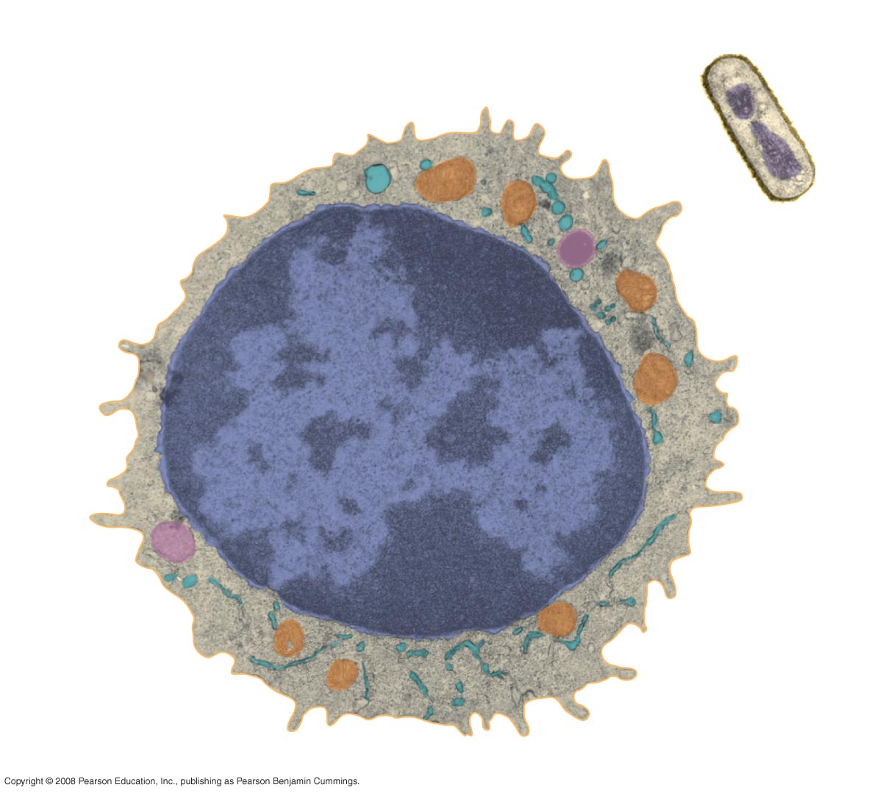
Fig. 1-8
Prokaryotic cell
Eukaryotic cell
DNA
(no nucleus)
Membrane
Membrane
Cytoplasm
Organelles
Nucleus (contains DNA)
1 µm
Notes:
Figure 1.8 Contrasting eukaryotic and prokaryotic cells in size and complexity

Slide 47
Theme: The continuity of life is based on heritable information in the form of DNA
Chromosomes contain most of a cell’s genetic material in the form of DNA (deoxyribonucleic acid)
DNA is the substance of genes
Genes are the units of inheritance that transmit information from parents to offspring
Copyright © 2008 Pearson Education, Inc., publishing as Pearson Benjamin Cummings

Slide 48
DNA Structure and Function
Each chromosome has one long DNA molecule with hundreds or thousands of genes
DNA is inherited by offspring from their parents
DNA controls the development and maintenance of organisms
Copyright © 2008 Pearson Education, Inc., publishing as Pearson Benjamin Cummings

Slide 49
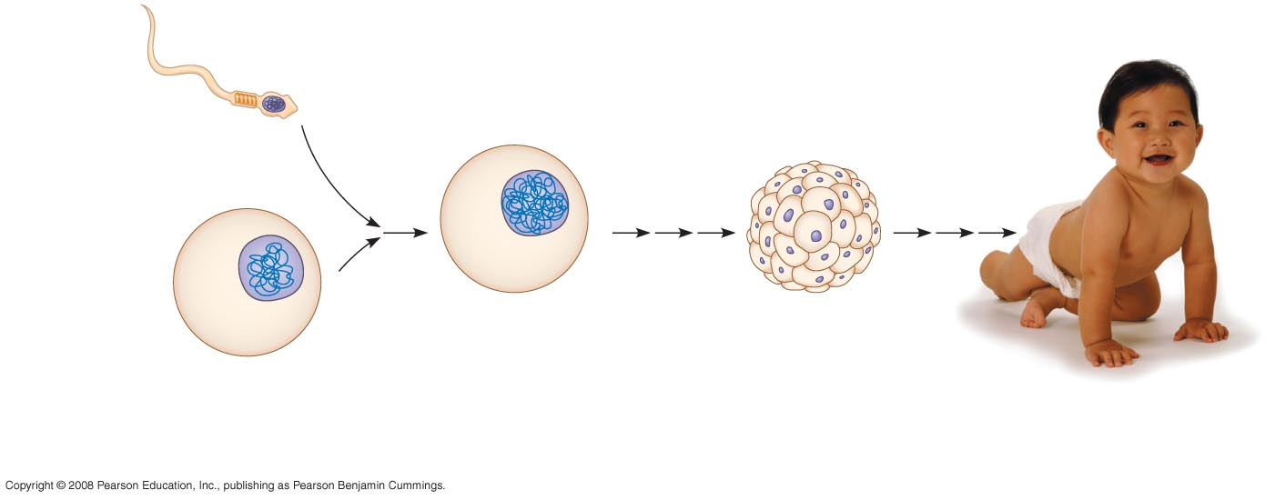
Fig. 1-9
Sperm cell
Nuclei
containing
DNA
Fertilized egg
with DNA from
both parents
Embryo’s cells with
copies of inherited DNA
Egg cell
Offspring with traits
inherited from
both parents
Notes:
Figure 1.9 Inherited DNA directs development of an organism

Slide 50
Each DNA molecule is made up of two long chains arranged in a double helix
Each link of a chain is one of four kinds of chemical building blocks called nucleotides
Copyright © 2008 Pearson Education, Inc., publishing as Pearson Benjamin Cummings

Slide 51
Fig. 1-10
Nucleus
DNA
Nucleotide
Cell
(a) DNA double helix
(b) Single strand of DNA
Notes:
Figure 1.10 DNA: The genetic material

Slide 52
Genes control protein production indirectly
DNA is transcribed into RNA then translated into a protein
An organism’s genome is its entire set of genetic instructions
Copyright © 2008 Pearson Education, Inc., publishing as Pearson Benjamin Cummings

Slide 53
Systems Biology at the Levels of Cells and Molecules
The human genome and those of many other organisms have been sequenced using DNA-sequencing machines
Knowledge of a cell’s genes and proteins can be integrated using a systems approach
Copyright © 2008 Pearson Education, Inc., publishing as Pearson Benjamin Cummings

Slide 54
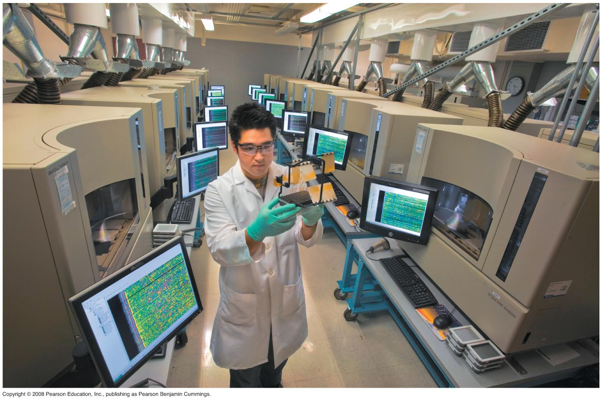
Fig. 1-11
Notes:
Figure 1.11 Modern biology as an information science

Slide 55
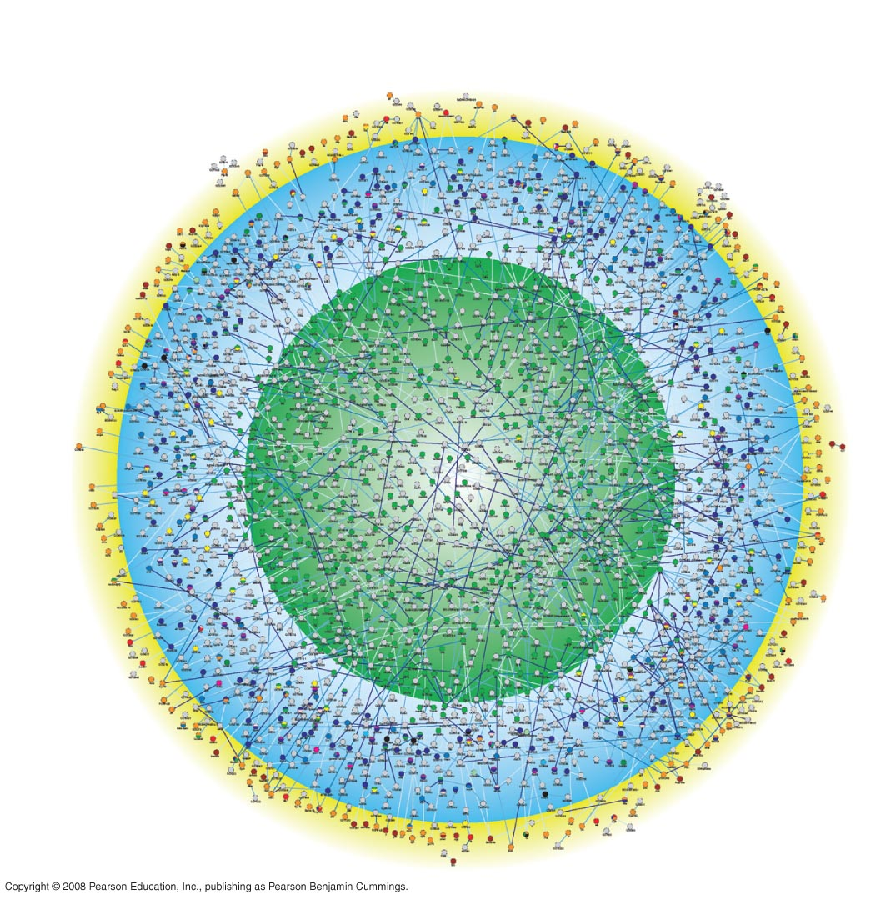
Fig. 1-12
Outer membrane
and cell surface
Cytoplasm
Nucleus
Notes:
Figure 1.12 A systems map of interactions among proteins in a cell

Slide 56
Advances in systems biology at the cellular and molecular level depend on
“High-throughput” technology, which yields enormous amounts of data
Bioinformatics, which is the use of computational tools to process a large volume of data
Interdisciplinary research teams
Copyright © 2008 Pearson Education, Inc., publishing as Pearson Benjamin Cummings

Slide 57
Theme: Feedback mechanisms regulate biological systems
Feedback mechanisms allow biological processes to self-regulate
Negative feedback means that as more of a product accumulates, the process that creates it slows and less of the product is produced
Positive feedback means that as more of a product accumulates, the process that creates it speeds up and more of the product is produced
Animation: Negative Feedback
Animation: Positive Feedback
Copyright © 2008 Pearson Education, Inc., publishing as Pearson Benjamin Cummings

Slide 58
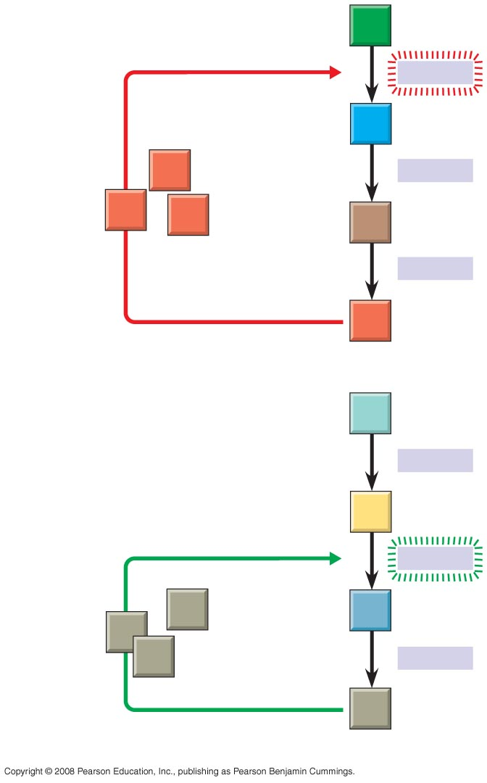
Fig. 1-13
Negative
feedback
A
−
Enzyme 1
B
Excess D
blocks a step
D
Enzyme 2
D
D
C
Enzyme 3
D
(a) Negative feedback
W
Enzyme 4
Positive
feedback
X
+
Enzyme 5
Excess Z
stimulates a
step
Z
Y
Z
Z
Enzyme 6
Z
(b) Positive feedback
Notes:
Figure 1.13 Regulation by feedback mechanisms

Slide 59
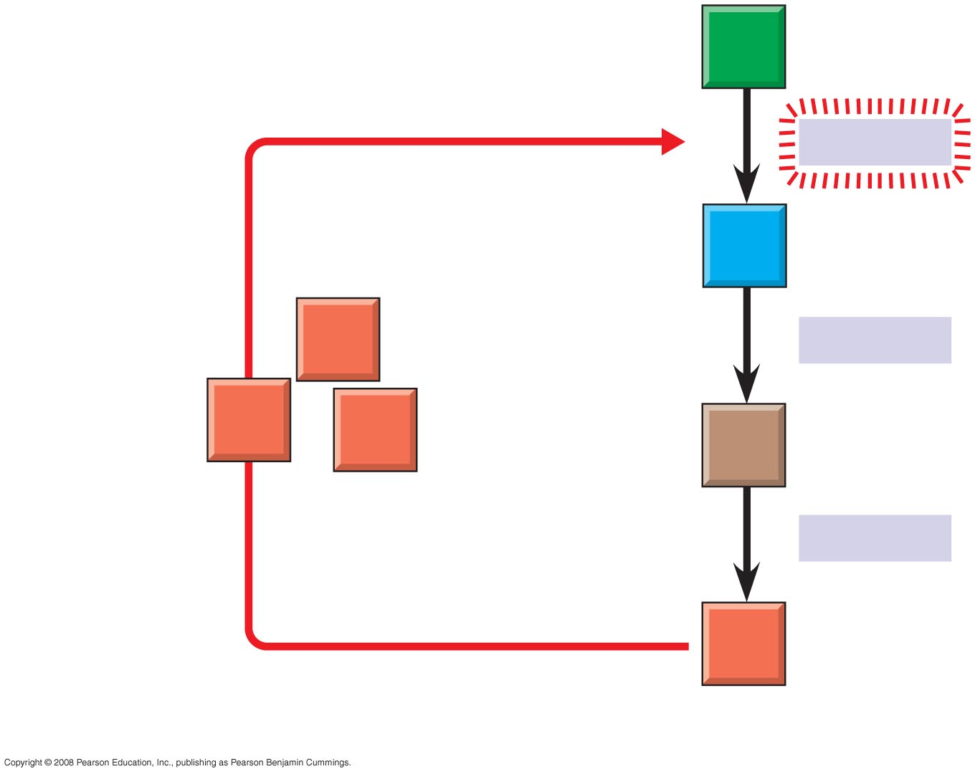
Fig. 1-13a
A
Negative
feedback
–
Enzyme 1
B
D
Enzyme 2
Excess D
blocks a step
D
D
C
Enzyme 3
D
(a) Negative feedback
Notes:
Figure 1.13 Regulation by feedback mechanisms

Slide 60
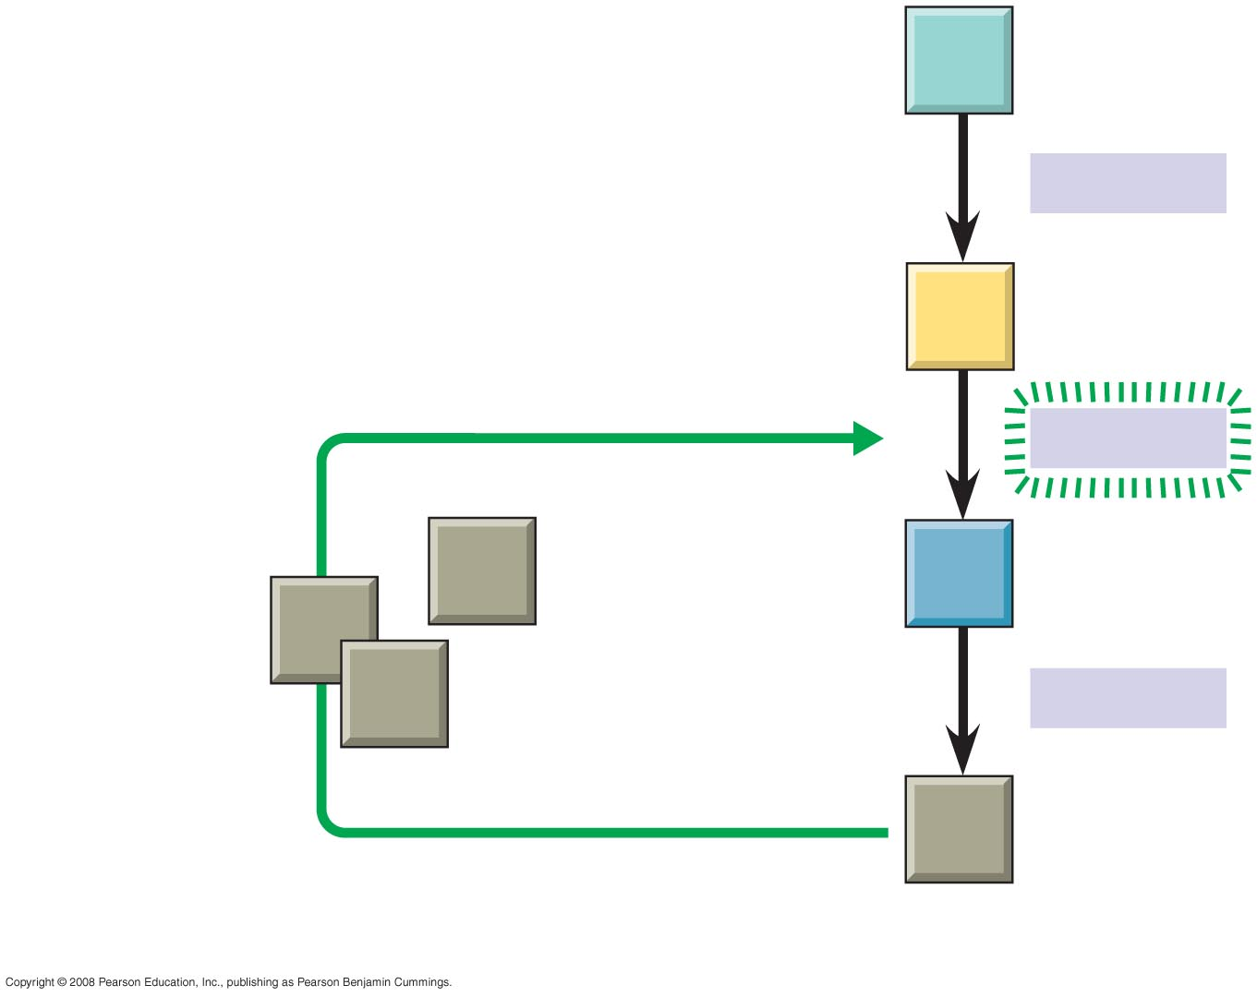
Fig. 1-13b
W
Enzyme 4
X
Positive
feedback
+
Enzyme 5
Excess Z
stimulates a step
Z
Y
Z
Z
Enzyme 6
Z
(b) Positive feedback
Notes:
Figure 1.13 Regulation by feedback mechanisms

Slide 61
Concept 1.2: The Core Theme: Evolution accounts for the unity and diversity of life
“Nothing in biology makes sense except in the light of evolution”—Theodosius Dobzhansky
Evolution unifies biology at different scales of size throughout the history of life on Earth
Copyright © 2008 Pearson Education, Inc., publishing as Pearson Benjamin Cummings

Slide 62
Organizing the Diversity of Life
Approximately 1.8 million species have been identified and named to date, and thousands more are identified each year
Estimates of the total number of species that actually exist range from 10 million to over 100 million
Copyright © 2008 Pearson Education, Inc., publishing as Pearson Benjamin Cummings

Slide 63
Grouping Species: The Basic Idea
Taxonomy is the branch of biology that names and classifies species into groups of increasing breadth
Domains, followed by kingdoms, are the broadest units of classification
Copyright © 2008 Pearson Education, Inc., publishing as Pearson Benjamin Cummings

Slide 64
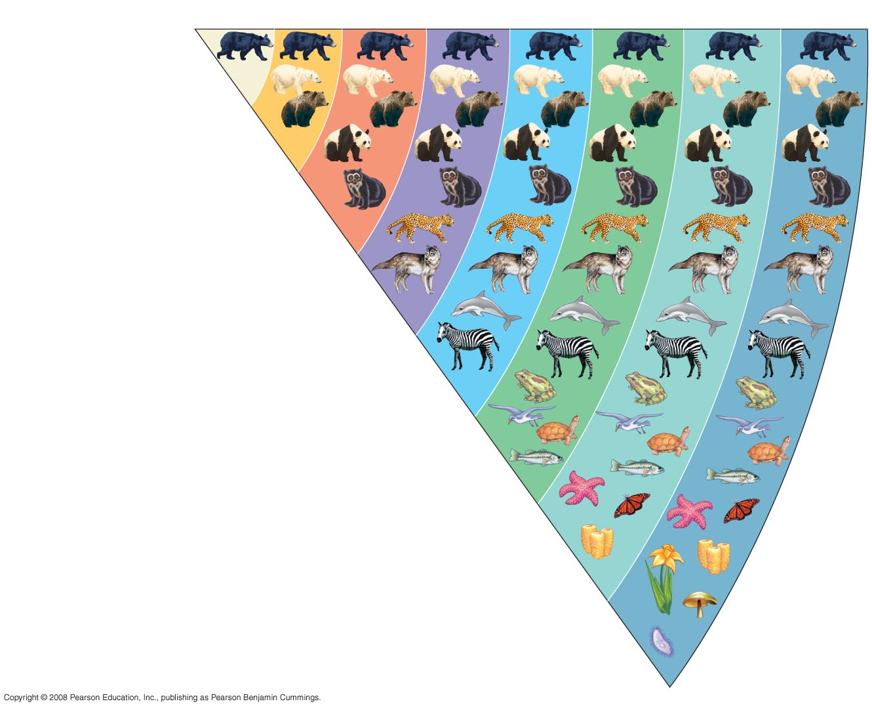
Fig. 1-14
Species
Genus
Family
Order
Class
Phylum
Kingdom
Domain
Ursus americanus
(American black bear)
Ursus
Ursidae
Carnivora
Mammalia
Chordata
Animalia
Eukarya
Notes:
Figure 1.14 Classifying life

Slide 65
The Three Domains of Life
The three-domain system is currently used, and replaces the old five-kingdom system
Domain Bacteria and domain Archaea comprise the prokaryotes
Domain Eukarya includes all eukaryotic organisms
Copyright © 2008 Pearson Education, Inc., publishing as Pearson Benjamin Cummings

Slide 66
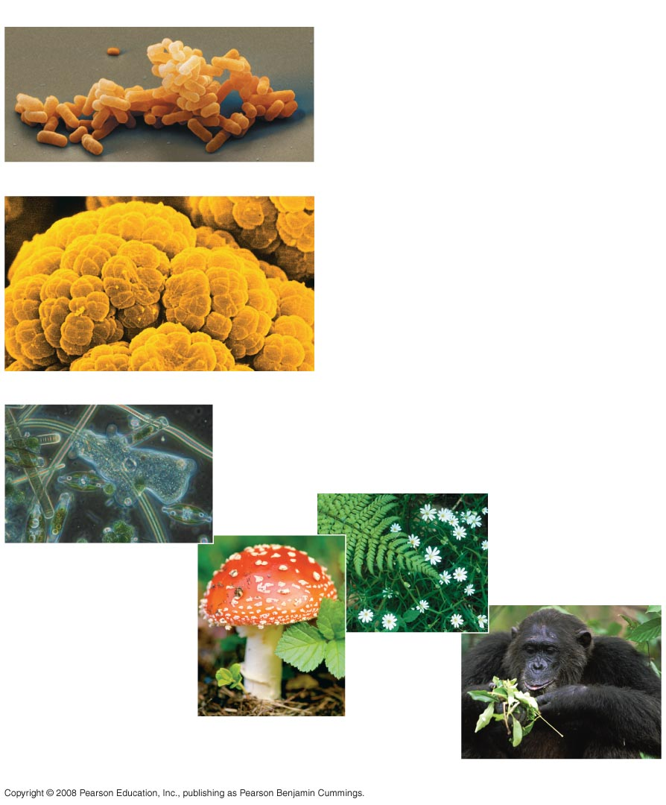
Fig. 1-15
(a) DOMAIN BACTERIA
(b) DOMAIN ARCHAEA
(c) DOMAIN EUKARYA
Protists
Kingdom
Plantae
Kingdom Fungi
Kingdom Animalia
Notes:
Figure 1.15 The three domains of life

Slide 67
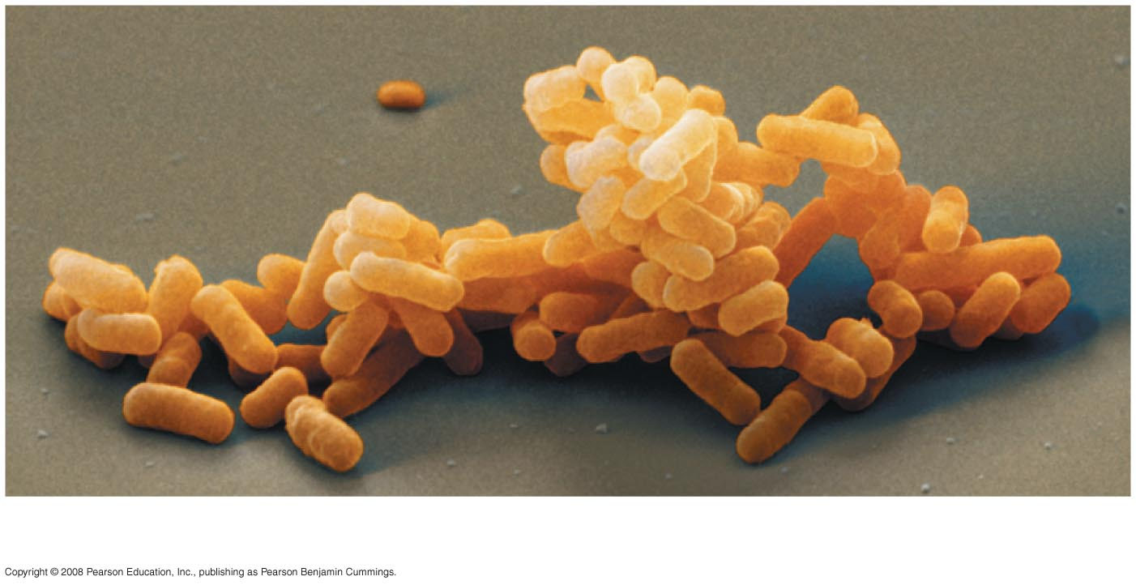
Fig. 1-15a
(a) DOMAIN BACTERIA
Notes:
Figure 1.15 The three domains of life

Slide 68
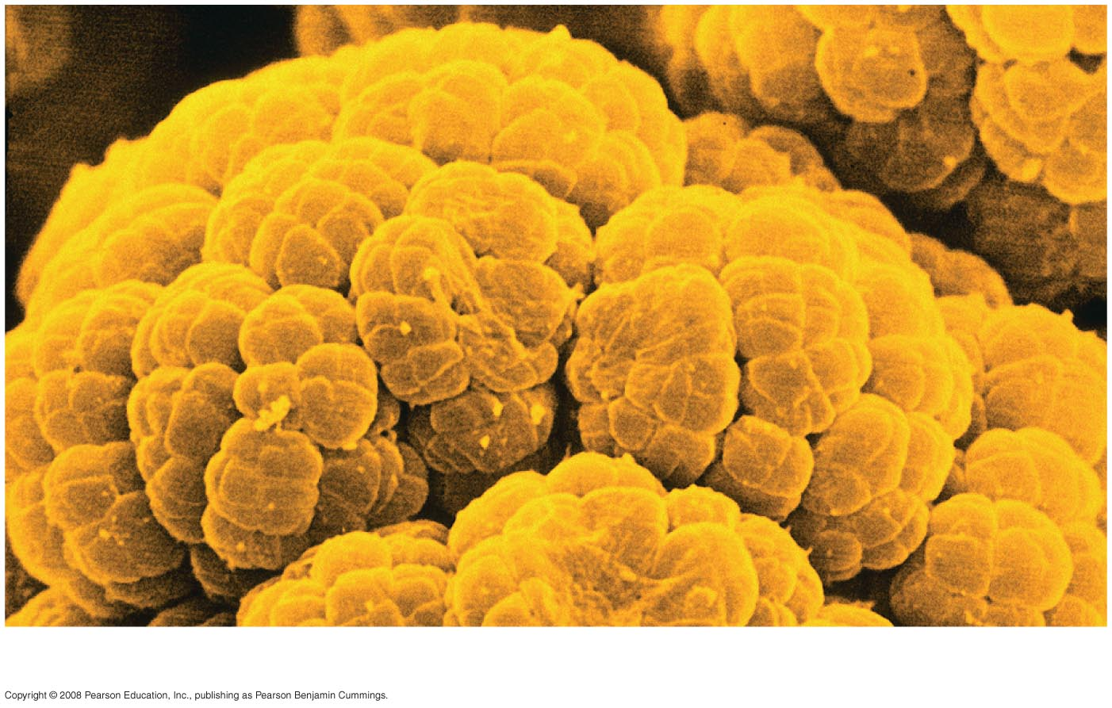
Fig. 1-15b
(b) DOMAIN ARCHAEA
Notes:
Figure 1.15 The three domains of life

Slide 69
The domain Eukarya includes three multicellular kingdoms:
Plantae
Fungi
Animalia
Other eukaryotic organisms were formerly grouped into a kingdom called Protista, though these are now often grouped into many separate kingdoms
Copyright © 2008 Pearson Education, Inc., publishing as Pearson Benjamin Cummings

Slide 70
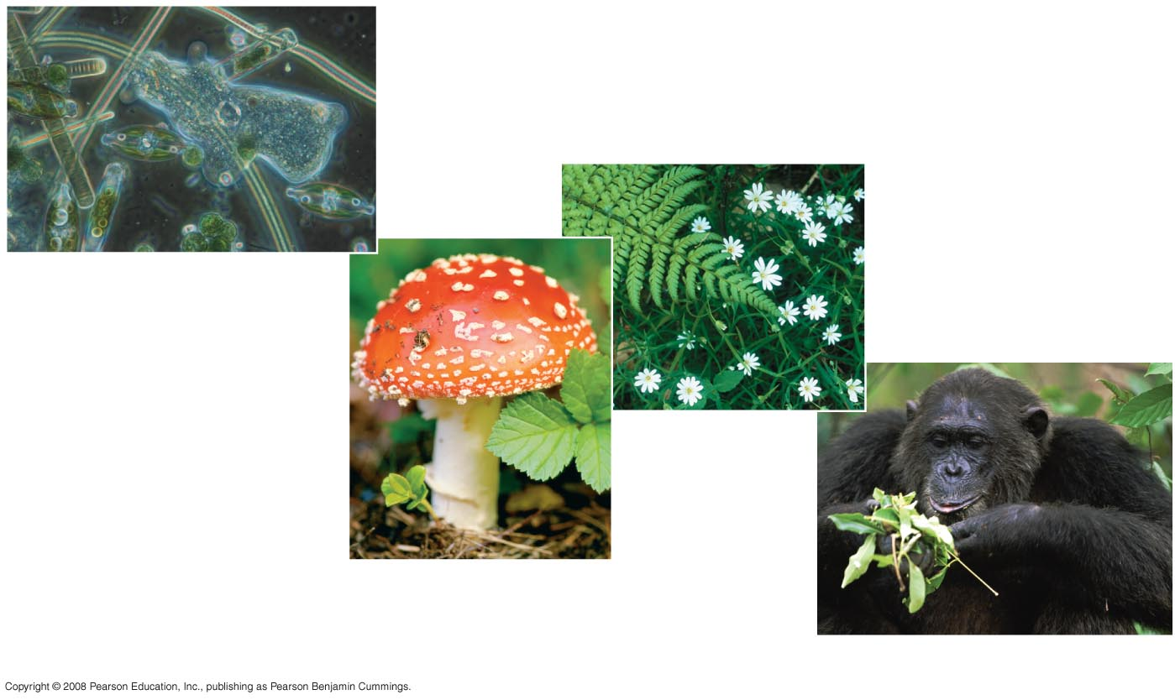
Fig. 1-15c
Protists
Kingdom Plantae
Kingdom Fungi
(c) DOMAIN EUKARYA
Kingdom Animalia
Notes:
Figure 1.15 The three domains of life

Slide 71
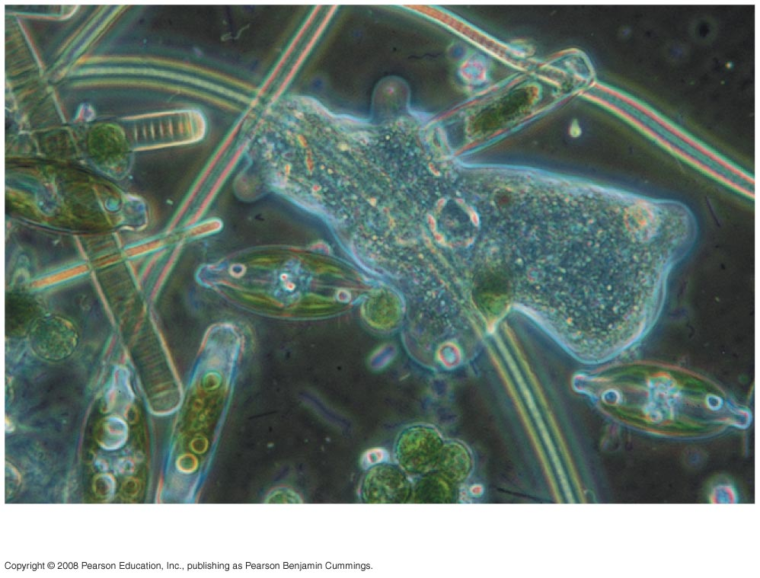
Fig. 1-15d
Protists
Notes:
Figure 1.15 The three domains of life

Slide 72
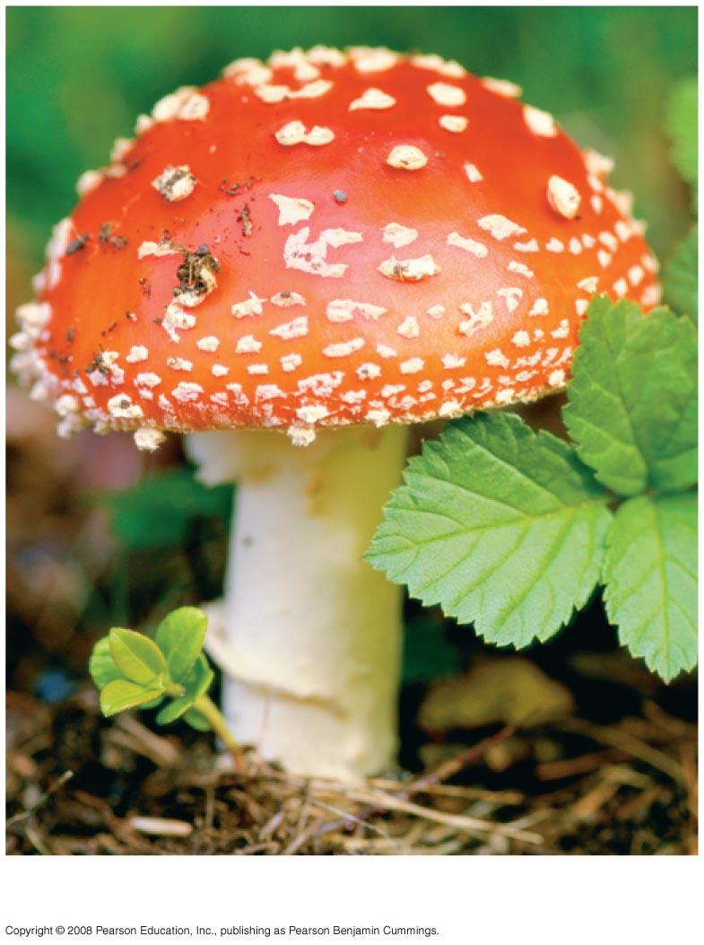
Fig. 1-15e
Kingdom Fungi
Notes:
Figure 1.15 The three domains of life

Slide 73
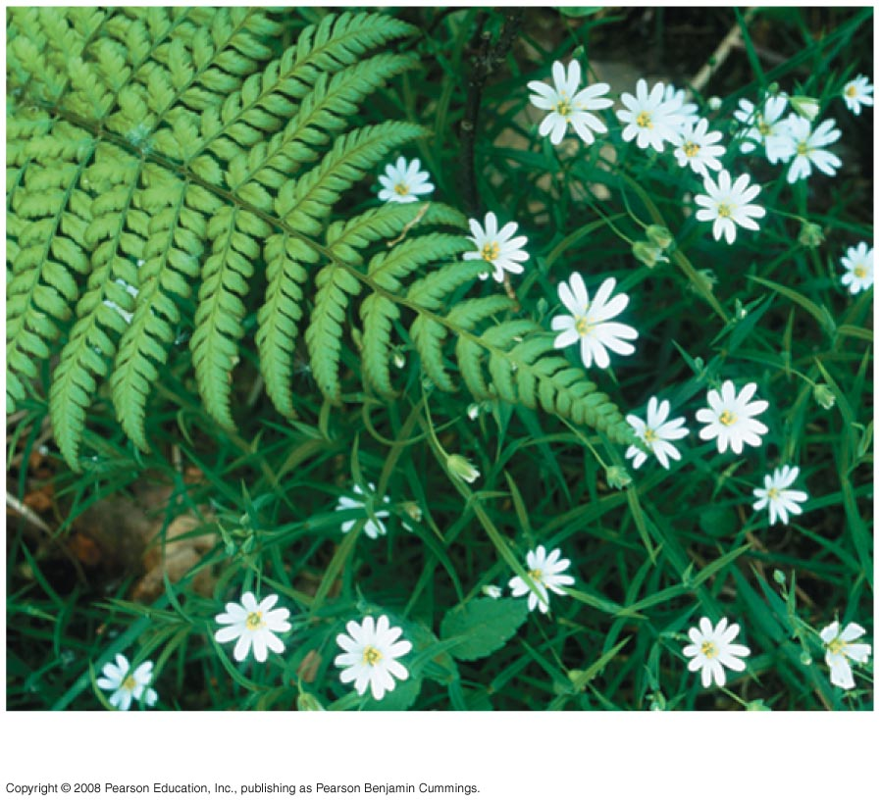
Fig. 1-15f
Kingdom Plantae
Notes:
Figure 1.15 The three domains of life

Slide 74
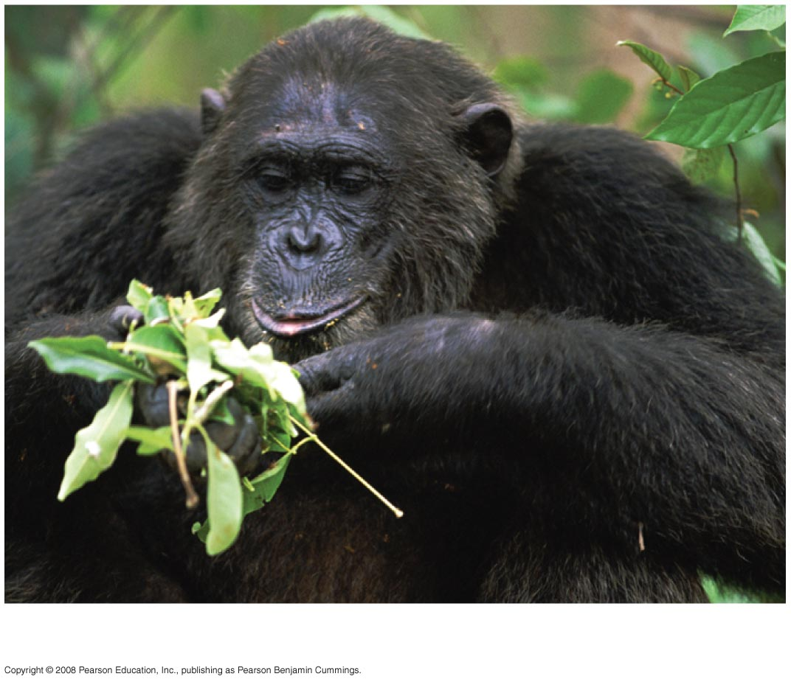
Fig. 1-15g
Kingdom Animalia
Notes:
Figure 1.15 The three domains of life

Slide 75
Unity in the Diversity of Life
A striking unity underlies the diversity of life; for example:
DNA is the universal genetic language common to all organisms
Unity is evident in many features of cell structure
Copyright © 2008 Pearson Education, Inc., publishing as Pearson Benjamin Cummings

Slide 76
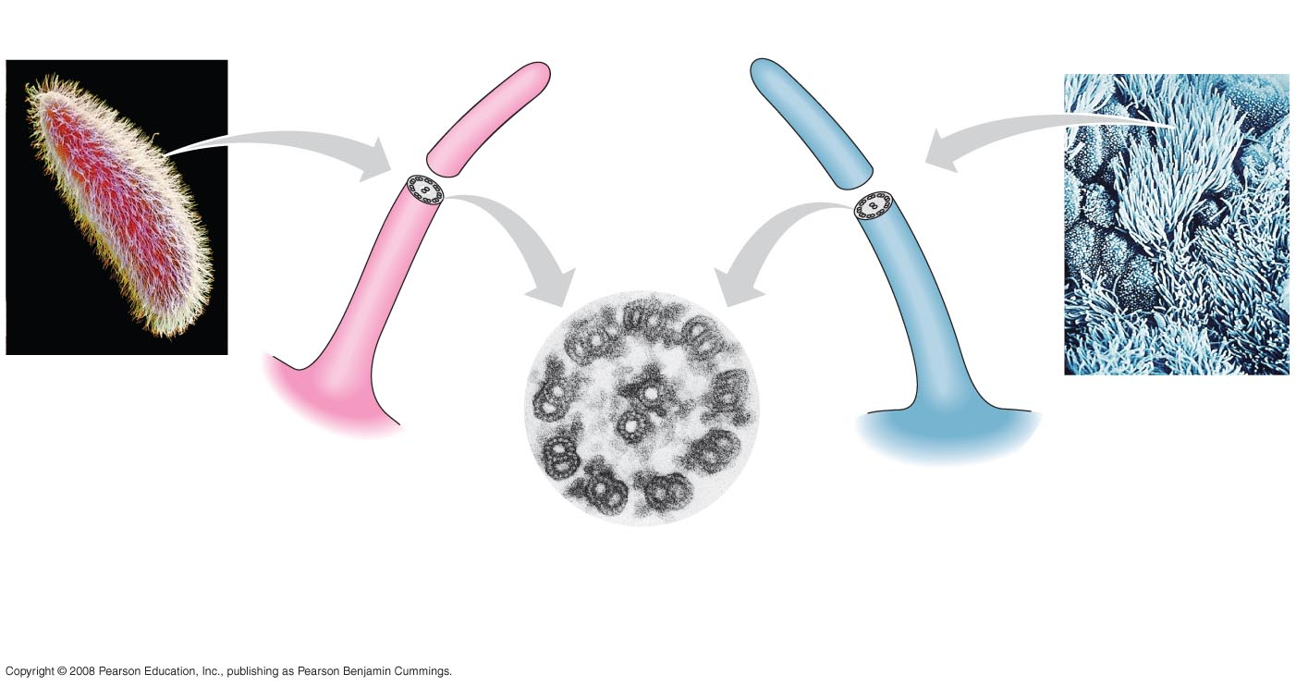
Fig. 1-16
15 µm
5 µm
Cilia of
Paramecium
Cilia of
windpipe
cells
0.1 µm
Cross section of a cilium, as viewed
with an electron microscope
Notes:
Figure 1.16 An example of unity underlying the diversity of life: the architecture of cilia in eukaryotes

Slide 77
Charles Darwin and the Theory of Natural Selection
Fossils and other evidence document the evolution of life on Earth over billions of years
Copyright © 2008 Pearson Education, Inc., publishing as Pearson Benjamin Cummings

Slide 78
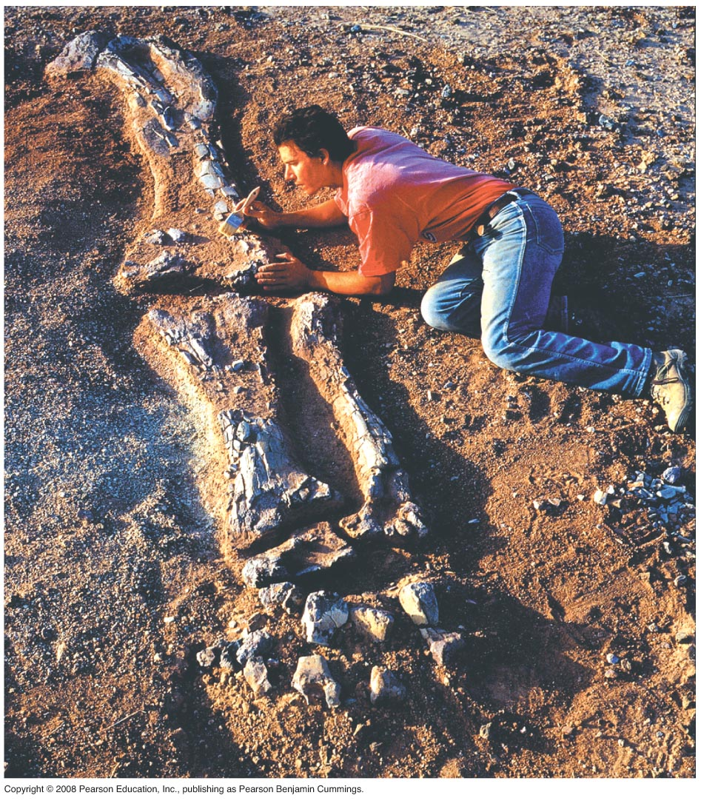
Fig. 1-17
Notes:
Figure 1.17 Digging into the past

Slide 79
Charles Darwin published On the Origin of Species by Means of Natural Selection in 1859
Darwin made two main points:
Species showed evidence of “descent with modification” from common ancestors
Natural selection is the mechanism behind “descent with modification”
Darwin’s theory explained the duality of unity and diversity
Copyright © 2008 Pearson Education, Inc., publishing as Pearson Benjamin Cummings

Slide 80
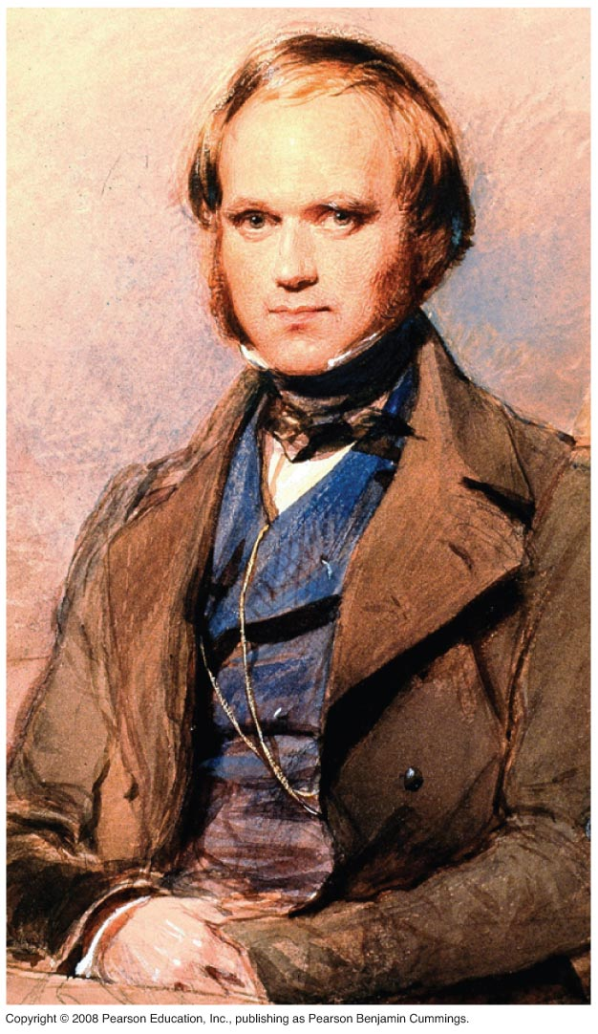
Fig. 1-18
Notes:
Figure 1.18 Charles Darwin as a young man

