Slide 1
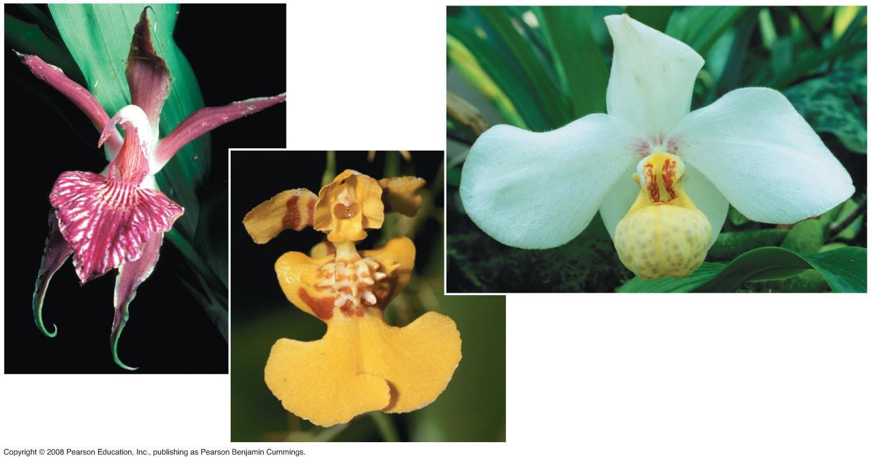
Fig. 1-19
Notes:
Fig 1.19 Unity and diversity in the orchid family

Slide 2
Darwin observed that:
Individuals in a population have traits that vary
Many of these traits are heritable (passed from parents to offspring)
More offspring are produced than survive
Competition is inevitable
Species generally suit their environment
Copyright © 2008 Pearson Education, Inc., publishing as Pearson Benjamin Cummings

Slide 3
Darwin inferred that:
Individuals that are best suited to their environment are more likely to survive and reproduce
Over time, more individuals in a population will have the advantageous traits
In other words, the natural environment “selects” for beneficial traits
Copyright © 2008 Pearson Education, Inc., publishing as Pearson Benjamin Cummings

Slide 4
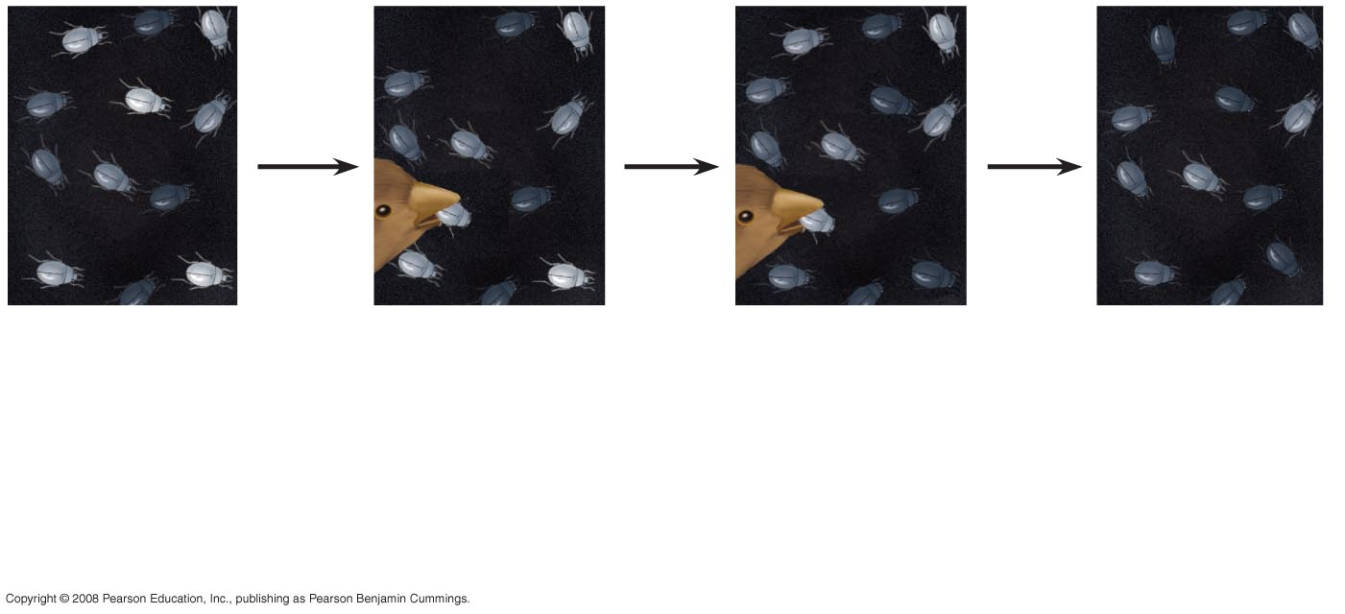
Fig. 1-20
1
Population
with varied
inherited traits.
2
Elimination
of individuals
with certain
traits.
3
Reproduction
of survivors.
4
Increasing
frequency
of traits that enhance survival and reproductive success.
Notes:
Figure 1.20 Natural selection

Slide 5
Natural selection is often evident in adaptations of organisms to their way of life and environment
Bat wings are an example of adaptation
Video: Soaring Hawk
Copyright © 2008 Pearson Education, Inc., publishing as Pearson Benjamin Cummings

Slide 6
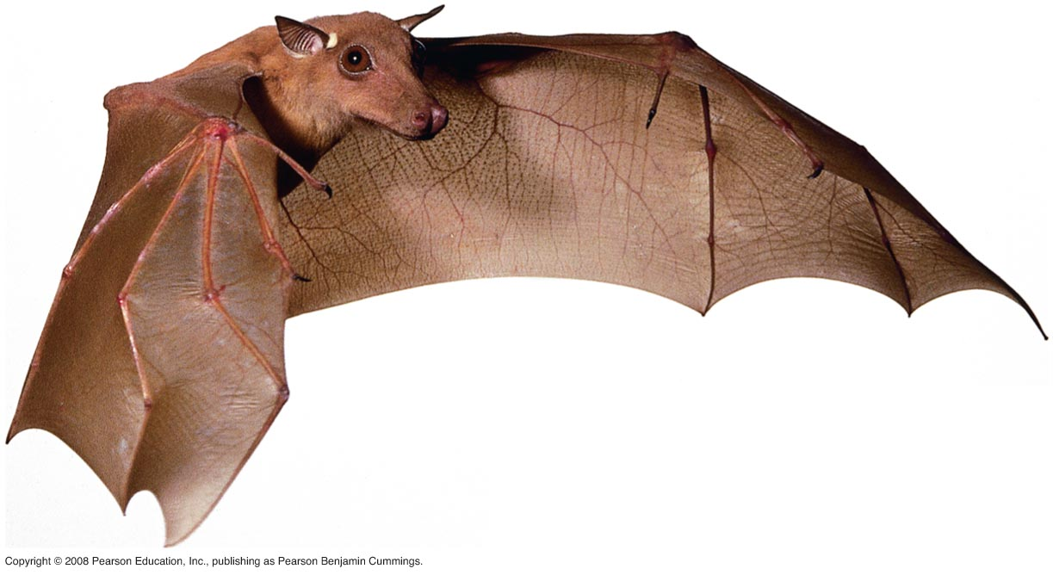
Fig. 1-21
Notes:
Figure 1.21 Evolutionary adaptation

Slide 7
The Tree of Life
“Unity in diversity” arises from “descent with modification”
For example, the forelimb of the bat, human, horse and the whale flipper all share a common skeletal architecture
Fossils provide additional evidence of anatomical unity from descent with modification
Copyright © 2008 Pearson Education, Inc., publishing as Pearson Benjamin Cummings

Slide 8
Darwin proposed that natural selection could cause an ancestral species to give rise to two or more descendent species
For example, the finch species of the Galápagos Islands
Evolutionary relationships are often illustrated with tree-like diagrams that show ancestors and their descendents
Copyright © 2008 Pearson Education, Inc., publishing as Pearson Benjamin Cummings

Slide 9
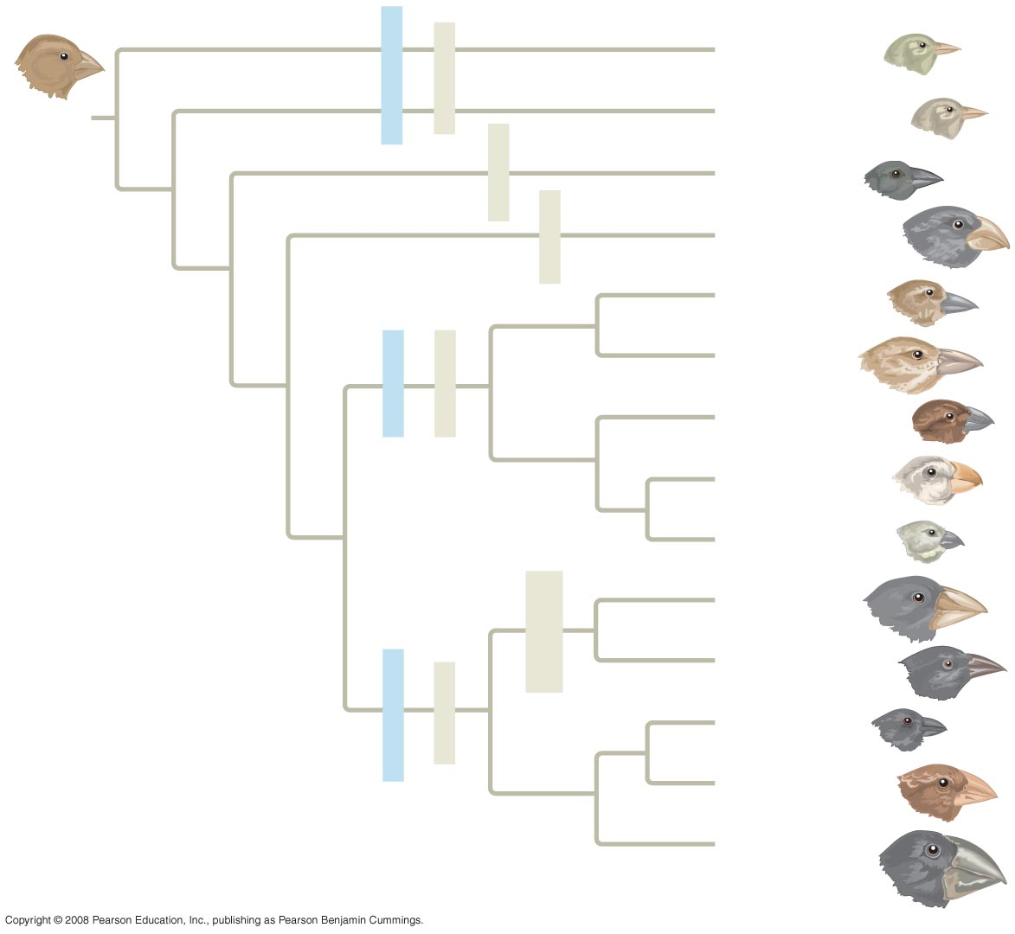
Fig. 1-22
Green warbler finch Certhidea olivacea
Warbler finches
Insect-eaters
COMMON
ANCESTOR
Gray warbler finch Certhidea fusca
Seed-eater
Sharp-beaked
ground finch Geospiza difficilis
Bud-eater
Vegetarian finch Platyspiza crassirostris
Mangrove finch Cactospiza heliobates
Woodpecker finch Cactospiza pallida
Tree finches
Insect-eaters
Medium tree finch Camarhynchus pauper
Large tree finch Camarhynchus psittacula
Small tree finch Camarhynchus parvulus
Large cactus
ground finch
Geospiza conirostris
Cactus-flower-eaters
Cactus ground finch
Geospiza scandens
Seed-eaters
Ground finches
Small ground finch
Geospiza fuliginosa
Medium ground finch
Geospiza fortis
Large ground finch
Geospiza magnirostris
Notes:
Figure 1.22 Descent with modification: adaptive radiation of finches on the Galápagos Islands

Slide 10
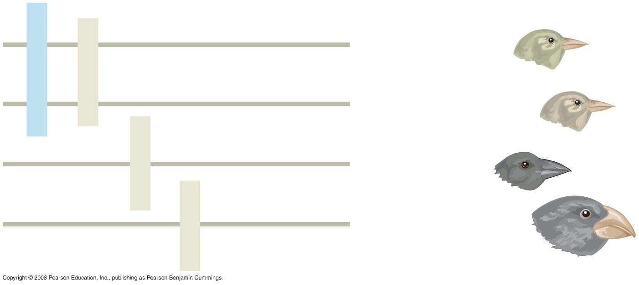
Fig. 1-22a
Green warbler finch Certhidea olivacea
Warbler finches
Insect-eaters
Gray warbler finch Certhidea fusca
Seed-eater
Sharp-beaked
ground finch Geospiza difficilis
Bud-eater
Vegetarian finch Platyspiza crassirostris
Notes:
Figure 1.22 Descent with modification: adaptive radiation of finches on the Galápagos Islands

Slide 11
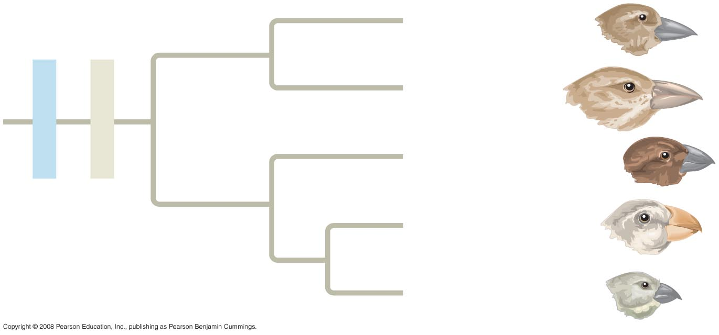
Fig. 1-22b
Mangrove finch Cactospiza heliobates
Woodpecker finch Cactospiza pallida
Tree finches
Insect-eaters
Medium tree finch Camarhynchus pauper
Large tree finch Camarhynchus psittacula
Small tree finch Camarhynchus parvulus
Notes:
Figure 1.22 Descent with modification: adaptive radiation of finches on the Galápagos Islands

Slide 12
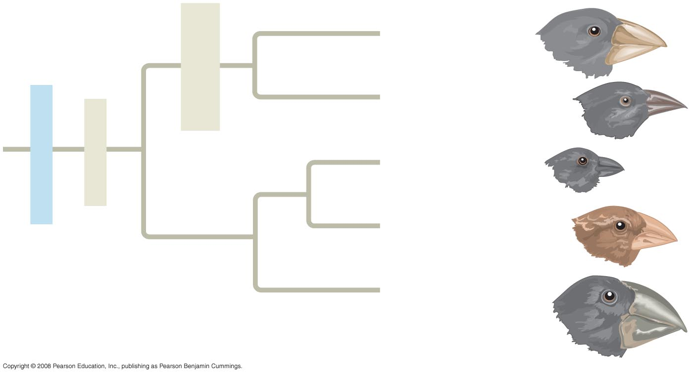
Fig. 1-22c
Large cactus
ground finch
Geospiza conirostris
Cactus-flower-eaters
Cactus ground finch
Geospiza scandens
Seed-eaters
Ground finches
Small ground finch
Geospiza fuliginosa
Medium ground finch
Geospiza fortis
Large ground finch
Geospiza magnirostris
Notes:
Figure 1.22 Descent with modification: adaptive radiation of finches on the Galápagos Islands

Slide 13
Video: Albatross Courtship Ritual
Video: Blue-footed Boobies Courtship Ritual
Video: Galápagos Islands Overview
Video: Galápagos Marine Iguana
Video: Galápagos Sea Lion
Video: Galápagos Tortoise
Copyright © 2008 Pearson Education, Inc., publishing as Pearson Benjamin Cummings

Slide 14
Concept 1.3: Scientists use two main forms of inquiry in their study of nature
The word Science is derived from Latin and means “to know”
Inquiry is the search for information and explanation
There are two main types of scientific inquiry: discovery science and hypothesis-based science
Copyright © 2008 Pearson Education, Inc., publishing as Pearson Benjamin Cummings

Slide 15
Discovery Science
Discovery science describes natural structures and processes
This approach is based on observation and the analysis of data
Copyright © 2008 Pearson Education, Inc., publishing as Pearson Benjamin Cummings

Slide 16
Types of Data
Data are recorded observations or items of information
Data fall into two categories
Qualitative, or descriptions rather than measurements
Quantitative, or recorded measurements, which are sometimes organized into tables and graphs
Copyright © 2008 Pearson Education, Inc., publishing as Pearson Benjamin Cummings

Slide 17
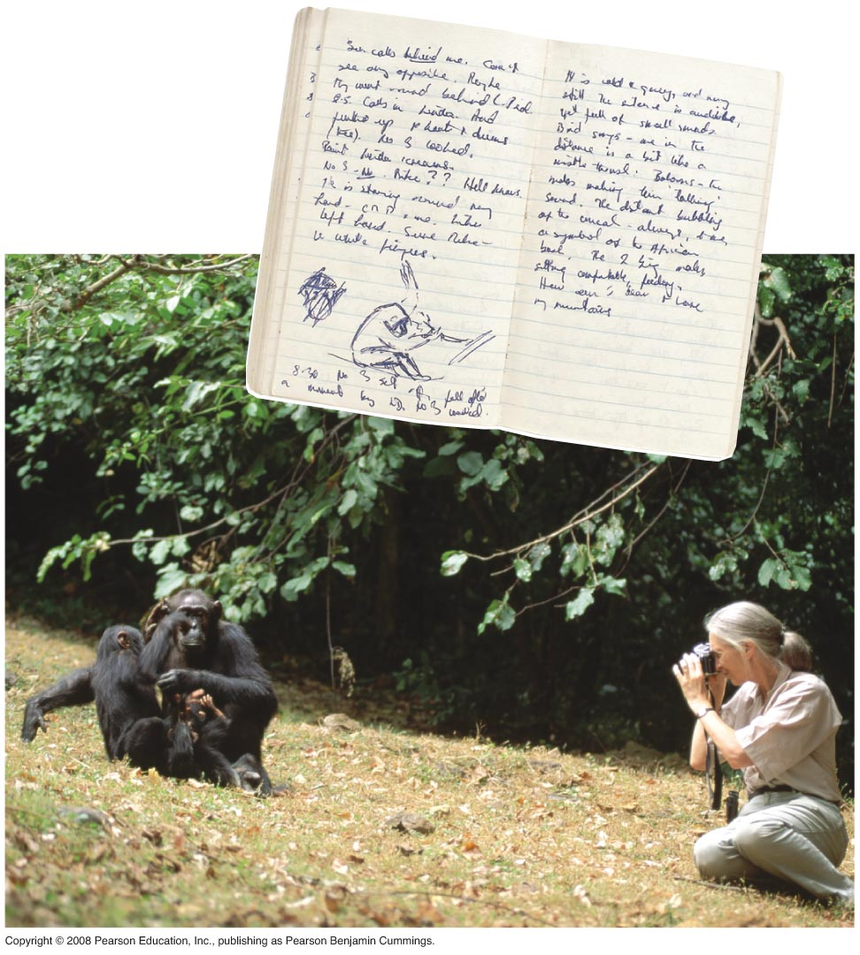
Fig. 1-23
Notes:
Figure 1.23 Jane Goodall collecting qualitative data on chimpanzee behavior

Slide 18
Induction in Discovery Science
Inductive reasoning draws conclusions through the logical process of induction
Repeat specific observations can lead to important generalizations
For example, “the sun always rises in the east”
Copyright © 2008 Pearson Education, Inc., publishing as Pearson Benjamin Cummings

Slide 19
Hypothesis-Based Science
Observations can lead us to ask questions and propose hypothetical explanations called hypotheses
Copyright © 2008 Pearson Education, Inc., publishing as Pearson Benjamin Cummings

Slide 20
The Role of Hypotheses in Inquiry
A hypothesis is a tentative answer to a well-framed question
A scientific hypothesis leads to predictions that can be tested by observation or experimentation
Copyright © 2008 Pearson Education, Inc., publishing as Pearson Benjamin Cummings

Slide 21
For example,
Observation: Your flashlight doesn’t work
Question: Why doesn’t your flashlight work?
Hypothesis 1: The batteries are dead
Hypothesis 2: The bulb is burnt out
Both these hypotheses are testable
Copyright © 2008 Pearson Education, Inc., publishing as Pearson Benjamin Cummings

Slide 22
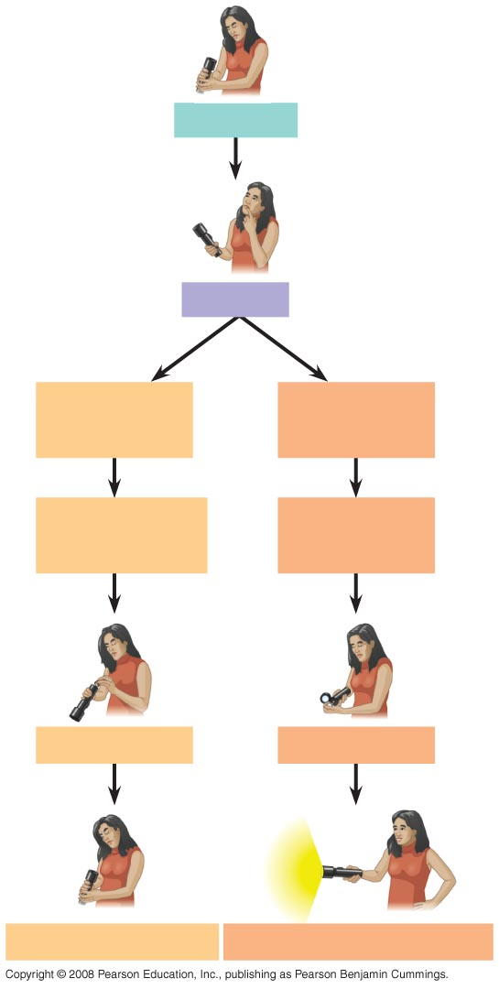
Fig. 1-24
Observations
Question
Hypothesis #1:
Dead batteries
Hypothesis #2:
Burnt-out bulb
Prediction:
Replacing batteries
will fix problem
Prediction:
Replacing bulb
will fix problem
Test prediction
Test prediction
Test falsifies hypothesis
Test does not falsify hypothesis
Notes:
Figure 1.24 A campground example of hypothesis-based inquiry

Slide 23
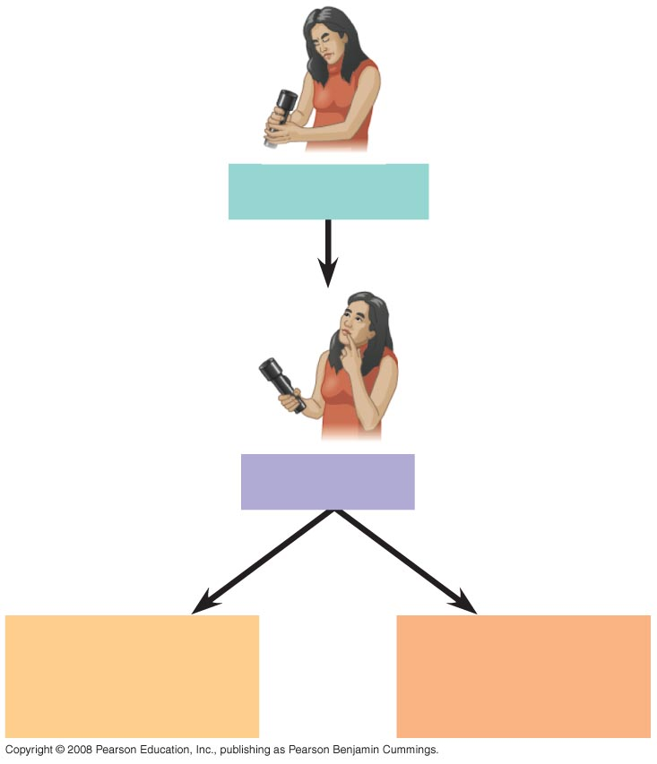
Fig. 1-24a
Observations
Question
Hypothesis #1:
Dead batteries
Hypothesis #2:
Burnt-out bulb
Notes:
Figure 1.24 A campground example of hypothesis-based inquiry

Slide 24
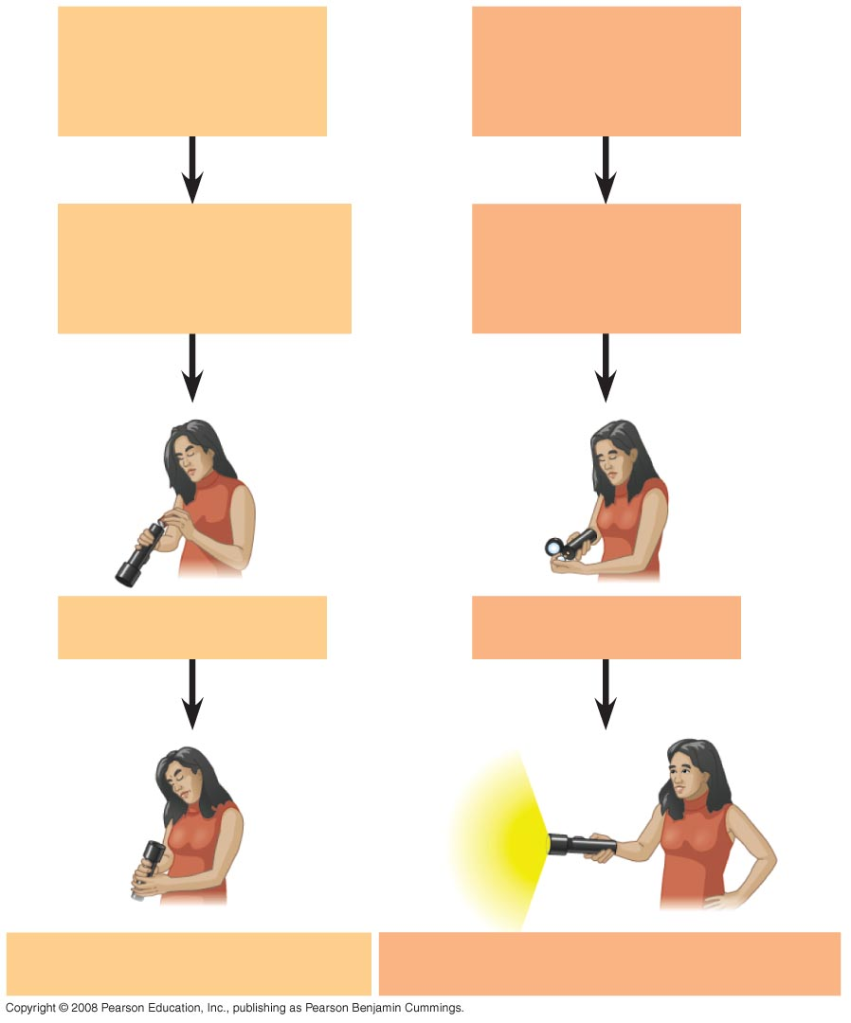
Fig. 1-24b
Hypothesis #1:
Dead batteries
Hypothesis #2:
Burnt-out bulb
Prediction:
Replacing batteries
will fix problem
Prediction:
Replacing bulb
will fix problem
Test prediction
Test prediction
Test falsifies hypothesis
Test does not falsify hypothesis
Notes:
Figure 1.24 A campground example of hypothesis-based inquiry

Slide 25
Deduction: The “If…Then” Logic of Hypothesis Based Science
Deductive reasoning uses general premises to make specific predictions
For example, if organisms are made of cells (premise 1), and humans are organisms (premise 2), then humans are composed of cells (deductive prediction)
Copyright © 2008 Pearson Education, Inc., publishing as Pearson Benjamin Cummings

Slide 26
A Closer Look at Hypotheses in Scientific Inquiry
A hypothesis must be testable and falsifiable
Hypothesis-based science often makes use of two or more alternative hypotheses
Failure to falsify a hypothesis does not prove that hypothesis
For example, you replace your flashlight bulb, and it now works; this supports the hypothesis that your bulb was burnt out, but does not prove it (perhaps the first bulb was inserted incorrectly)
Copyright © 2008 Pearson Education, Inc., publishing as Pearson Benjamin Cummings

Slide 27
The Myth of the Scientific Method
The scientific method is an idealized process of inquiry
Hypothesis-based science is based on the “textbook” scientific method but rarely follows all the ordered steps
Discovery science has made important contributions with very little dependence on the so-called scientific method
Copyright © 2008 Pearson Education, Inc., publishing as Pearson Benjamin Cummings

Slide 28
A Case Study in Scientific Inquiry: Investigating Mimicry in Snake Populations
Many poisonous species are brightly colored, which warns potential predators
Mimics are harmless species that closely resemble poisonous species
Henry Bates hypothesized that this mimicry evolved in harmless species as an evolutionary adaptation that reduces their chances of being eaten
Copyright © 2008 Pearson Education, Inc., publishing as Pearson Benjamin Cummings

Slide 29
This hypothesis was tested with the poisonous eastern coral snake and its mimic the nonpoisonous scarlet kingsnake
Both species live in the Carolinas, but the kingsnake is also found in regions without poisonous coral snakes
If predators inherit an avoidance of the coral snake’s coloration, then the colorful kingsnake will be attacked less often in the regions where coral snakes are present
Copyright © 2008 Pearson Education, Inc., publishing as Pearson Benjamin Cummings

Slide 30
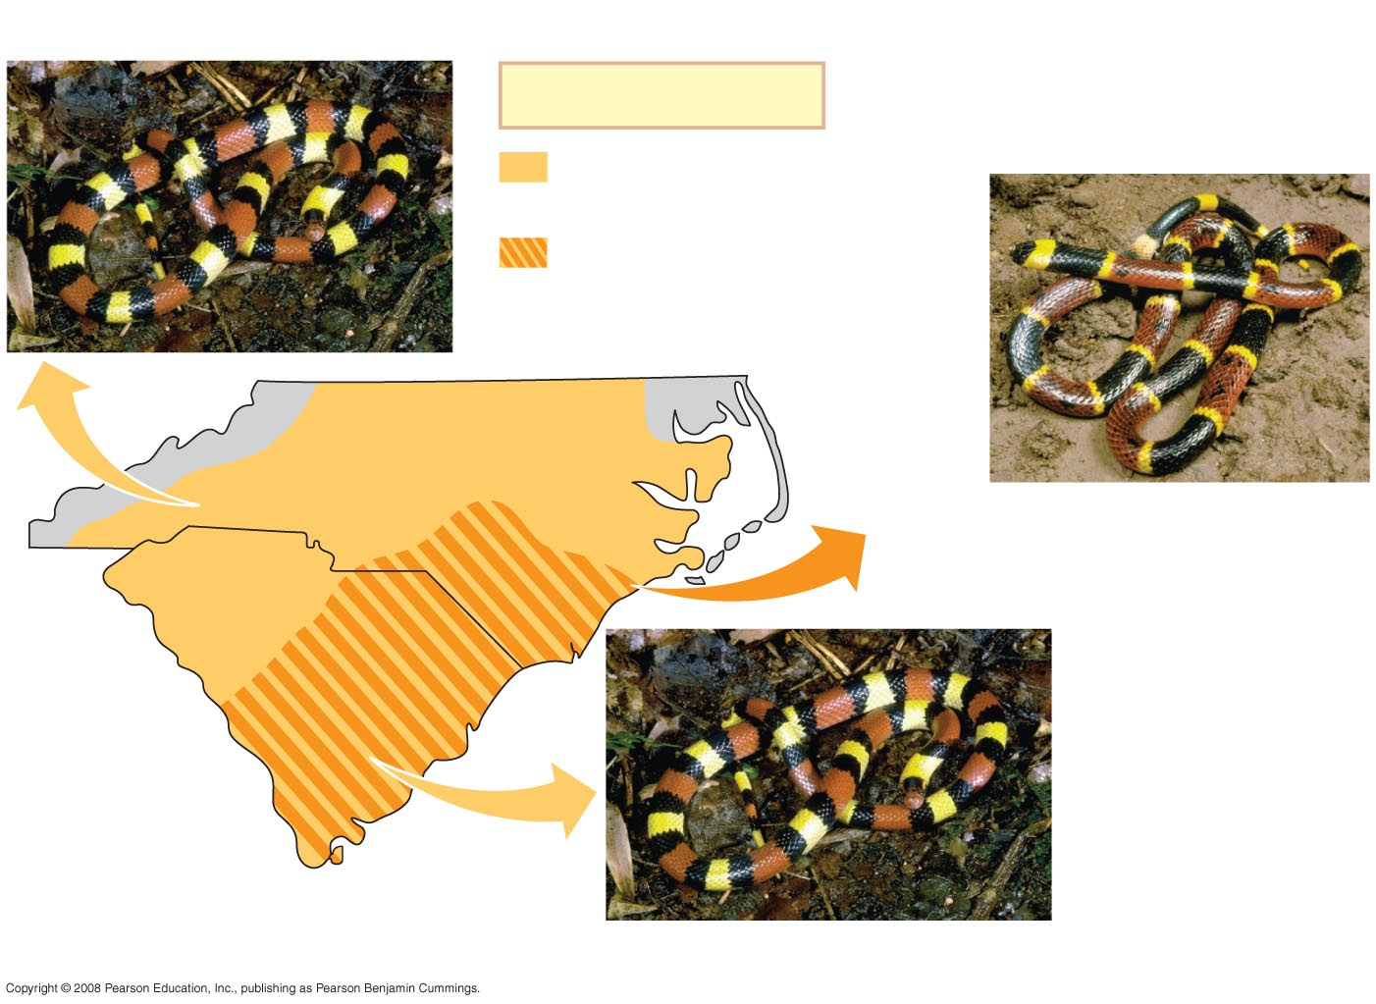
Fig. 1-25
Scarlet kingsnake (nonpoisonous)
Key
Range of scarlet
kingsnake only
Overlapping ranges of
scarlet kingsnake and
eastern coral snake
North Carolina
Eastern coral snake (poisonous)
South Carolina
Scarlet kingsnake (nonpoisonous)
Notes:
Figure 1.25 The geographic ranges of a poisonous snake and its mimic

Slide 31
Field Experiments with Artificial Snakes
To test this mimicry hypothesis, researchers made hundreds of artificial snakes:
An experimental group resembling kingsnakes
A control group resembling plain brown snakes
Equal numbers of both types were placed at field sites, including areas without poisonous coral snakes
Copyright © 2008 Pearson Education, Inc., publishing as Pearson Benjamin Cummings

Slide 32
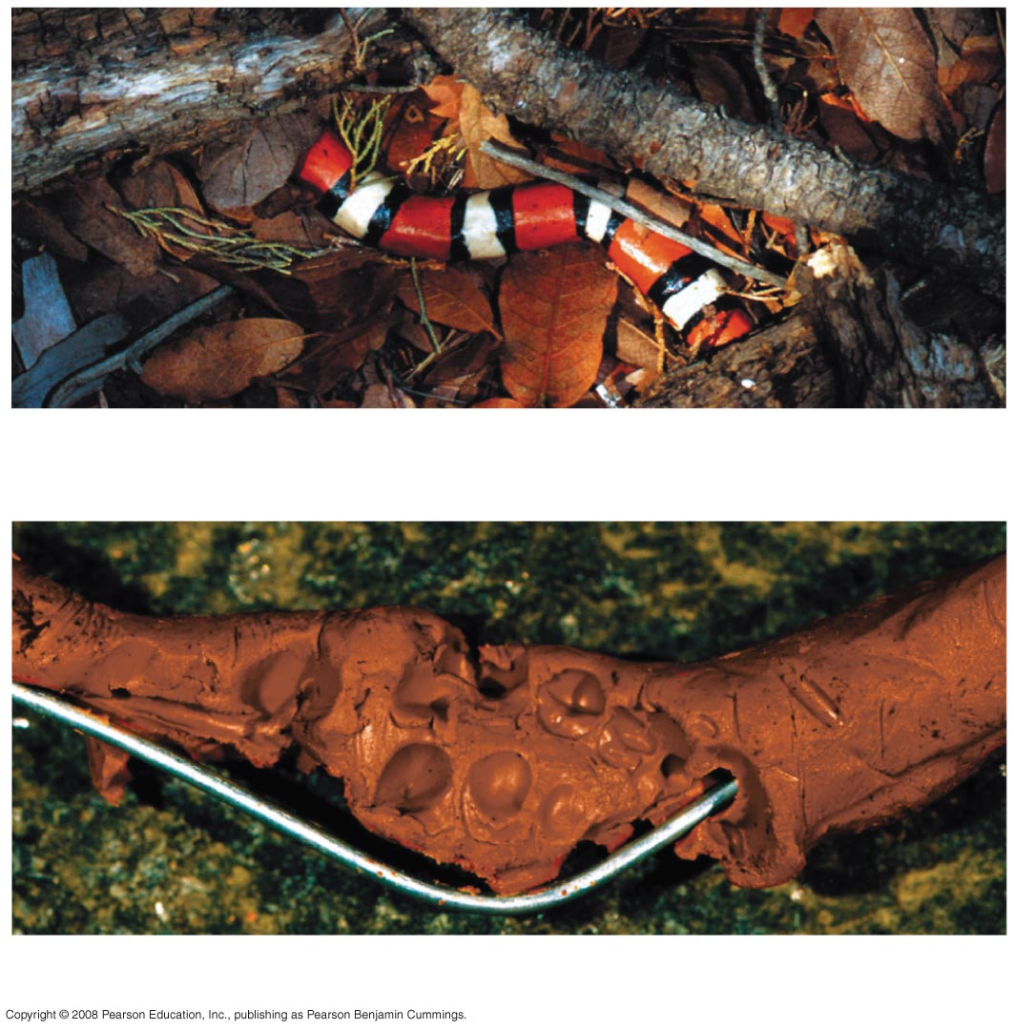
Fig. 1-26
(a) Artificial kingsnake
(b) Brown artificial snake that has been attacked
Notes:
Figure 1.26 Artificial snakes used in field experiments to test the mimicry hypothesis

Slide 33
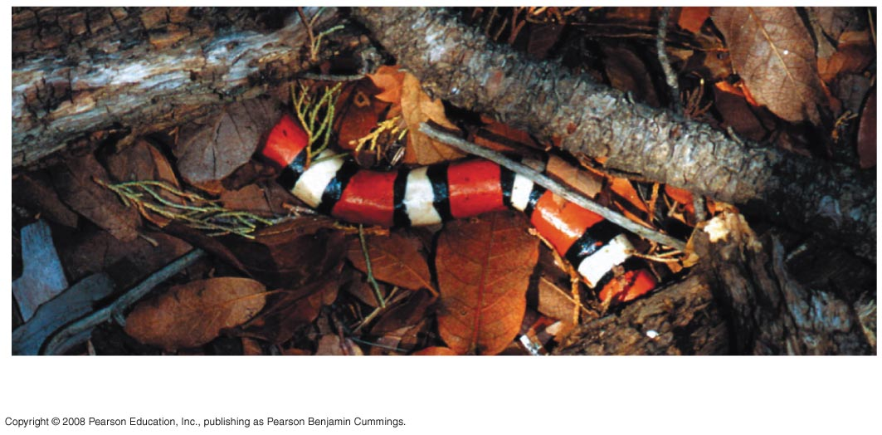
Fig. 1-26a
(a) Artificial kingsnake
Notes:
Figure 1.26 Artificial snakes used in field experiments to test the mimicry hypothesis

Slide 34
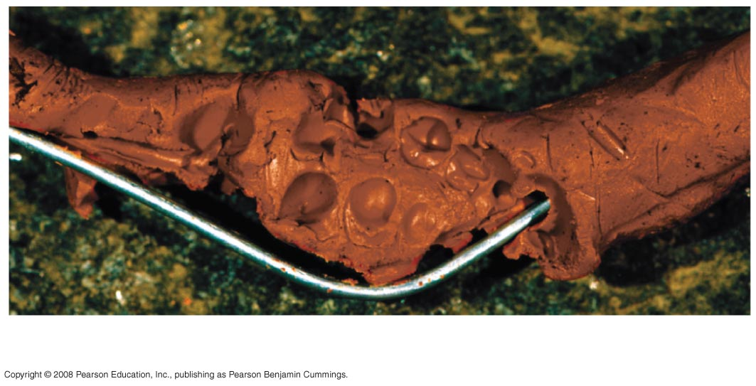
Fig. 1-26b
(b) Brown artificial snake that has been attacked
Notes:
Figure 1.26 Artificial snakes used in field experiments to test the mimicry hypothesis

Slide 35
After four weeks, the scientists retrieved the artificial snakes and counted bite or claw marks
The data fit the predictions of the mimicry hypothesis: the ringed snakes were attacked less frequently in the geographic region where coral snakes were found
Copyright © 2008 Pearson Education, Inc., publishing as Pearson Benjamin Cummings

Slide 36
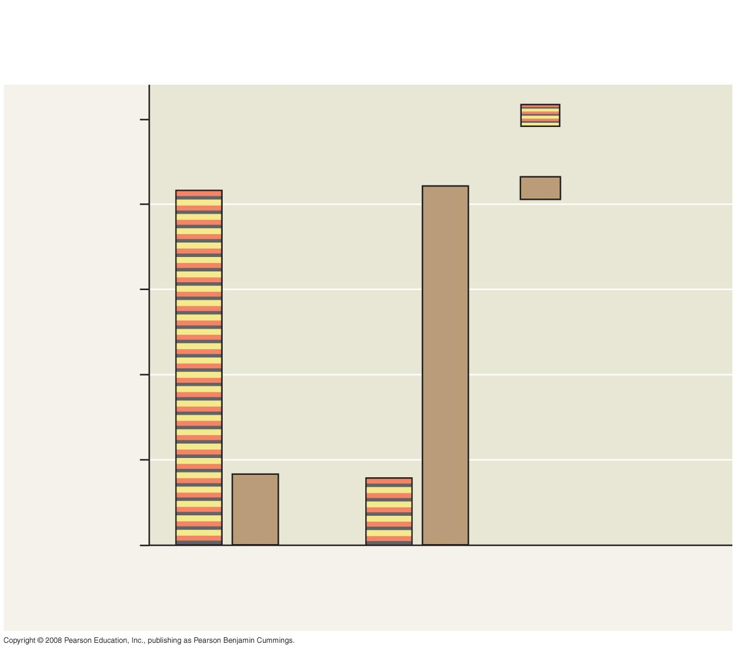
Fig. 1-27
RESULTS
100
Artificial kingsnakes
83%
84%
Brown
artificial snakes
80
60
Percent of total attacks
on artificial snakes
40
20
17%
16%
0
Coral snakes
absent
Coral snakes
present
Notes:
Figure 1.27 Does the presence of poisonous coral snakes affect predation rates on their mimics, kingsnakes?

Slide 37
Designing Controlled Experiments
A controlled experiment compares an experimental group (the artificial kingsnakes) with a control group (the artificial brown snakes)
Ideally, only the variable of interest (the color pattern of the artificial snakes) differs between the control and experimental groups
A controlled experiment means that control groups are used to cancel the effects of unwanted variables
A controlled experiment does not mean that all unwanted variables are kept constant
Copyright © 2008 Pearson Education, Inc., publishing as Pearson Benjamin Cummings

Slide 38
Limitations of Science
In science, observations and experimental results must be repeatable
Science cannot support or falsify supernatural explanations, which are outside the bounds of science
Copyright © 2008 Pearson Education, Inc., publishing as Pearson Benjamin Cummings

Slide 39
Theories in Science
In the context of science, a theory is:
Broader in scope than a hypothesis
General, and can lead to new testable hypotheses
Supported by a large body of evidence in comparison to a hypothesis
Copyright © 2008 Pearson Education, Inc., publishing as Pearson Benjamin Cummings

Slide 40
Model Building in Science
Models are representations of natural phenomena and can take the form of:
Diagrams
Three-dimensional objects
Computer programs
Mathematical equations
Copyright © 2008 Pearson Education, Inc., publishing as Pearson Benjamin Cummings

Slide 41
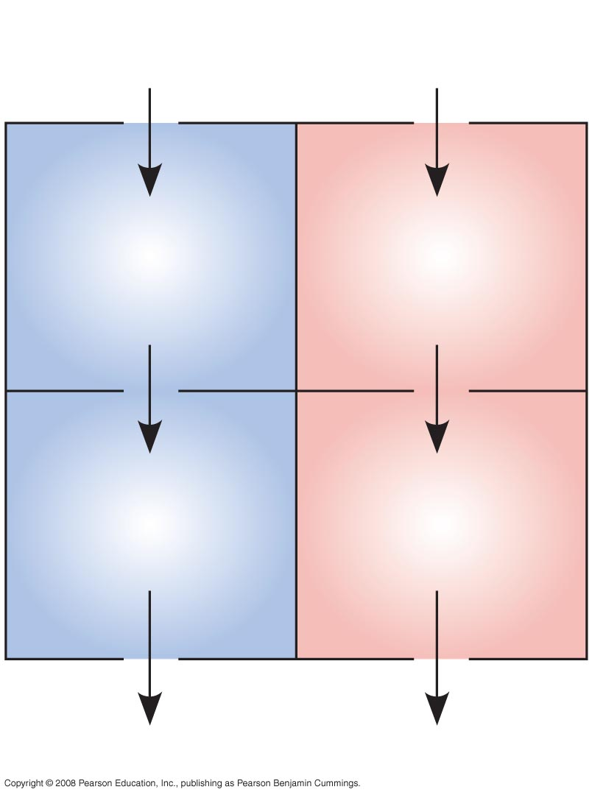
Fig. 1-28
From
body
From
lungs
Right
atrium
Left
atrium
Right
ventricle
Left
ventricle
To lungs
To body
Notes:
Figure 1.28 A model of the blood flow through the four chambers of a human heart

Slide 42
The Culture of Science
Most scientists work in teams, which often include graduate and undergraduate students
Good communication is important in order to share results through seminars, publications, and websites
Copyright © 2008 Pearson Education, Inc., publishing as Pearson Benjamin Cummings

Slide 43
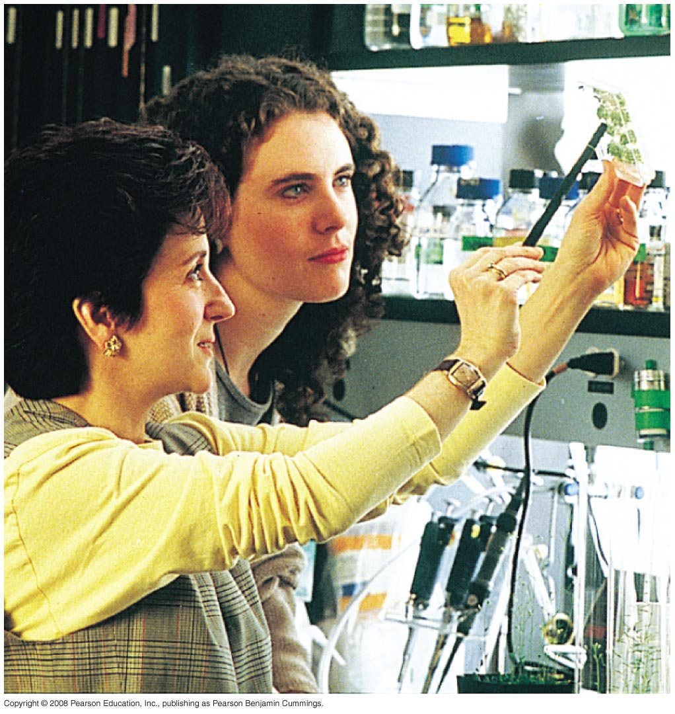
Fig. 1-29
Notes:
Figure 1.29 Science as a social process

Slide 44
Science, Technology, and Society
The goal of science is to understand natural phenomena
The goal of technology is to apply scientific knowledge for some specific purpose
Science and technology are interdependent
Biology is marked by “discoveries,” while technology is marked by “inventions”
Copyright © 2008 Pearson Education, Inc., publishing as Pearson Benjamin Cummings

Slide 45
The combination of science and technology has dramatic effects on society
For example, the discovery of DNA by James Watson and Francis Crick allowed for advances in DNA technology such as testing for hereditary diseases
Ethical issues can arise from new technology, but have as much to do with politics, economics, and cultural values as with science and technology
Copyright © 2008 Pearson Education, Inc., publishing as Pearson Benjamin Cummings

Slide 46
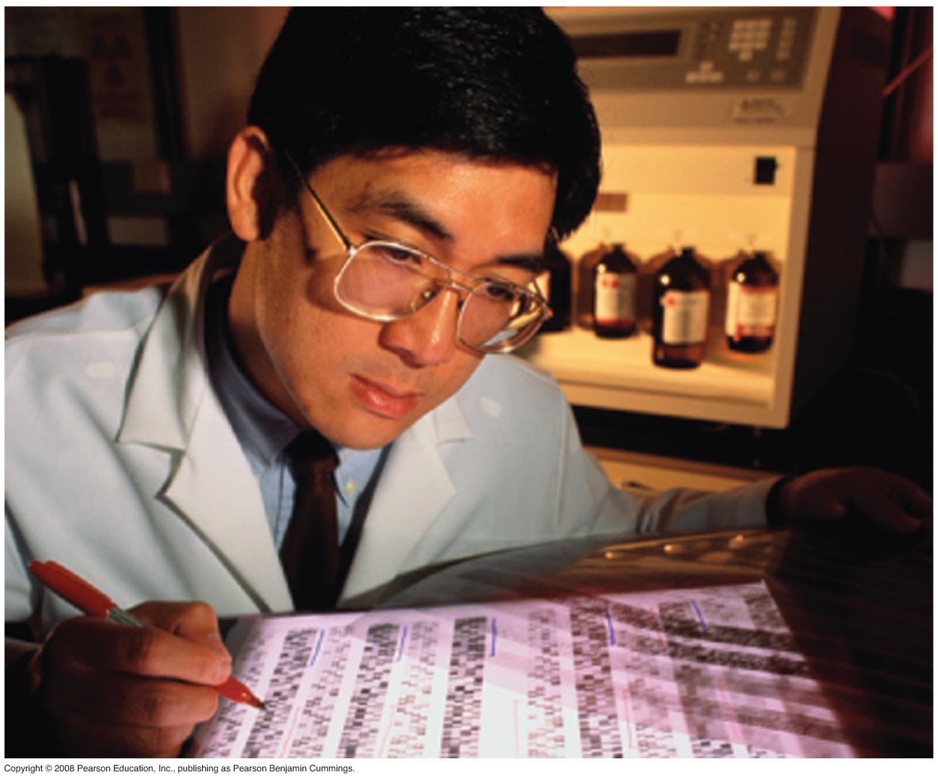
Fig. 1-30
Notes:
Figure 1.30 DNA technology and crime scene investigation

Slide 47
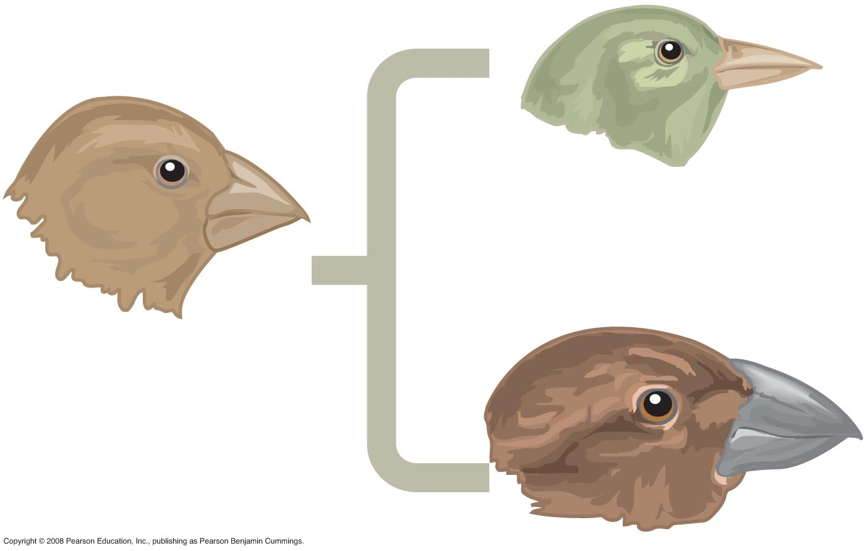
Fig. 1-UN1

Slide 48
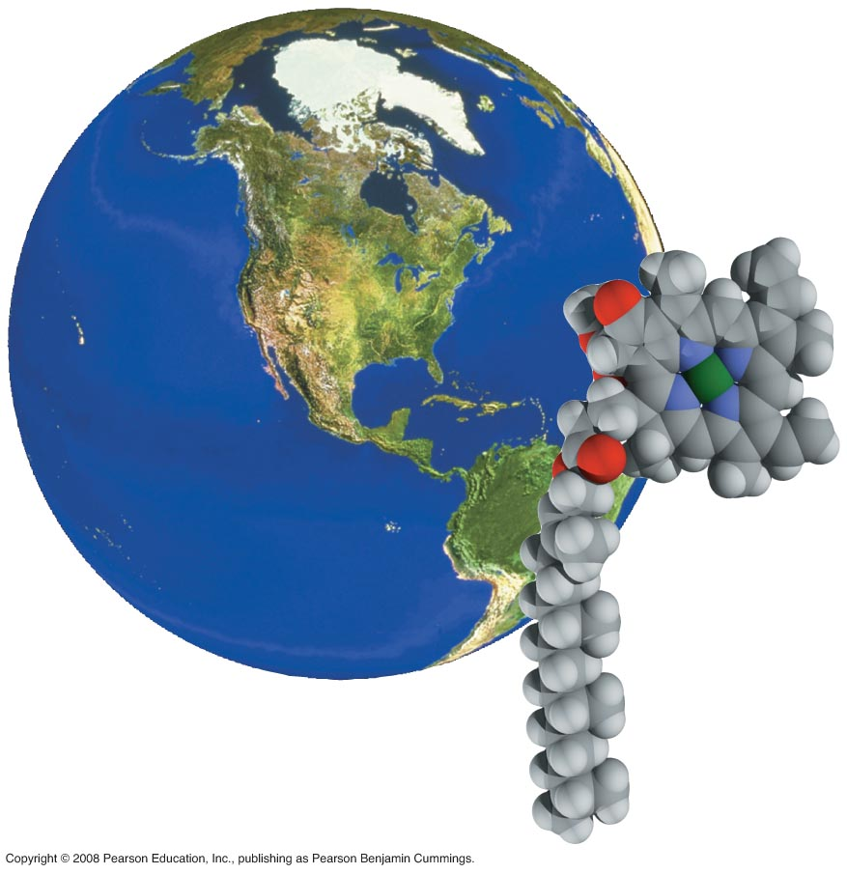
Fig. 1-UN2

Slide 49
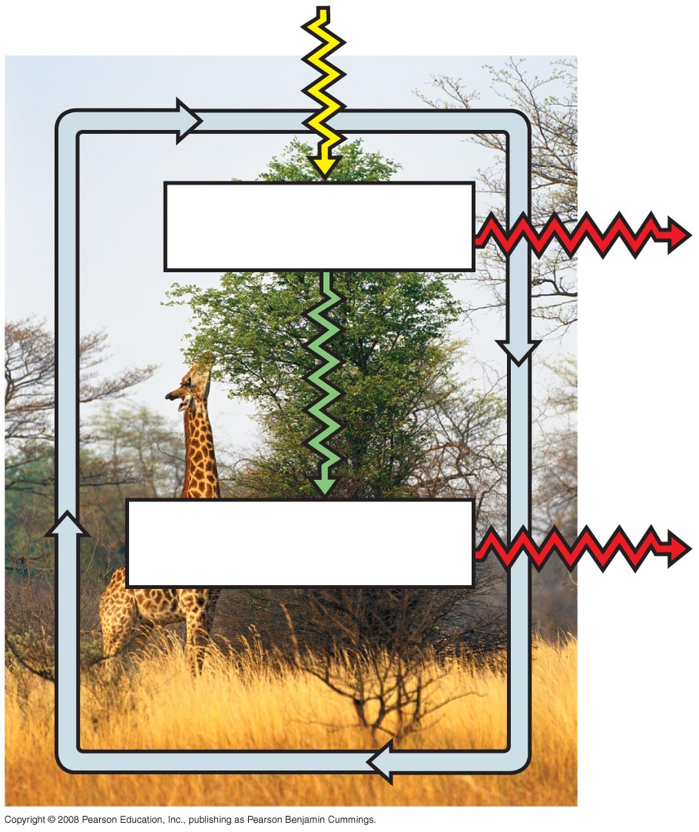
Fig. 1-UN3
Producers
Consumers

Slide 50
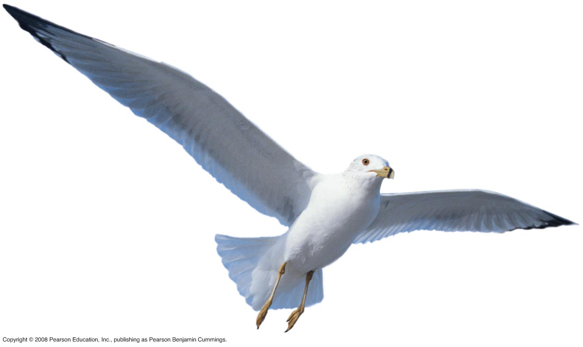
Fig. 1-UN4

Slide 51
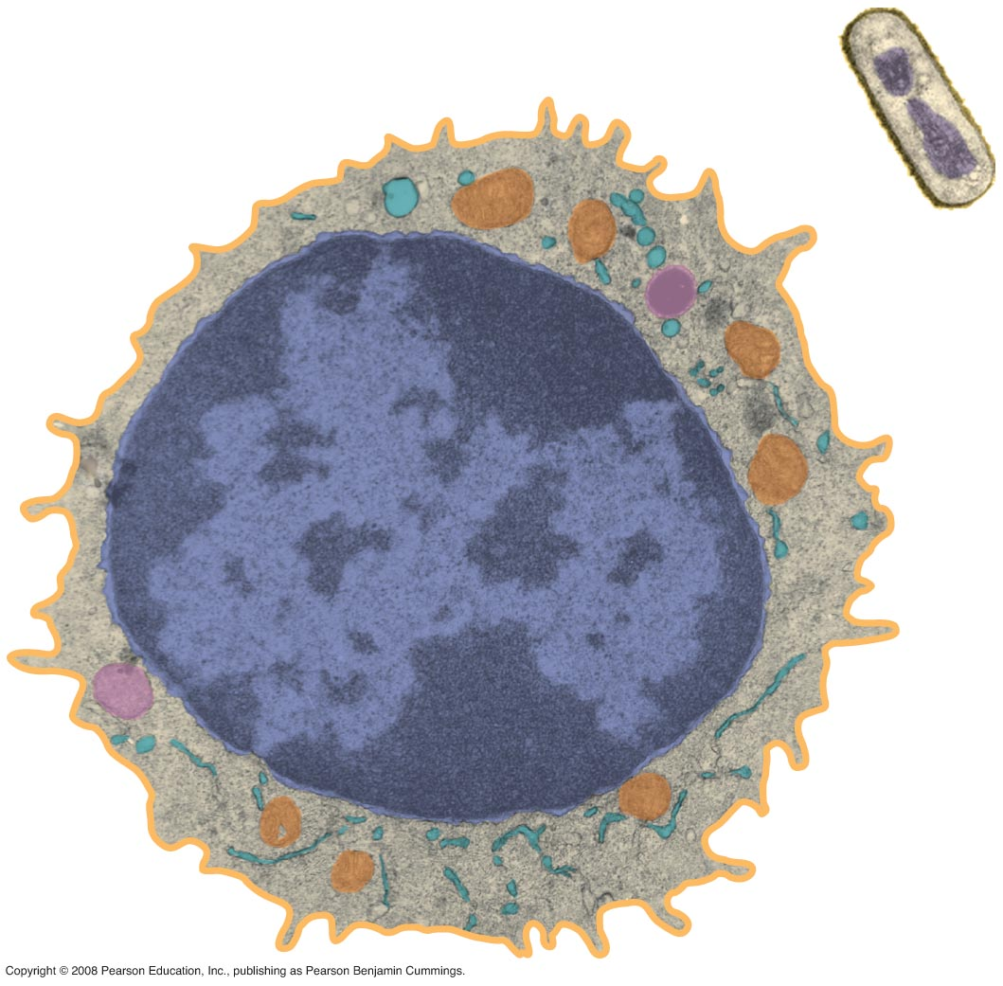
Fig. 1-UN5

Slide 52
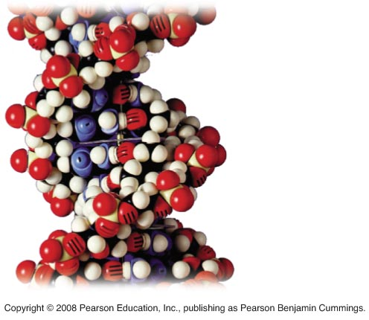
Fig. 1-UN6

Slide 53
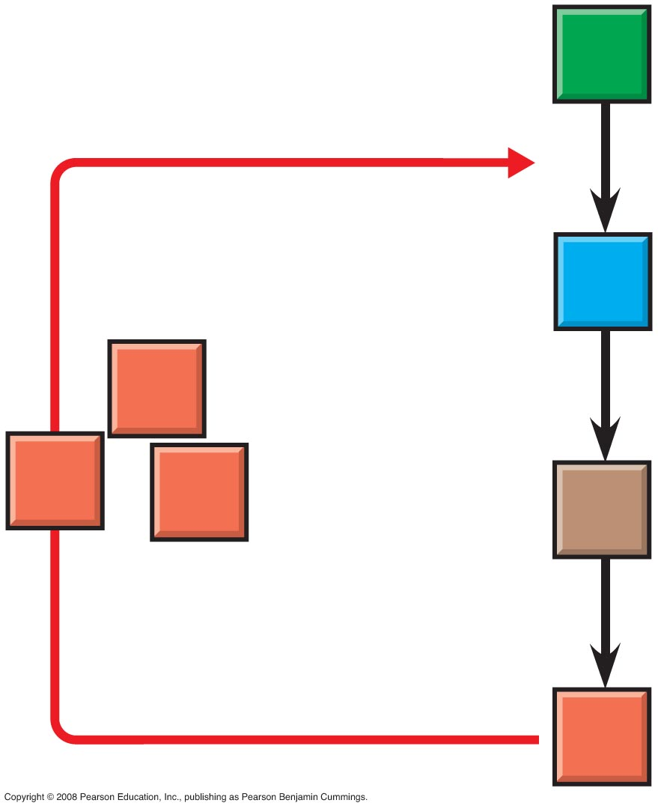
Fig. 1-UN7

Slide 54
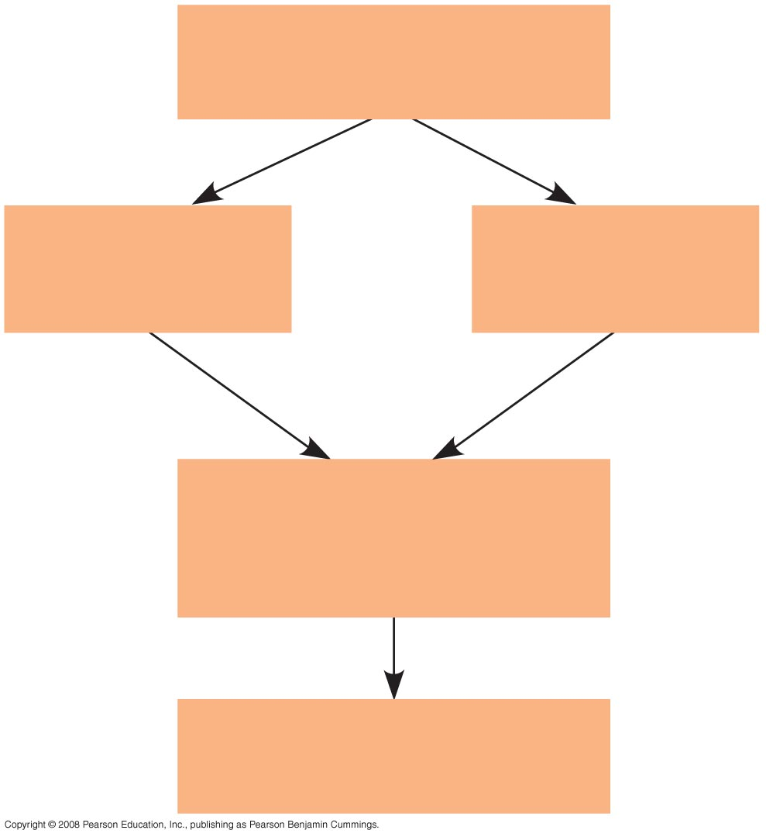
Fig. 1-UN8
Population
of organisms
Hereditary
variations
Overproduction
and competition
Environmental
factors
Differences in
reproductive success
of individuals
Evolution of adaptations
in the population

Slide 55
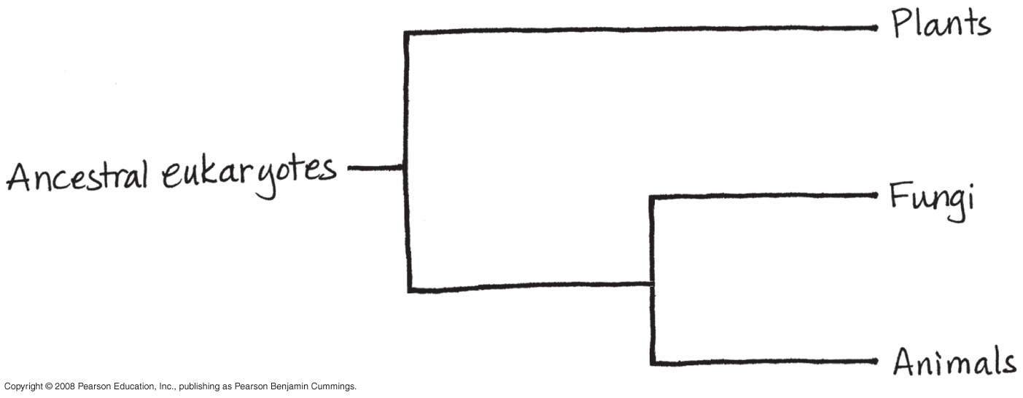
Fig. 1-UN9

Slide 56
You should now be able to:
Briefly describe the unifying themes that characterize the biological sciences
Distinguish among the three domains of life, and the eukaryotic kingdoms
Distinguish between the following pairs of terms: discovery science and hypothesis-based science, quantitative and qualitative data, inductive and deductive reasoning, science and technology
Copyright © 2008 Pearson Education, Inc., publishing as Pearson Benjamin Cummings

