Slide 1
Chapter 2
The Chemical Context of Life

Slide 2
Overview: A Chemical Connection to Biology
Biology is a multidisciplinary science
Living organisms are subject to basic laws of physics and chemistry
One example is the use of formic acid by ants to maintain “devil’s gardens,” stands of Duroia trees
Copyright © 2008 Pearson Education, Inc., publishing as Benjamin Cummings

Slide 3
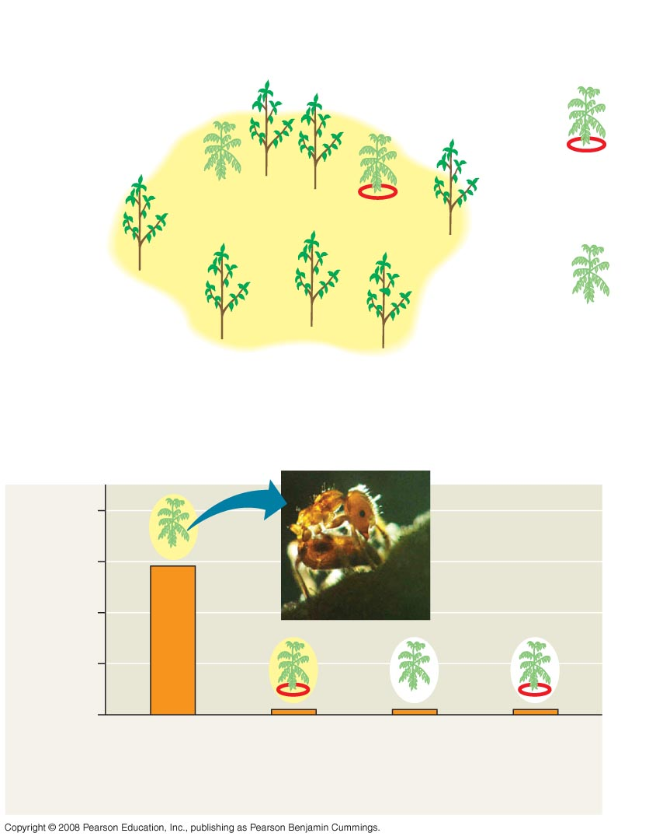
Fig. 2-2
EXPERIMENT
Cedrela
sapling
Insect
barrier
Duroia
tree
Outside,
protected
Inside,
unprotected
Inside,
protected
Devil’s
garden
Outside,
unprotected
RESULTS
16
12
Dead leaf tissue (cm²)
after one day
8
4
0
Inside,
unprotected
Inside,
protected
Outside,
unprotected
Outside,
protected
Cedrela saplings, inside and outside devil’s gardens
Notes:
Figure 2.2 What creates “devil’s gardens” in the rain forest?

Slide 4
Concept 2.1: Matter consists of chemical elements in pure form and in combinations called compounds
Organisms are composed of matter
Matter is anything that takes up space and has mass
Copyright © 2008 Pearson Education, Inc., publishing as Benjamin Cummings

Slide 5
Elements and Compounds
Matter is made up of elements
An element is a substance that cannot be broken down to other substances by chemical reactions
A compound is a substance consisting of two or more elements in a fixed ratio
A compound has characteristics different from those of its elements
Copyright © 2008 Pearson Education, Inc., publishing as Benjamin Cummings

Slide 6
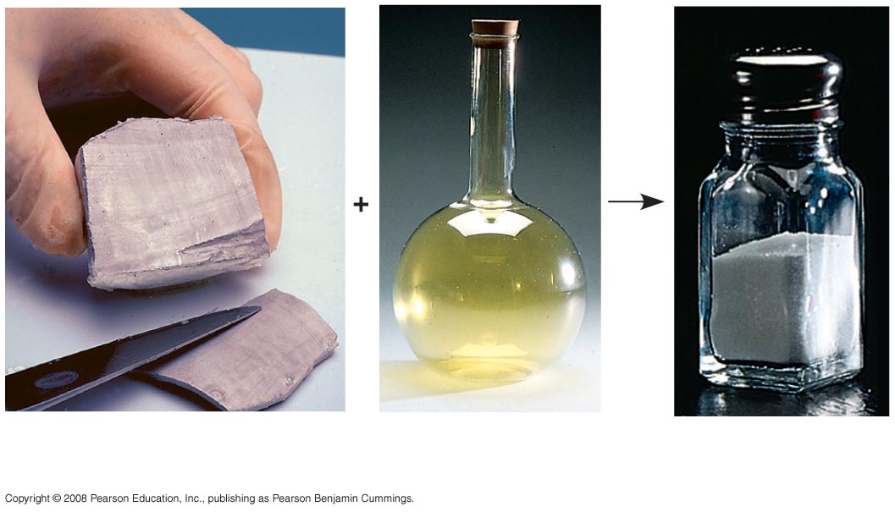
Fig. 2-3
Sodium
Chlorine
Sodium
chloride
Notes:
Figure 2.3 The emergent properties of a compound

Slide 7
Essential Elements of Life
About 25 of the 92 elements are essential to life
Carbon, hydrogen, oxygen, and nitrogen make up 96% of living matter
Most of the remaining 4% consists of calcium, phosphorus, potassium, and sulfur
Trace elements are those required by an organism in minute quantities
Copyright © 2008 Pearson Education, Inc., publishing as Benjamin Cummings

Slide 8
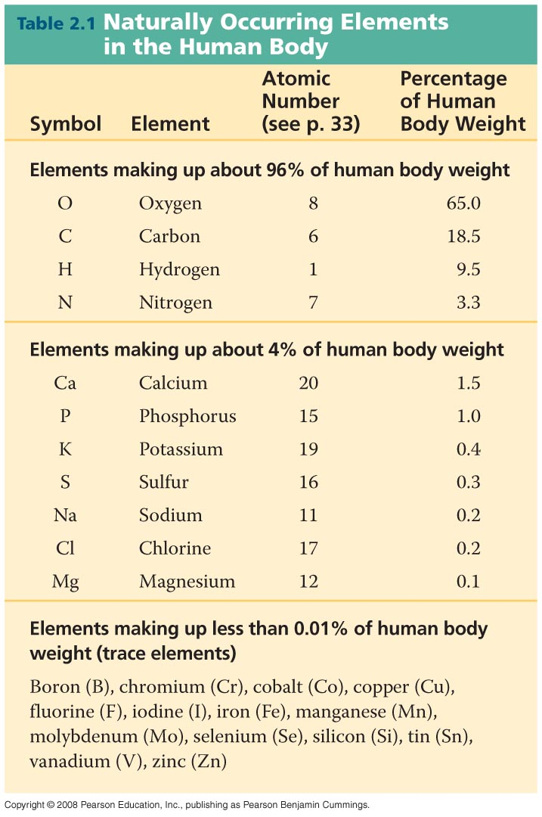
Table 2-1
Notes:
Table 2-1

Slide 9
Concept 2.2: An element’s properties depend on the structure of its atoms
Each element consists of unique atoms
An atom is the smallest unit of matter that still retains the properties of an element
Copyright © 2008 Pearson Education, Inc., publishing as Benjamin Cummings

Slide 10
Subatomic Particles
Atoms are composed of subatomic particles
Relevant subatomic particles include:
Neutrons (no electrical charge)
Protons (positive charge)
Electrons (negative charge)
Copyright © 2008 Pearson Education, Inc., publishing as Benjamin Cummings

Slide 11
Neutrons and protons form the atomic nucleus
Electrons form a cloud around the nucleus
Neutron mass and proton mass are almost identical and are measured in daltons
Copyright © 2008 Pearson Education, Inc., publishing as Benjamin Cummings

Slide 12
Fig. 2-5
Cloud of negative
charge (2 electrons)
Electrons
Nucleus
(a)
(b)
Notes:
Figure 2.5 Simplified models of a helium (He) atom

Slide 13
Atomic Number and Atomic Mass
Atoms of the various elements differ in number of subatomic particles
An element’s atomic number is the number of protons in its nucleus
An element’s mass number is the sum of protons plus neutrons in the nucleus
Atomic mass, the atom’s total mass, can be approximated by the mass number
Copyright © 2008 Pearson Education, Inc., publishing as Benjamin Cummings

Slide 14
Isotopes
All atoms of an element have the same number of protons but may differ in number of neutrons
Isotopes are two atoms of an element that differ in number of neutrons
Radioactive isotopes decay spontaneously, giving off particles and energy
Copyright © 2008 Pearson Education, Inc., publishing as Benjamin Cummings

Slide 15
Some applications of radioactive isotopes in biological research are:
Dating fossils
Tracing atoms through metabolic processes
Diagnosing medical disorders
Copyright © 2008 Pearson Education, Inc., publishing as Benjamin Cummings

Slide 16
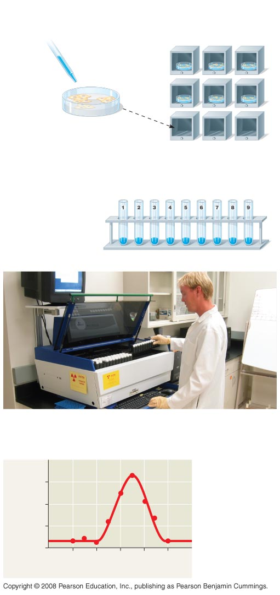
Fig. 2-6
TECHNIQUE
Compounds including
radioactive tracer
(bright blue)
Incubators
1
2
3
10°C
15°C
20°C
Human cells
4
5
6
25°C
30°C
35°C
1
Human
cells are
incubated
with compounds used to
make DNA. One compound is
labeled with ³H.
7
8
9
40°C
45°C
50°C
2
The cells are
placed in test
tubes; their DNA is
isolated; and
unused labeled
compounds are
removed.
DNA (old and new)
3
The test tubes are placed in a scintillation counter.
RESULTS
30
Optimum
temperature
for DNA
synthesis
Counts per minute
(× 1,000)
20
10
0
10
20
30
40
50
Temperature (ºC)
Notes:
Figure 2.6 Radioactive tracers

Slide 17
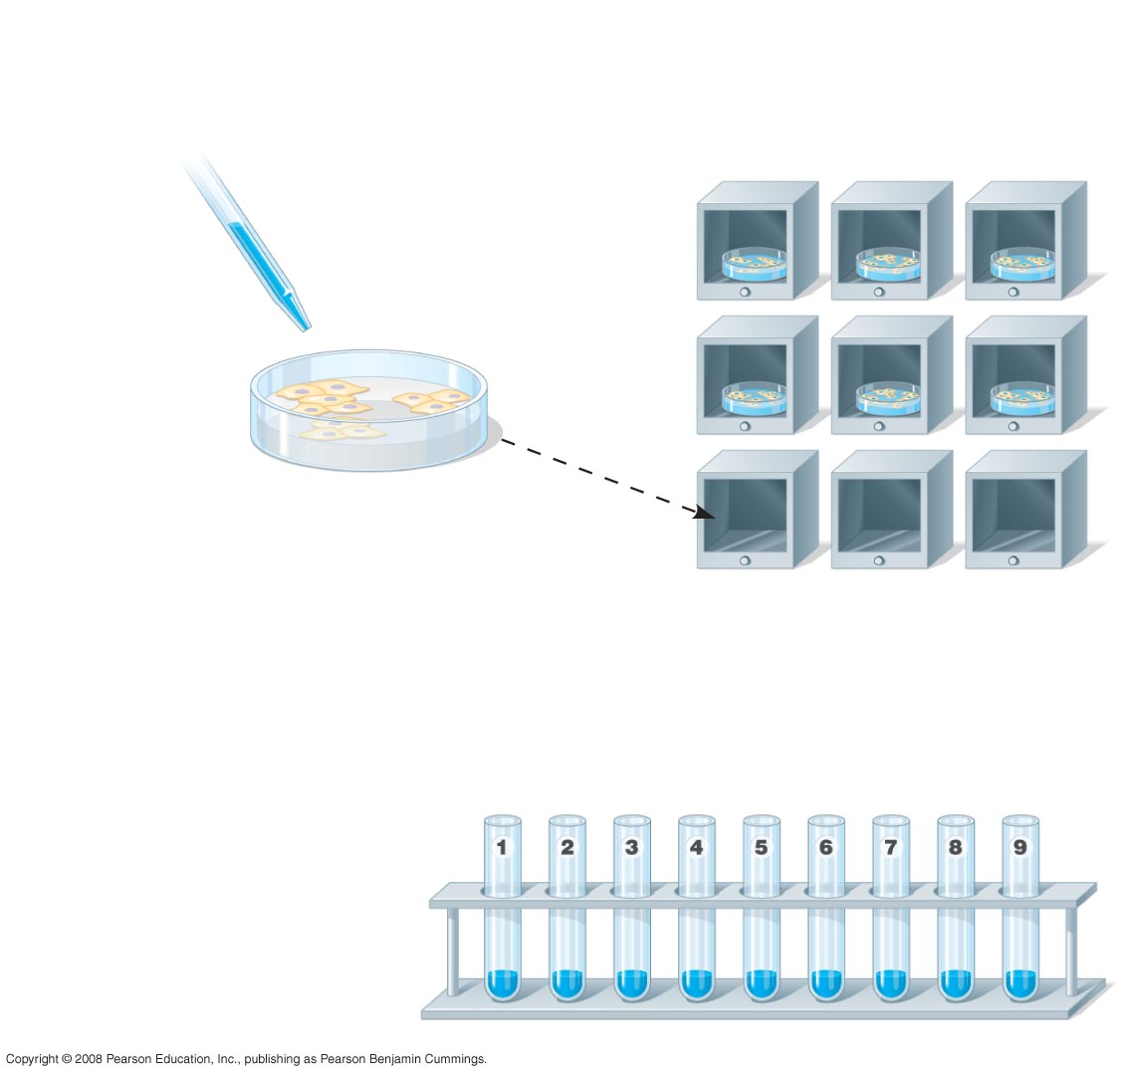
Fig. 2-6a
TECHNIQUE
Compounds including
radioactive tracer
(bright blue)
Incubators
1
2
3
10ºC
15ºC
20ºC
Human cells
4
5
6
25ºC
30ºC
35ºC
1
Human
cells are
incubated
with compounds used to
make DNA. One compound is
labeled with ³H.
7
8
9
40ºC
45ºC
50ºC
2
The cells are
placed in test
tubes; their DNA is
isolated; and
unused labeled
compounds are
removed.
DNA (old and new)
Notes:
Figure 2.6 Radioactive tracers

Slide 18
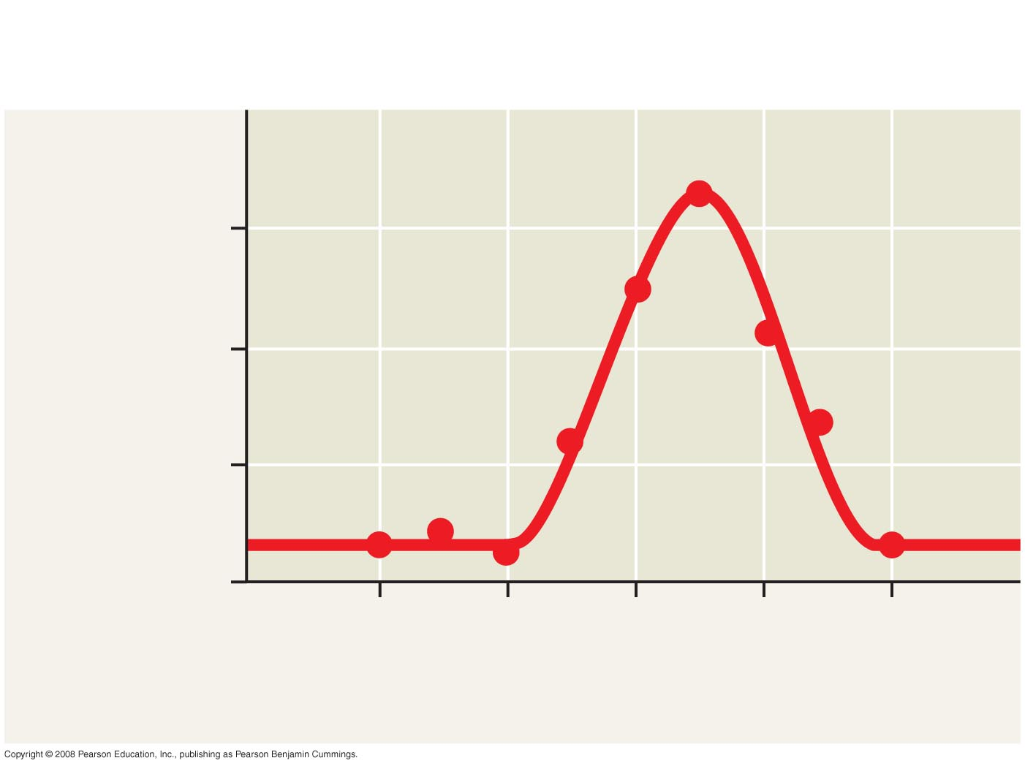
Fig. 2-6c
RESULTS
Optimum
temperature
for DNA
synthesis
30
Counts per minute
(× 1,000)
20
10
0
10
20
30
40
50
Temperature (ºC)
Notes:
Figure 2.6 Radioactive tracers

Slide 19
The Energy Levels of Electrons
Energy is the capacity to cause change
Potential energy is the energy that matter has because of its location or structure
The electrons of an atom differ in their amounts of potential energy
An electron’s state of potential energy is called its energy level, or electron shell
Copyright © 2008 Pearson Education, Inc., publishing as Benjamin Cummings

Slide 20
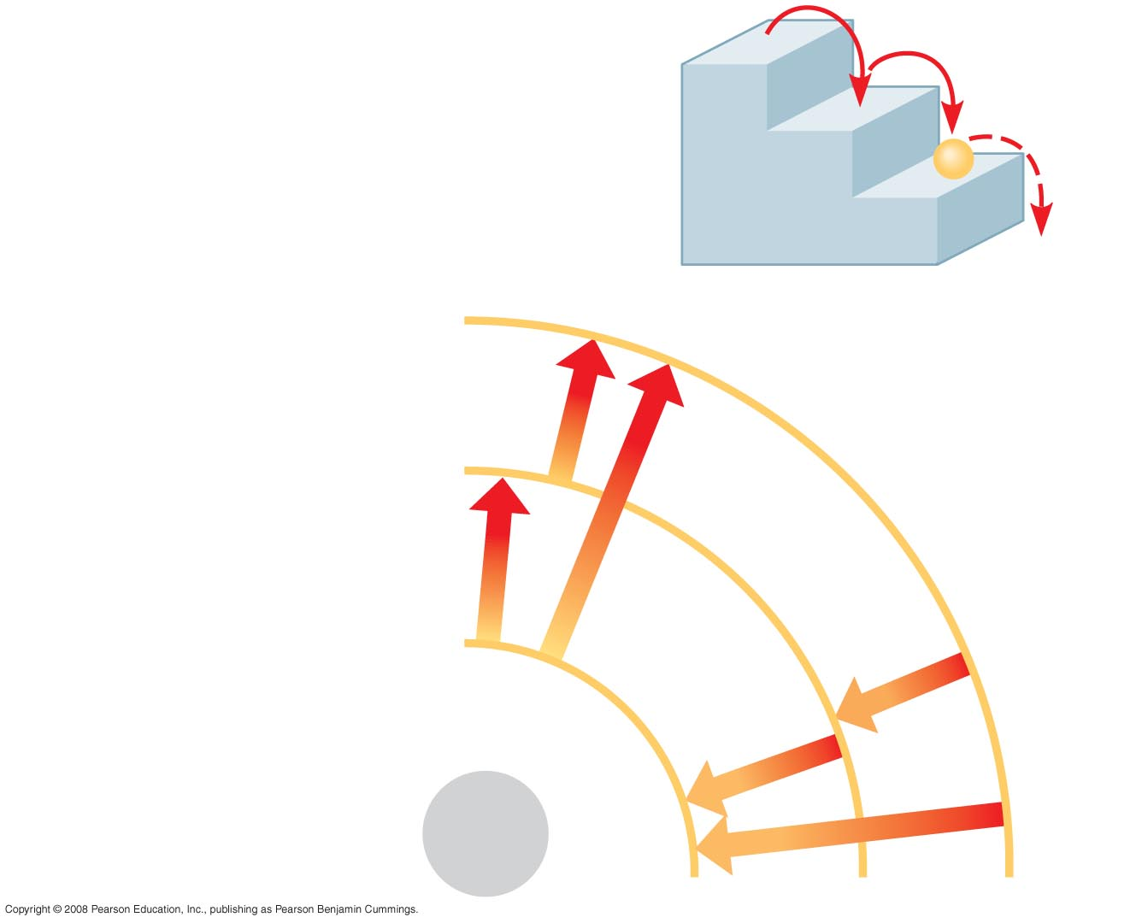
Fig. 2-8
(a) A ball bouncing down a flight
of stairs provides an analogy
for energy levels of electrons
Third shell (highest energy
level)
Second shell (higher
energy level)
Energy
absorbed
First shell (lowest energy
level)
Energy
lost
Atomic
nucleus
(b)
Notes:
Figure 2.8 Energy levels of an atom’s electrons

Slide 21
Electron Distribution and Chemical Properties
The chemical behavior of an atom is determined by the distribution of electrons in electron shells
The periodic table of the elements shows the electron distribution for each element
Copyright © 2008 Pearson Education, Inc., publishing as Benjamin Cummings

Slide 22
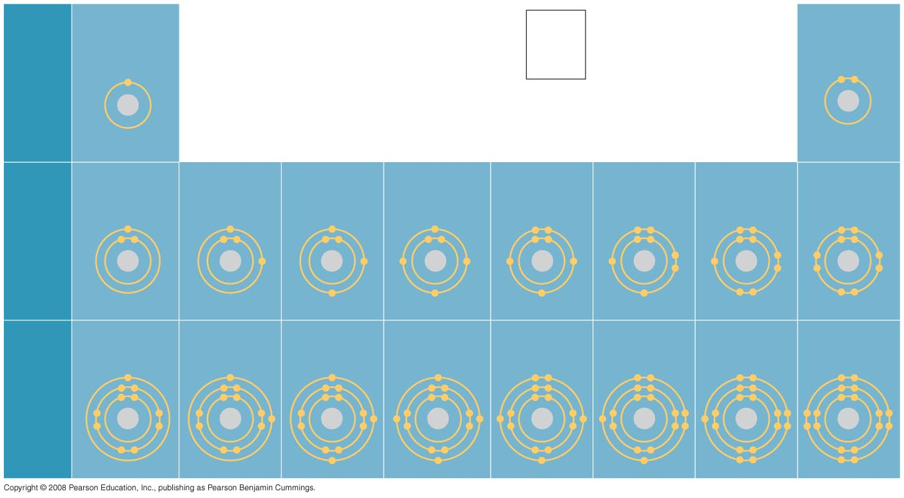
Fig. 2-9
Hydrogen
₁H
2
Atomic number
Helium
₂He
He
First
shell
Atomic mass
4.00
Element symbol
Electron-
distribution
diagram
Lithium
₃Li
Beryllium
₄Be
Boron
₅B
Carbon
₆C
Nitrogen
₇N
Oxygen
₈O
Fluorine
₉F
Neon
₁₀Ne
Second
shell
Sodium
₁₁Na
Magnesium
₁₂Mg
Aluminum
₁₃Al
Silicon
₁₄Si
Phosphorus
₁₅P
Sulfur
₁₆S
Chlorine
₁₇Cl
Argon
₁₈Ar
Third
shell
Notes:
Figure 2.9 Electron-distribution diagrams for the first 18 elements in the periodic table

Slide 23
Valence electrons are those in the outermost shell, or valence shell
The chemical behavior of an atom is mostly determined by the valence electrons
Elements with a full valence shell are chemically inert
Copyright © 2008 Pearson Education, Inc., publishing as Benjamin Cummings

Slide 24
Electron Orbitals
An orbital is the three-dimensional space where an electron is found 90% of the time
Each electron shell consists of a specific number of orbitals
Copyright © 2008 Pearson Education, Inc., publishing as Benjamin Cummings

Slide 25
Fig. 2-10-1
Neon, with two filled shells (10 electrons)
(a)
Electron-distribution
diagram
First shell
Second shell
Notes:
Figure 2.10 Electron orbitals

Slide 26
Fig. 2-10-2
Neon, with two filled shells (10 electrons)
(a)
Electron-distribution
diagram
First shell
Second shell
(b)
Separate electron
orbitals
1s orbital
Notes:
Figure 2.10 Electron orbitals

Slide 27
Fig. 2-10-3
Neon, with two filled shells (10 electrons)
(a)
Electron-distribution
diagram
First shell
Second shell
(b)
Separate electron
orbitals
x
y
z
1s orbital
2s orbital
Three 2p orbitals
Notes:
Figure 2.10 Electron orbitals

Slide 28
Fig. 2-10-4
Neon, with two filled shells (10 electrons)
(a)
Electron-distribution
diagram
First shell
Second shell
(b)
Separate electron
orbitals
x
y
z
1s orbital
2s orbital
Three 2p orbitals
(c)
Superimposed electron
orbitals
1s, 2s, and 2p orbitals
Notes:
Figure 2.10 Electron orbitals

Slide 29
Concept 2.3: The formation and function of molecules depend on chemical bonding between atoms
Atoms with incomplete valence shells can share or transfer valence electrons with certain other atoms
These interactions usually result in atoms staying close together, held by attractions called chemical bonds
Copyright © 2008 Pearson Education, Inc., publishing as Benjamin Cummings

Slide 30
Covalent Bonds
A covalent bond is the sharing of a pair of valence electrons by two atoms
In a covalent bond, the shared electrons count as part of each atom’s valence shell
Copyright © 2008 Pearson Education, Inc., publishing as Benjamin Cummings

Slide 31
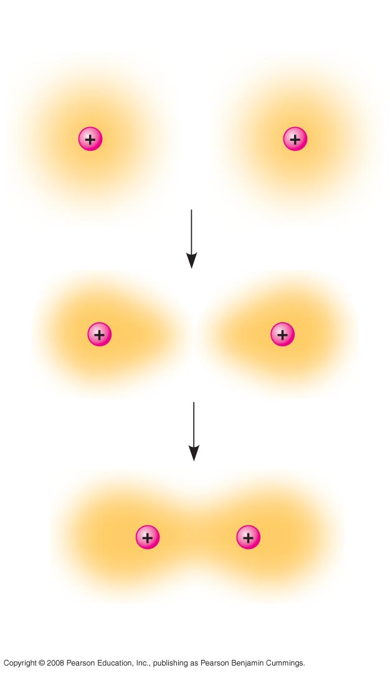
Fig. 2-11
Hydrogen
atoms (2 H)
Hydrogen
molecule (H₂)
Notes:
Figure 2.11 Formation of a covalent bond

Slide 32
A molecule consists of two or more atoms held together by covalent bonds
A single covalent bond, or single bond, is the sharing of one pair of valence electrons
A double covalent bond, or double bond, is the sharing of two pairs of valence electrons
Copyright © 2008 Pearson Education, Inc., publishing as Benjamin Cummings

Slide 33
The notation used to represent atoms and bonding is called a structural formula
For example, H–H
This can be abbreviated further with a molecular formula
For example, H₂
Animation: Covalent Bonds
Copyright © 2008 Pearson Education, Inc., publishing as Benjamin Cummings

Slide 34
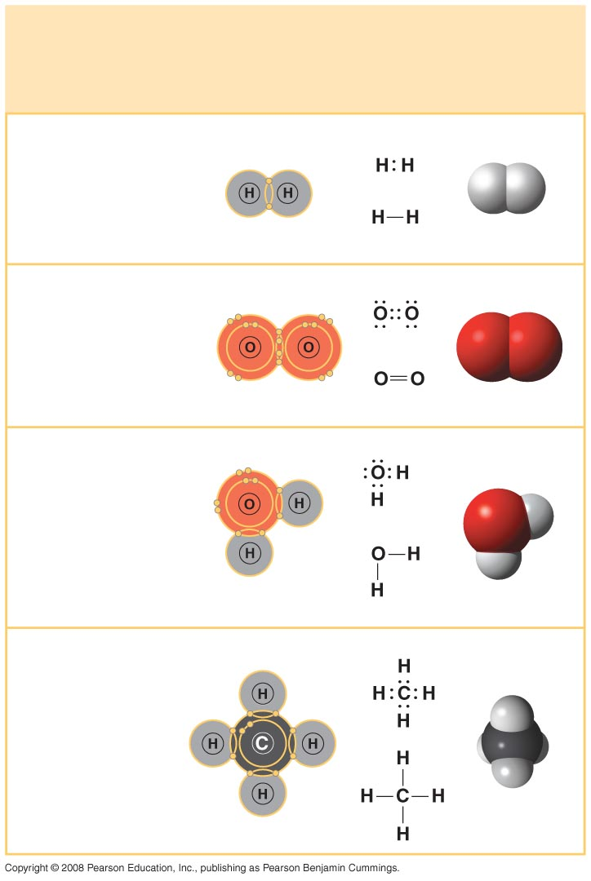
Fig. 2-12
Name and
Molecular
Formula
Electron-
distribution
Diagram
Lewis Dot
Structure and
Structural
Formula
Space-
filling
Model
(a) Hydrogen (H₂)
(b) Oxygen (O₂)
(c) Water (H₂O)
(d) Methane (CH₄)
Notes:
Figure 2.12 Covalent bonding in four molecules

Slide 35
Covalent bonds can form between atoms of the same element or atoms of different elements
A compound is a combination of two or more different elements
Bonding capacity is called the atom’s valence
Copyright © 2008 Pearson Education, Inc., publishing as Benjamin Cummings

Slide 36
Electronegativity is an atom’s attraction for the electrons in a covalent bond
The more electronegative an atom, the more strongly it pulls shared electrons toward itself
Copyright © 2008 Pearson Education, Inc., publishing as Benjamin Cummings

Slide 37
In a nonpolar covalent bond, the atoms share the electron equally
In a polar covalent bond, one atom is more electronegative, and the atoms do not share the electron equally
Unequal sharing of electrons causes a partial positive or negative charge for each atom or molecule
Copyright © 2008 Pearson Education, Inc., publishing as Benjamin Cummings

Slide 38
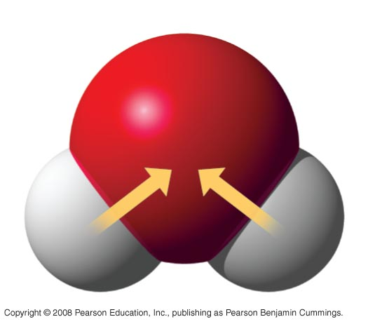
Fig. 2-13
δ –
O
H
H
δ+
δ+
H₂O
Notes:
Figure 2.13 Polar covalent bonds in a water molecule

Slide 39
Ionic Bonds
Atoms sometimes strip electrons from their bonding partners
An example is the transfer of an electron from sodium to chlorine
After the transfer of an electron, both atoms have charges
A charged atom (or molecule) is called an ion
Copyright © 2008 Pearson Education, Inc., publishing as Benjamin Cummings

Slide 40
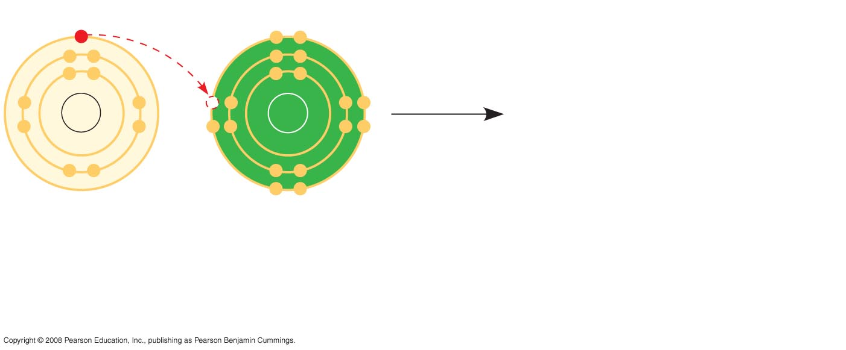
Fig. 2-14-1
Na
Cl
Na
Cl
Sodium atom
Chlorine atom
Notes:
Figure 2.14 Electron transfer and ionic bonding

Slide 41
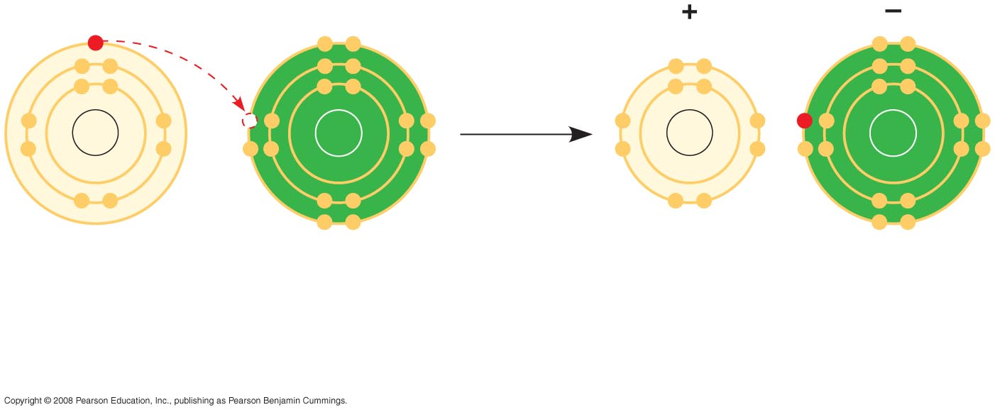
Fig. 2-14-2
Na
Cl
Na
Cl
Na
Cl
Na⁺
Cl–
Sodium atom
Chlorine atom
Sodium ion
(a cation)
Chloride ion
(an anion)
Sodium chloride (NaCl)
Notes:
Figure 2.14 Electron transfer and ionic bonding

