Slide 1
Phylogenetics Questions

Slide 2
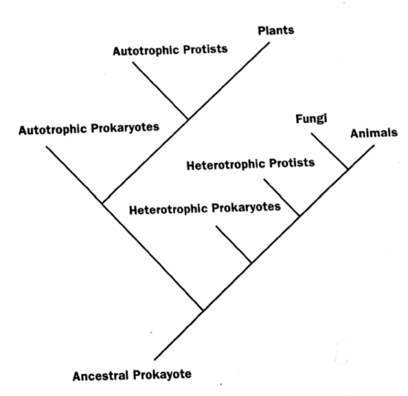
The phylogenic analysis shown suggests that
Animals are descended from fungi.
Fungi are more similar to animals than to plants.
Protists are a monophyletic group.
The first organisms were eukaryotes.

Slide 3
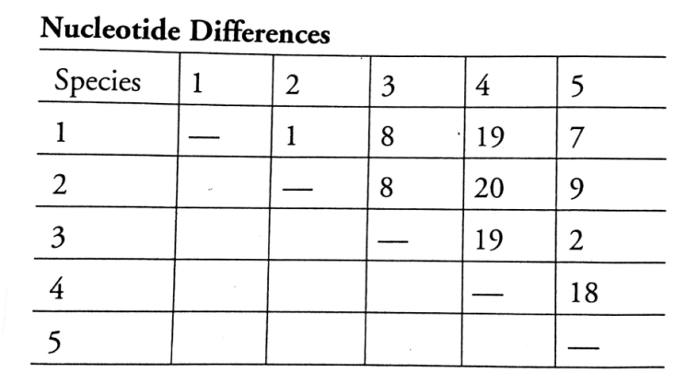
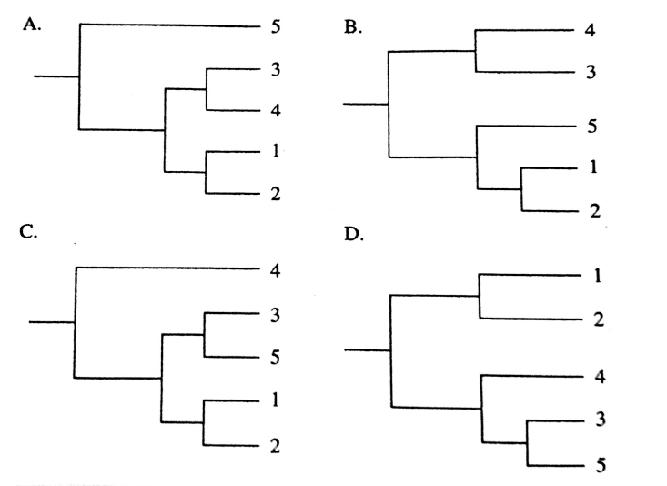
A single gene from five related species of leafhopper was compared, and the nucleotide differences between the genes are shown in the table. Which of the following phylogenetic trees best shows the correct evolutionary relationship between the leafhoppers?
Answer: C

Slide 4
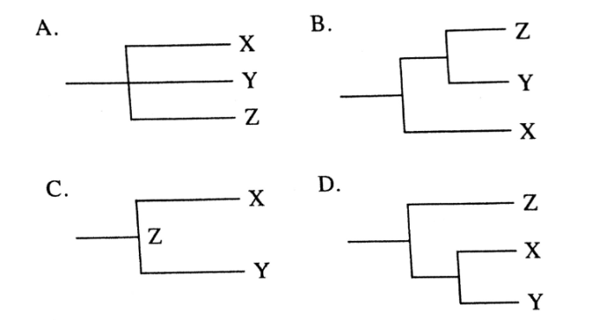
Two species of hamster (X and Y) are in the genus Cricetulus, whereas a third species (Z) is instead part of genus Mesocricetus. Which of the following phylogenetic trees shows the correct evolutionary relatedness?
Answer: D

Slide 5
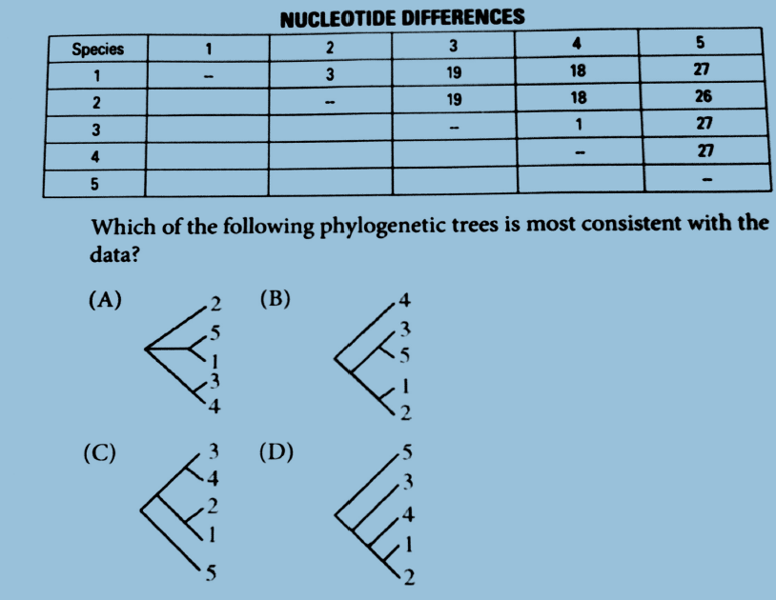
Five new species of bacteria were discovered in Antarctic ice core samples. The nucleotide (base) sequences of rRNA subunits were determined for the new species. The table below shows the number of nucleotide differences between the species.
Answer: C

Slide 6
Questions 5-7 refer to the following figure that illustrates the evolution of nine species from a single ancestral species. Roman numerals I through V identify different areas of the figure.
During which of the indicated periods is the rate of evolution most rapid?
a) II b) III c) IV d) V
Which of the following could be responsible for the evolutionary pattern indicated by area III?
Directional selection
Stabilizing selection
Disruptive selection
Sexual selection
Answers: C, B

Slide 7
If the diagram describes the pattern of evolution after a single species is introduced to a remote, newly formed island, the pattern in the diagram best suggests
Adaptive radiation
allopatric speciation
coevolution
multiple occurences of gene flow
Answer: A

Slide 8
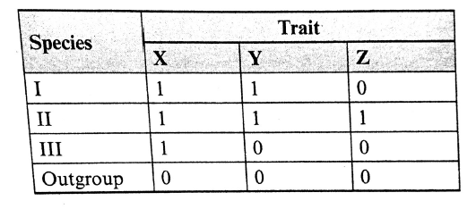
Questions 8 and 9 refer to the following table that indicates the presence or absence of traits X, Y, and Z in species I, II, and III. The number 1 indicates that a character is present; a 0 indicates that it is absent.
With respect to traits X, Y, and Z, which of the following is true?
a) Species II is most closely related to species I.
b) Species II is most closely related to species III.
c) Species II is most closely related to the outgroup.
d) Species II is related to both species I and III equally.
Answers: D, A

Slide 9
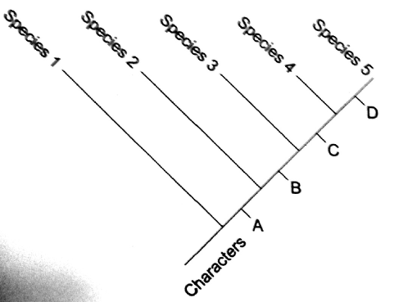
Questions 10-12 refer to the following cladogram:
Which species most likely represents the outgroup for this analysis?
a) species 1 b) species 2
c) species 3 d) species 5
According to this analysis, which of the following two species are most closely related?
  species 1 and 3
  species 2 and 5
  species 3 and 5
d) species 4 and 5
Which of the following is a correct interpretation of this analysis?
a) Species 4 is the ancestor of species 5
b) species 5 is the ancestor of species 4
c) species 3 is the ancestor of species 4 and 5
d) species 4 and 5 share a common ancestor.
Answers: A, D, D

Slide 10
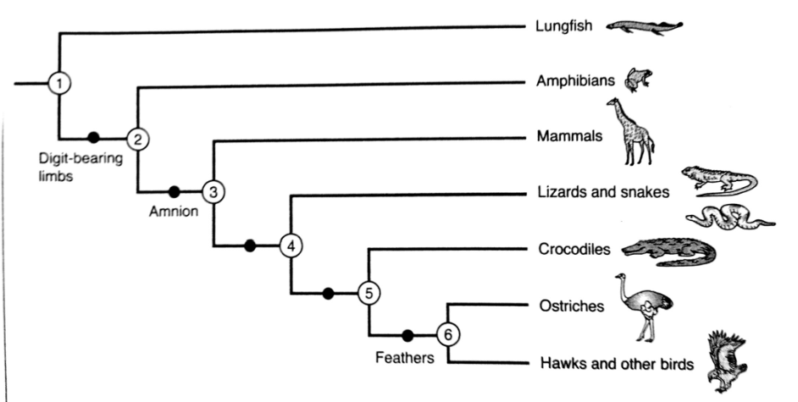
Based on the following cladogram, which of the following is NOT true?
a) Only some tetrapods have amnions.
b) Mammals and amphibians are more closely related than mammals and birds.
c) Ancestor 2 lived before ancestor 3; but we do not know when that was.
d) Lungfishes and amphibians share a common ancestor.

Slide 11
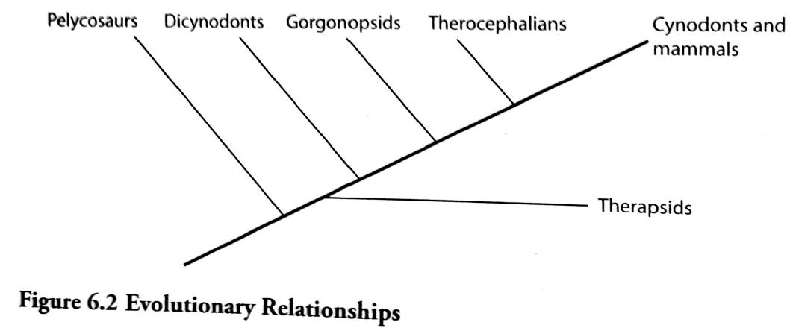
Questions 14-16 refer to the figure below.
Which of the following statements is TRUE concerning the evolution of mammals?
a) The therocephalians evolved before the gorgonopsids.
b) The pelycosaurs went extinct before the dicynodonts.
c) The common ancestor of the therocephalians and the mammals lived at the same time as the common ancestor of the gorgonopsids and the mammals.
d) The cynodonts and mammals are the only extant group.
e) The pelycosaurs are more closely related to the dicynodonts than to the therocephalians.

Slide 12
According to the figure, which group of animals most likely shows the greatest homology with modern mammals?
a) Pelycosaurs
b) Dicynodonts
c) Gorgonopsids
d) Therocephalians
e) Therapsids

Slide 13
Which of the following is true concerning the use of phylogenics?
a) They indicate relative times between the appearance of certain groups of organisms on Earth.
b) They show common ancestry between groups.
c) They indicate analogous relationships between organisms.
d) They indicate the order in which organisms evolved.

Slide 14
2009 AP Exam Question 3
Phylogeny is the evolutionary history of a species.
(a) The evolution of a species is dependent on changes in the genome of the species. Identify TWO mechanisms of genetic change, and explain how each affects genetic variation.

Slide 15
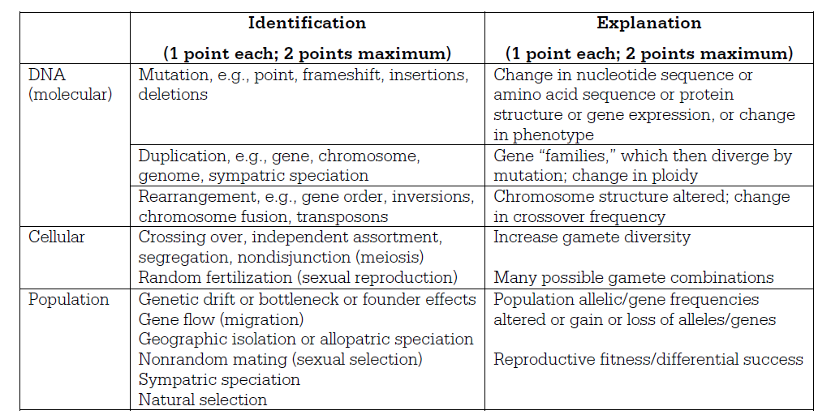
Identify TWO mechanisms of genetic change, and explain how each affects genetic variation.

Slide 16
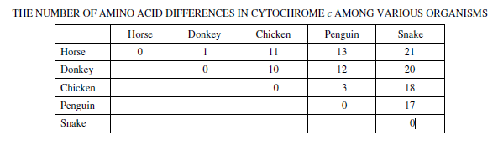
Based on the data in the table below, draw a phylogenetic tree that reflects the evolutionary relationships of the organisms based on the differences in their cytochrome c amino-acid sequences and explain the relationships of the organisms. Based on the data, identify which organism is most closely related to the chicken and explain your choice.

Slide 17
Draw Your Tree!

Slide 18
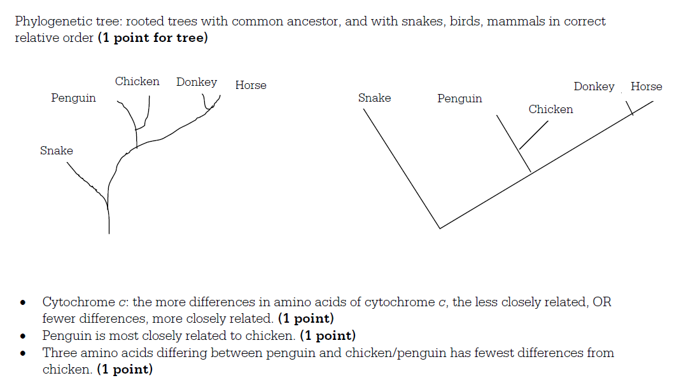

Slide 19
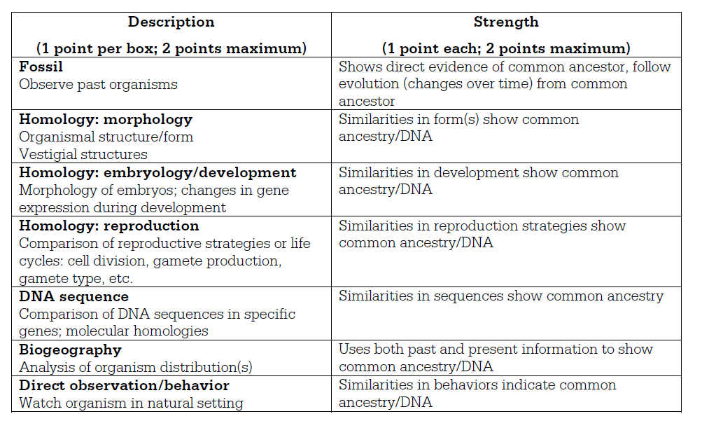
(c) Describe TWO types of evidence—other than the comparison of proteins—that can be used to determine the phylogeny of organisms. Discuss one strength of each type of evidence you described.

Slide 20
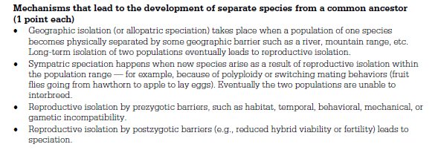
2011 B Exam Question 4
Phylogeny reflects the evolutionary history of organisms.
(a) Discuss TWO mechanisms of speciation that lead to the development of separate species from a common ancestor.

Slide 21
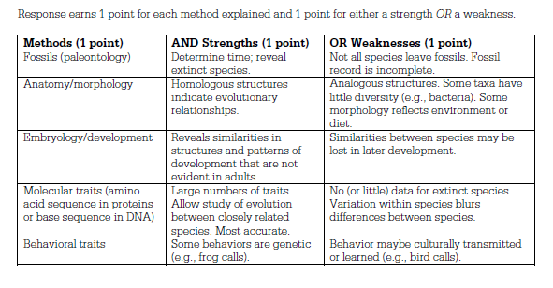
Explain THREE methods that have been used to investigate the phylogeny of organisms. Describe a strength or weakness of each method.

Slide 22
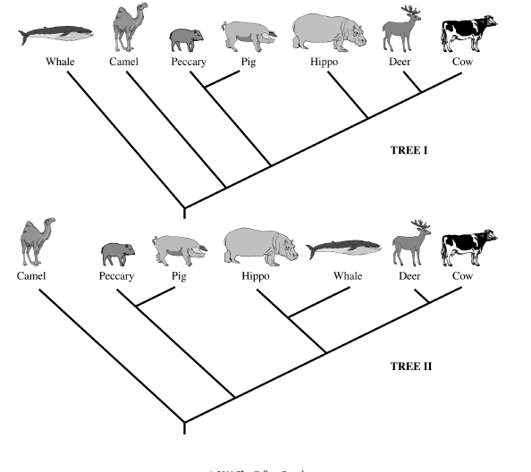
The two phylogenetic trees represent the relationship of whales to six other mammals. All of the organisms shown have a pulley-shaped astragalus bone in the ankle except for the whale.

Slide 23
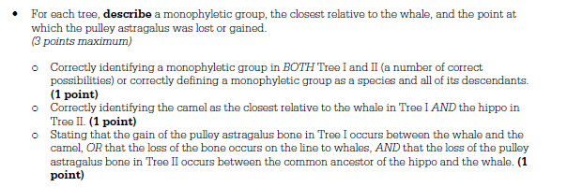
For each tree, describe a monophyletic group, the closest relative to the whale, and the point at which the pulley astragalus was lost or gained.

Slide 24
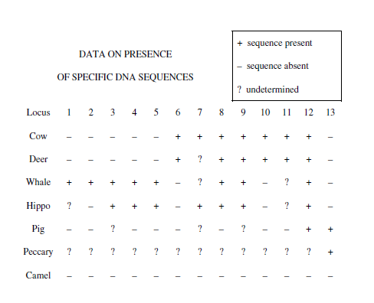
Based on the principle of parsimony (the simplest explanation is the best) and the genomic information in the table shown, identify which tree is the best representation of the evolutionary relationship of these animals, and justify your answer.

Slide 25
